Slide 1
STAMPRIET (KALAHARI/ KAROO) TRANSBOUNDARY AQUIFERS
Overview of the Stampriet aquifer between Namibia, RSA and Botswana
South African Perspective
22 October 2013

Slide 2
PRESENTATION OUTLINE
Introduction
Current status (data bases, IMS, institutional arrangement, 3-Country establishment)
Harmonization of what exists
Conclusion
Discussions

Slide 3
Groundwater governance at national level (1)
Policies and legislation (1.1)
NWP (1997) and NWA (1998):
All water resources common to all and subject to national control
All water consistent status in law
Groundwater integral part of the water resource and must be managed as such
NWRS (2004):
Describes how to protect, use, develop, conserve, manage and control water resources
Formulation of National Groundwater Strategy (2010) to address shortcomings
NGS objectives (2010):
Groundwater to be recognised as important strategic water resource
Knowledge and use of groundwater increased along with the capacity
Better groundwater management programmes developed
Priority actions
Policy, legislation and regulation
Water resources planning
Human capacity
Sustainable groundwater management
Institutional capacity
Information management
Groundwater research
Communication and awareness

Slide 4
Policies and legislation (1.1 cont.)
NWP (1997): Groundwater provisions well catered for...
Topic… | Groundwater Provisions…
Rights and access to groundwater | All water part of interdependent water cycle; a resource common to all Equity in access for all South African citizens to water services, water resources and benefits from usage No ownership but only a right for environmental and basic human needs (Reserve) and authorization for its use
Groundwater allocation | Allocation licensing policy (registration of new wells, drillers; groundwater use in context of CMP)
Protection of water resources | Resource directed measures – setting clear objectives for protection of resources (classification, reserve determination and RQOs) Source directed measures – control and ensure that objectives are met Artificial recharge strategy (2007)
Climate change impacts and adaptation | Develop pro-active and pre-emptive approaches in water related disaster prevention
Conjunctive use and management | Water conservation and utilization policy Water development in accordance with Integrated Environmental management
Groundwater monitoring | Detailed account on resource monitoring and information management
Water pricing | Water pricing policy – not clear on compliance regimes
Transboundary water management | SADC Protocol on Shared Water Course systems
Institutions for water management | National (DWA) regional (CMA) and local (Irrigation boards)
Stakeholder participation | Integral part of SA’s water sector reform

Slide 5
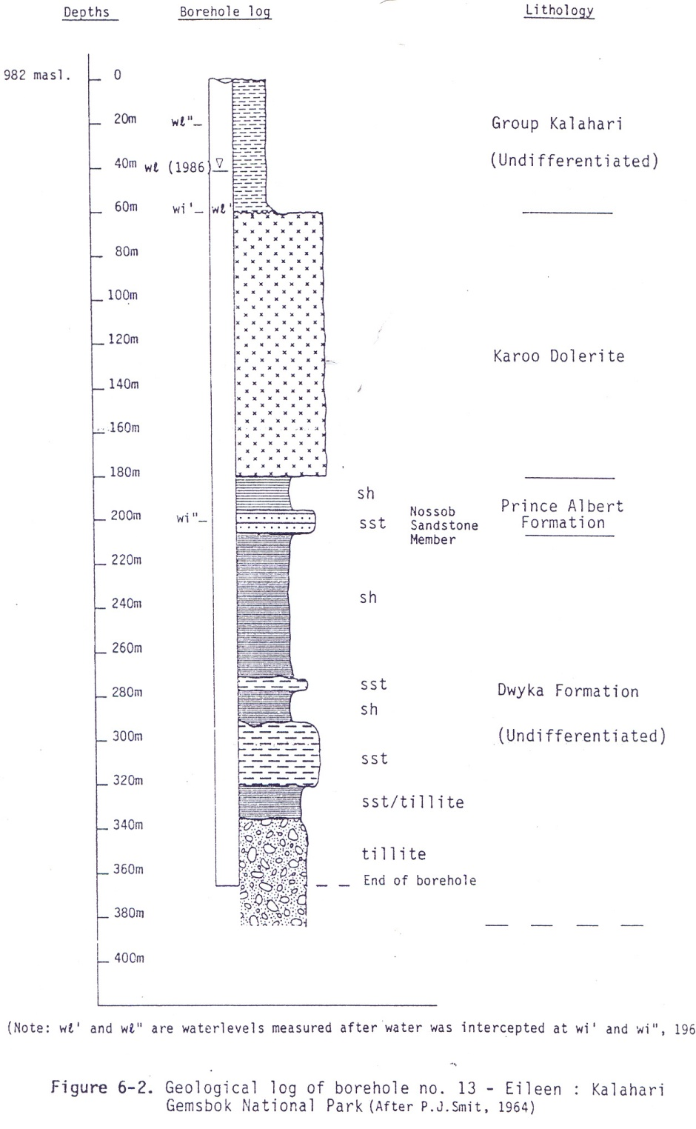
Geological log of Eileen Bore -RSA
  In Nossib River (just south of Nossib Rest Camp)
  Total T-Qk: 60m
  Water strike (1) ±20m
  Waterlevel (’61): 21m.
  Waterlevel (’86): 41m.
  EC: >1000mS/m (TDS: ±7500mg/l);
  Yield: 1.6l/s.
  The 1961 Deep Aquifer Drilling Programme:
  The Eileen Bore is the deepest (381m) of about four bores drilled by DWA in 1961 to explore the occurrence of “deep aquifers” in the Gemsbok Park.
  Bores drilled in the northern sector of the park, intercepted “a whitish sandstone with coal beds” which was at that time was described as the Auob Sandstone Member (P.J. Smit, 1964).
  Although the water strikes were quite deep, the aquifer was under pressure (sub-artesian conditions) and (unfortunately) yielded saline water (EC: >1600 mS/m).
  Yields were in the order of 1.5 to 3l/s. Some of these bores were still used for game water supplies, although they used it merely to satisfy their mineral requirement.

Slide 6
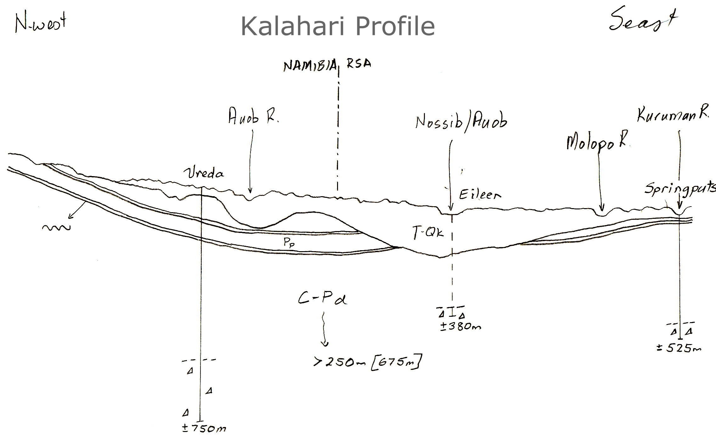
Section showing Auob (Pp-a) and Nossib (Pp-n) Sandstones along a Namibia-Botswana-South Africa profile. To note is the so-called Gemsbok Park palaeo-escarpment where the aquifers are probably leaking into the Kalahari Formations (high saline water in palaeo valley) .
Pp-a
Pp-n
Pp-n

Slide 7
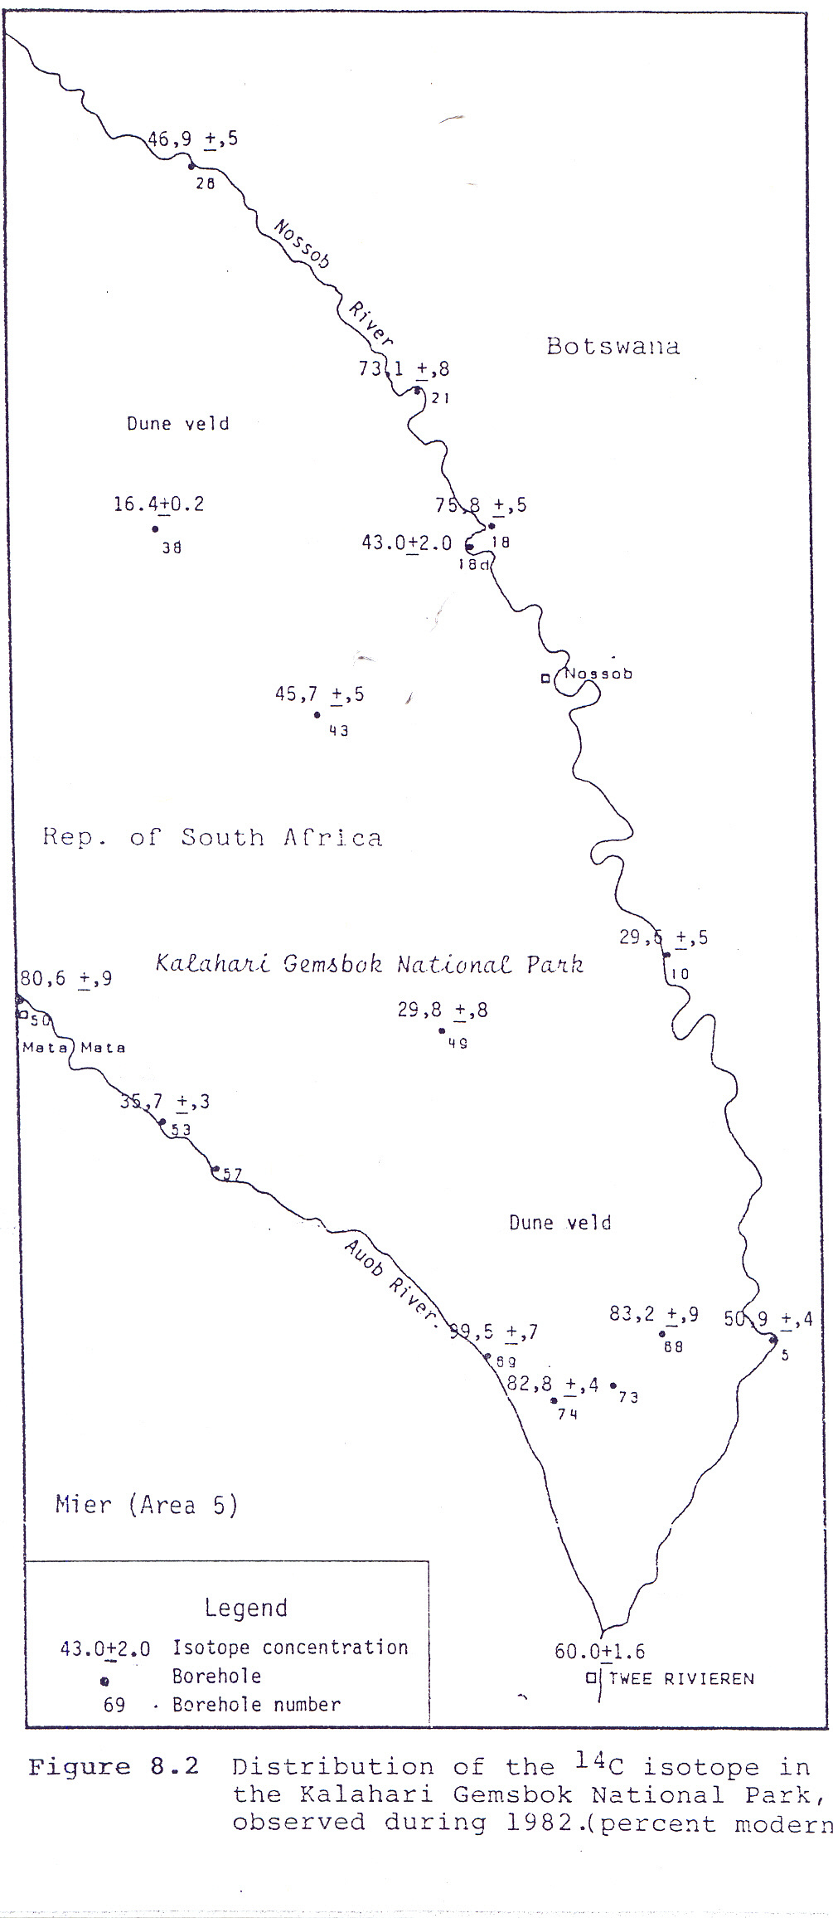
Lower Karoo – Kalahari Hydrogeology
❶
Gemsbok Park palaeo escarpment (covered with 80 to 120m T-Qk
Sub-outcrop of Auob Sandstone on escarpment;
Central Gemsbok Kalahari valley –draining in to Botswana;
Central Mier Kalahari Valley – drains from Namibia to saline basin ❿;
Southern Mier Kalahari Valley – drains from isolated dolerite plateau towards Hakskeen Pan (saline outflow area);
Askham Kalahari Valley – “young” isolated valley replenished by floods in Krm R.
Totsplaas Kalahari Valley – Thickest saturated valley (45m);
Springputs palaeo plateau (Auob Snds)
Mier Palaeo Plateau (dolerite sheet); and
Boksputs “salt basin” – extremely saline area);
Botswana “Deep Karoo Bore” – 1000m, T-Qk (91m), Rwl = 1m bgl.
❷
❶
❸
❷
❹
❸
❺
❻
❾
❼
❺
❹

❽
❿
❾
Molopo R.
Hakskeen Pan
❽
❻
❿
❼
Kuruman R.

Slide 8
DATA/ INFORMATION
NGA
WMS
HYDSTRA
DWA-IMS (CD:WRIM)
OTHER (CGS, CSIR, WRC, etc)
Previously REGIS/ NORAD

Slide 9
DATA HARMONIZATION
Stratigraphy
Project Coordination, inventory
Baseline data gathered
Areas to optimize monitoring networks
Raising of “Flag” high impact areas

Slide 10
CONCLUSION
Closure of gaps since 1999 to present
Adapt to the existing groundwater governance institutional arrangements
Adapt to best practice of each country
Environmental Awareness; CC and vulnerability
Socio-economic impact of water in women growing their local knowledge and role in broader IWRM

Slide 11
Q & A
THANK YOU/ BAIE DANKIE/ REALEBOGA
DISCUSSIONS

