Slide 1

Ministry of Agriculture, Water & Forestry
Overview of the information availability on Stampriet Artesian Basin
By
Abraham Nehemia
Department of Water Affairs & Forestry

Slide 2
Stampriet Basin
Country Area 824,292 km²
Basin Area
71,000 km²

Slide 3
Catchment Area
Auob River
Catchment
55,000 km²
Nossob River
Catchment
47,000 km²

Slide 4
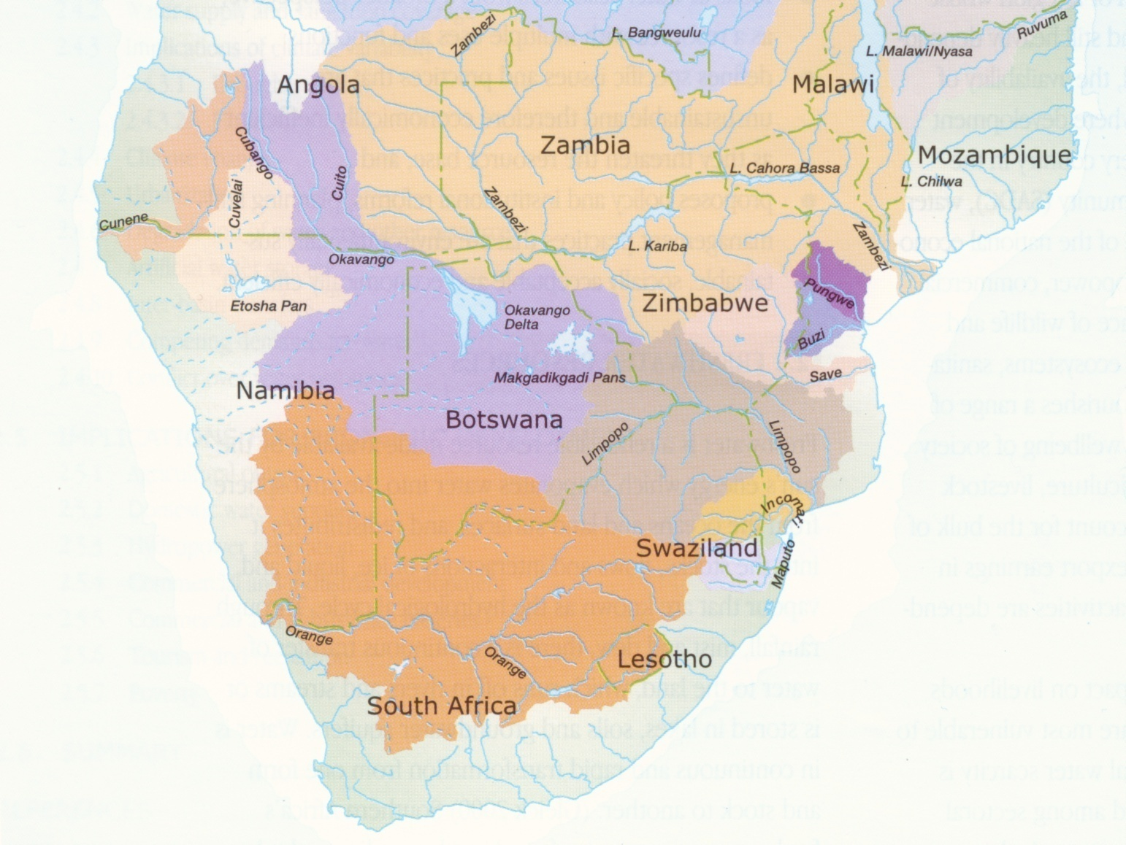
Part of the Orange-Senqu Basin

Slide 5
Geomorphology
Topography
Elevation

Slide 6
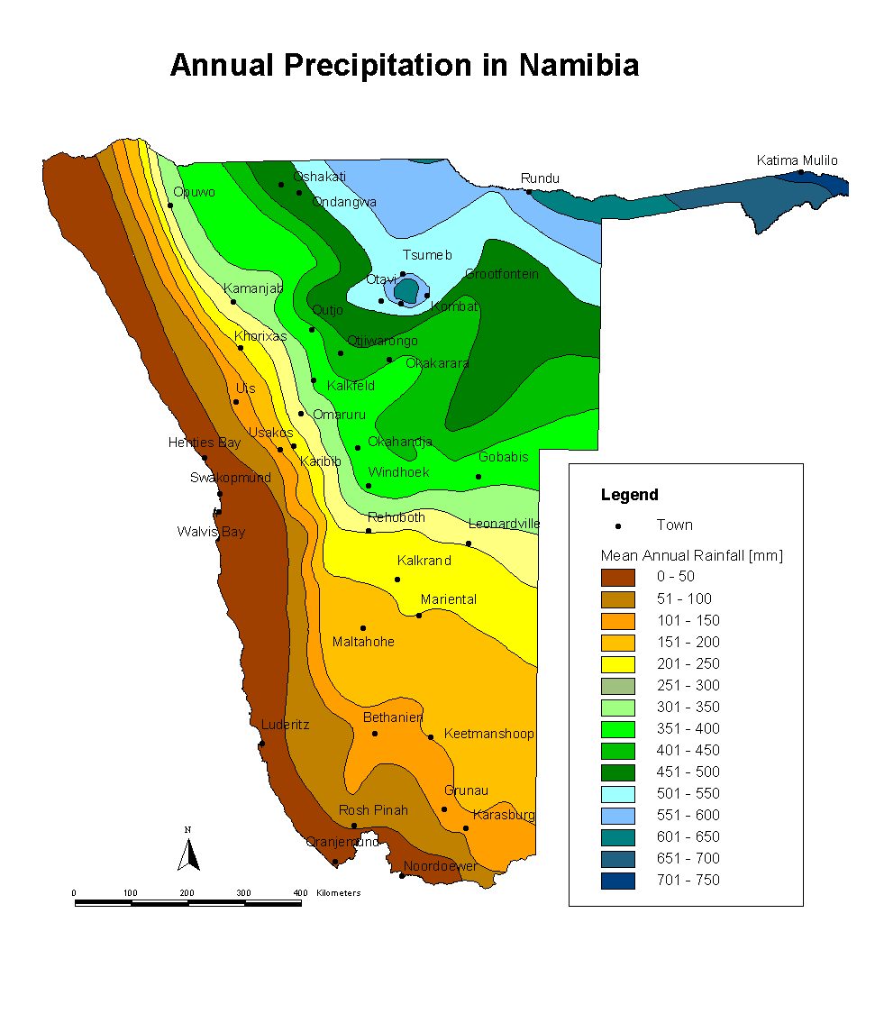
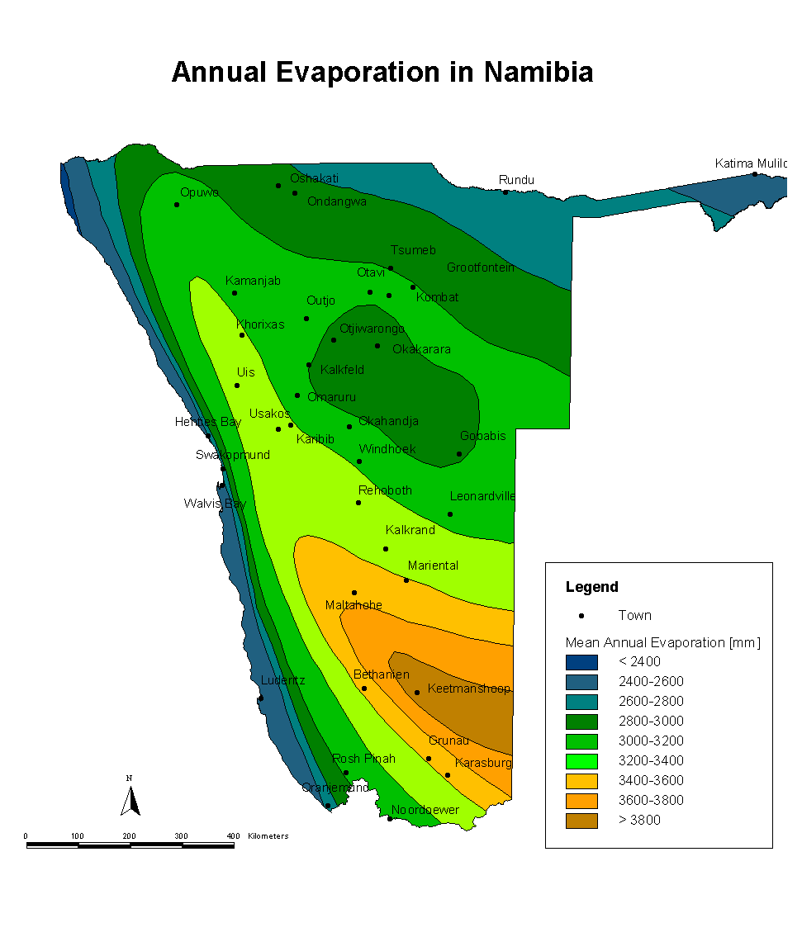
Meteorology

Slide 7
Hydrogeological Classification

Slide 8
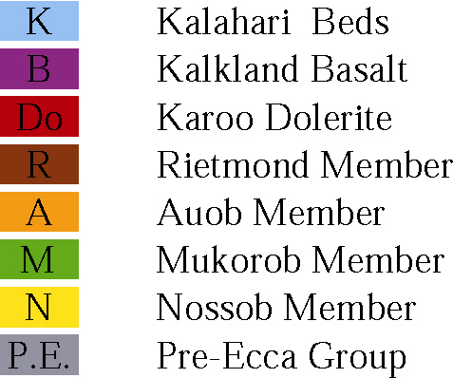
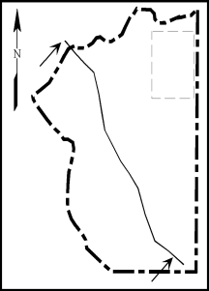
Geological Cross Section
Geological Cross Section of Stampriet Basin

Slide 9
Water Quality (TDS)
Kalahari Aquifer
Auob Aquifer
Nossob Aquifer

Slide 10
Acknowledgements
Data from the following investigations were used for this presentation:
PCI JICA study of the Stampriet Artesian Basin
Transboundary Stampriet Artesian Aquifer by Prof Jurgen Kichner

Slide 11
Thank you

Slide 12
Present Groundwater Use
(Unit: million m³/y)
Irrigation
5.69 (38%)
Stock Watering
6.89 (46%)
2.36 (16%)
Domestic

