Slide 1
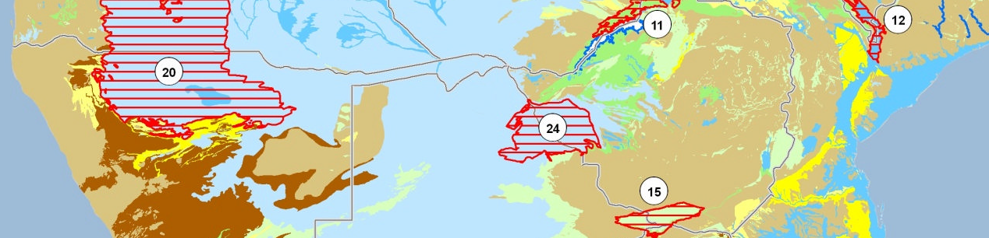
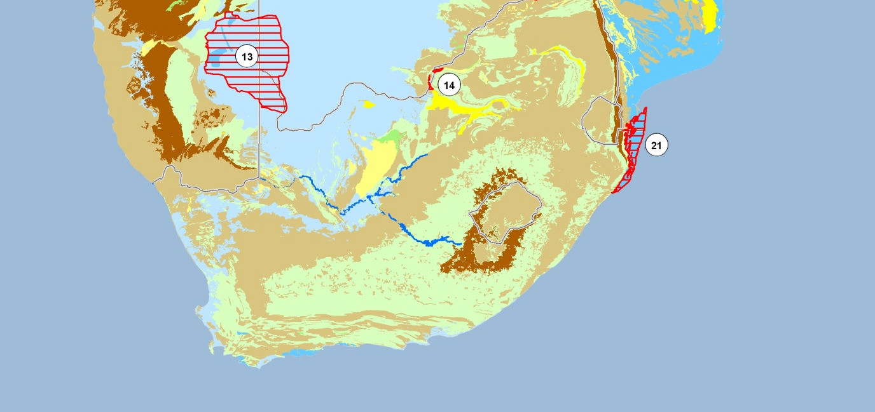



Groundwater Resources Governance
Kalahari Karoo / Stampriet Transboundary Aquifer
Aquifer assessment – Data
Geert-Jan Nijsten Windhoek, October 2013
Notes:
Presentation to give an idea about what an aquifer assessment entails.
It will focus on the type of data to collect and how value can be added to these data by using indicators.
Certain aspects of this will be dealed with in more detail tomorrow.

Slide 2
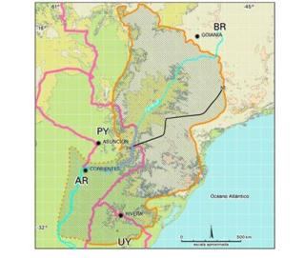
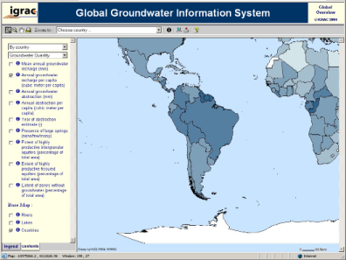
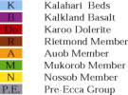





Groundwater assessment in general
Hydrogeological Aspects
  Delineation and description
  Static data and time-variable
  Classification, diagnostic analysis and zoning
  Data harmonisation and information management
Environmental issues
Socio-economic aspects
Institutional settings
Legal framework

Slide 3
Transboundary assessment:
What’s so special ?
Sharing knowledge and data between countries
Harmonising information
And ultimately to agree on:
Most important issues for priority action, and
Agree on the actions to be taken
Notes:
Data harmonisation in particular, we will talk about in more detail tomorrow, but I thought it is good to get a clear understanding of groundwater assessment in general and transboundary assessment in particular.
Now let’s move on to the proposed assessment methodology

Slide 4
Aquifer Assessment - a definition
This project:
Administrative, hydrogeology, usage, governance, etc.
Indicators
Projections
a consideration of all the facts about it (=the aquifer) and
a judgement or opinion of the position and of
what is likely to happen.
source: Collins – English language dictionary
Notes:
Aquifer assessment: a consideration of all the facts about the aquifer and a judgement or opinion of the position and of what is likely to happen.
all the facts: describing an aquifer in many parameters as already touched upon by Jac: Different categories of variables: Static ←→ time dependent. “administrative, hydrogeological, usage, governance etc)
judgement: indicators
what is likely to happen: projections through modelling + expert judgement
Will use this definition as a guide or general outline for my presentation.

Slide 5
Aquifer Assessment - 1: a consideration of all the facts about the aquifer and a judgement or opinion of the position and of what is likely to happen.

Slide 6
Key aquifer properties
- more or less Static -
Aquifer location and geometry (3D)
Countries sharing
Lithology of aquifer formations
Hydraulics: (un)confined, transmissivity, porosity
Hydrological: recharge rate, source and area, and an estimate of volume of groundwater resources
Natural water quality and vulnerability to pollution
Table 5 in methodology report/handout
Notes:
Aquifer assessment: a consideration of all the facts about the aquifer and a judgement or opinion of the position and of what is likely to happen.
1 – all the facts: Static data, not time dependent.
Aquifer location and geometry: Boundary, horizontal extend, thickness, depth
Countries sharing: names of countries, size of national segment
Lithology: predominant lithology
Hydraulic setting: type of voids, (un)confined, transmissivity
Hydrological setting: source of recharge, discharge type, recharge amount, recharge area, gw volume
Water quality: natural quality, vulnerability to polution

Slide 7
Time dependent variables
Drivers: demography, climate, water supply and sanitation, water scarcity
Pressures : recharge, abstraction (groundwater + blue water), pollution, sea water intrusion
State: quantity, quality
Impact: human usage / dependency, impact on ecosystems
Responses: Legal instrument, institutional framework, law & regulations, incentives / hindrances, infrastructure
Table 6 in methodology report/handout
Notes:
Aquifer assessment: a consideration of all the facts about the aquifer and a judgement or opinion of the position and of what is likely to happen.
1 – all the facts:
The additional 67! Parameters are time dependent parameters describing the aquifer more in depth. The parameters can be grouped into 5 main categories, based on the DPSIR framework of analyses (optional additional slide in the end)

Slide 8
Time dependent variables (1)
Population
Climate and replenishment of resource:
  Rainfall and evapo(transpi)ration
  Natural recharge and source of recharge
  Managed aquifer recharge and induced recharge
  But also
  Availability of surface water

Slide 9
Time dependent variables (2)
Groundwater usage
Total groundwater abstractions
Abstraction per sector (domestic, agriculture, industry, wildlife, etc)
But also:
Surface water usage

Slide 10
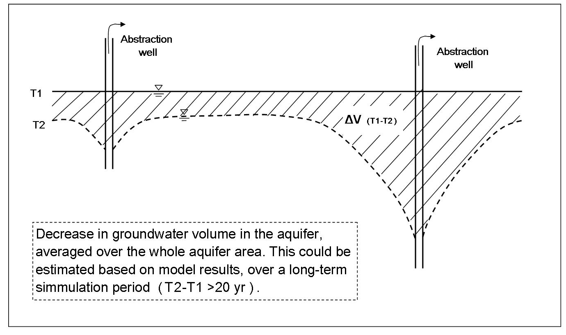
Time dependent variables (3)
Groundwater depletion / decline

Slide 11
Time dependent variables (4)
Pollution related
  Percentage of population covered by public sanitation services
  Percentage of waste water treated before re-entering
  Areas of aquifer exposed to pollution
  Natural suitability of groundwater

Slide 12
Time dependent variables (5)
“Groundwater services”
Groundwater dependent eco-systems (shallow water tables)
Groundwater dependent agricultural land (shallow water tables)
Agriculture irrigated by groundwater

Slide 13
Time dependent variables (6)
Legal instruments
Existing agreements and their scope
Institutional
Transboundary/Domestic, Mandate and Capacity

Slide 14
Time dependent variables (7)
Implementation of laws / regulations:
(incentives / disincentives)
Well drilling permits
Abstraction permits
Land use regulations and/or groundwater protection zones
Waste disposal regulations
Subsidies or taxes on wells / groundwater use
Subsidies on water savings schemes
Public awareness

Slide 15
Aquifer Assessment - 2:
a consideration of all the facts about the aquifer and a judgement or opinion of the position and of what is likely to happen.

Slide 16
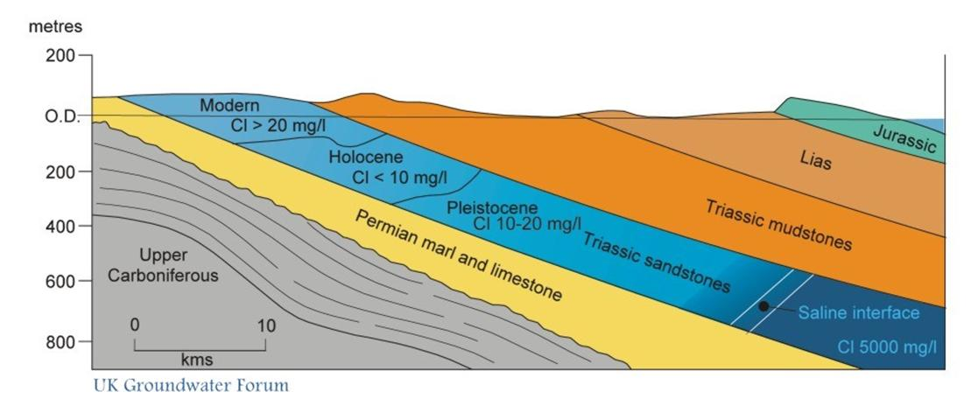
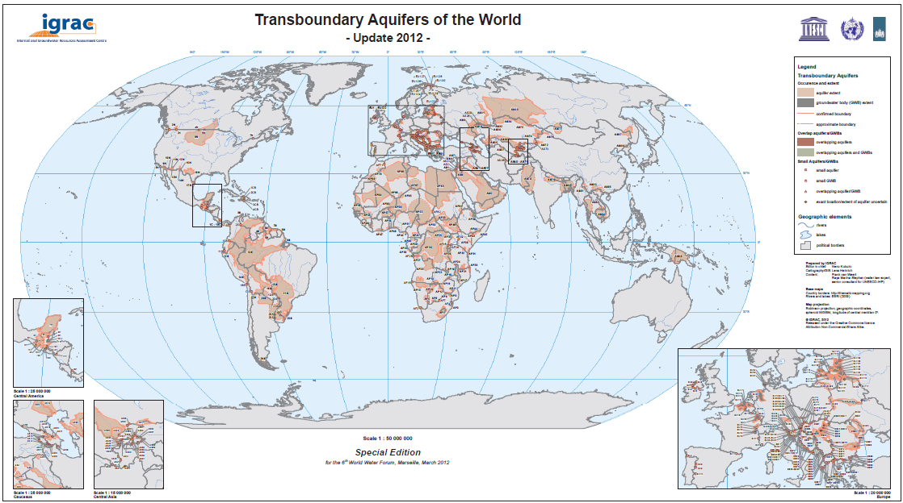
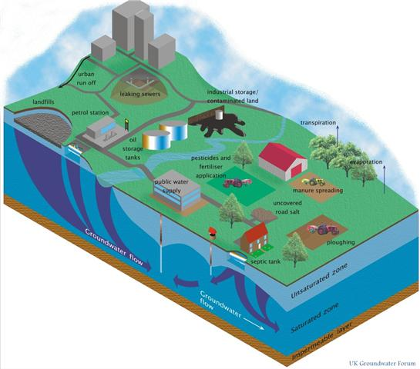
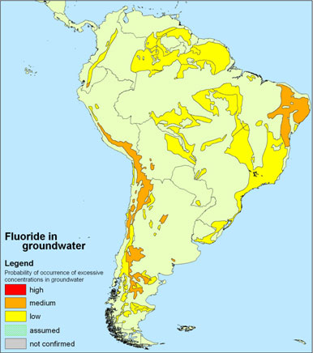
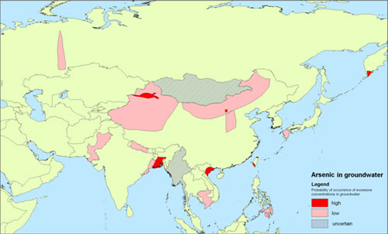
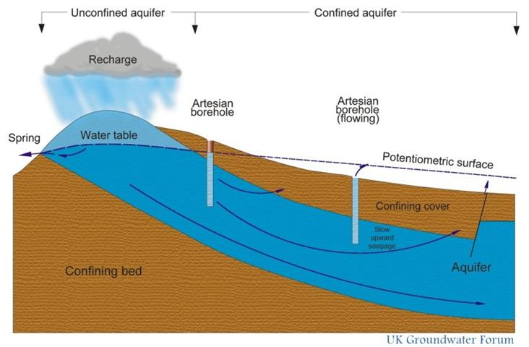
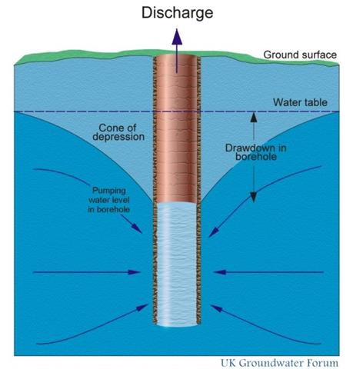
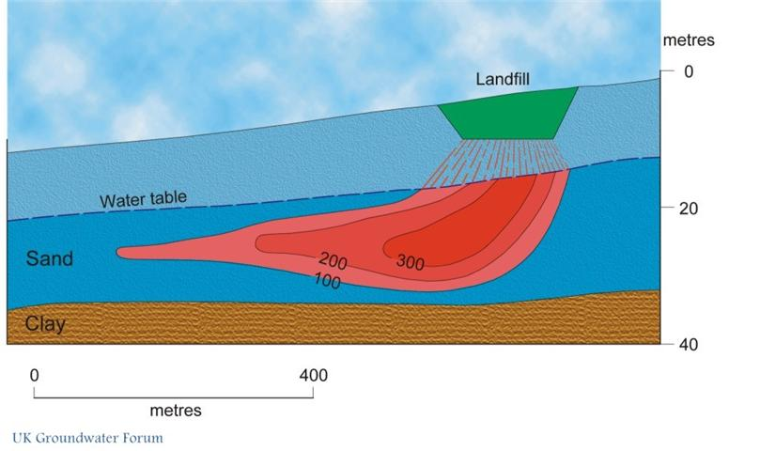
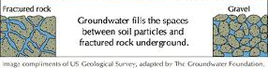
How to judge or give an opinion?
Notes:
Explain the reasoning behind indicators:
We’ll have more than 150 aquifers, some 50 Small Island Developing States and for each one of these we’re looking for 84 parameters → MORE THAN 15000 data!
How to go into part two of an assessment: judge or give an opinion of the position?

Slide 17

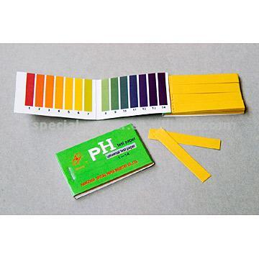
Using indicators
To simplify
complex systems
Notes:
Role of indicators: to simplify AND to bring a message across to none-hydrogeologists: policy makers / decision makers

Slide 18
20 indicators in 6 categories
Defining or constraining the value of aquifers and their potential functions
Role and importance of groundwater for humans & environment
Changes in groundwater state
Drivers of change and pressures
Enabling environment for
TBA/SIDS resource
management
Implementation of
groundwater resources
management measures
The in-depth assessment will try to assess al 20
(TWAP does only 10)
Table 7 in methodology report/handout
Notes:
Explain that in total 20 indicators have been developed, but that we will use only 10 of them as the core indicators
For budgetary reasons cut down from 20 to 10. Between Medium sized project and start of Full size project the methodology has been reviewed → in this process the 20 indicators have been divided into two groups

Slide 19
Indicator group 1:
Defining or constraining the value of aquifers and their potential functions
Notes:
Explain that in total 20 indicators have been developed, but that we will use only 10 of them as the core indicators
For budgetary reasons cut down from 20 to 10. Between Medium sized project and start of Full size project the methodology has been reviewed → in this process the 20 indicators have been divided into two groups

Slide 20



Long term mean groundwater recharge, incl. man-made components.
1.1 Recharge
Rate
1. Very low: < 2 mm/yr
2. Low: 2 -20 mm/yr
3. Medium: 20-100 mm/yr
4. High: 100-300 mm/yr
5. Very high: > 300 mm/yr
Notes:
Recharge rate: Long-term mean ground-water recharge, including man-made components (return-flows, induced recharge, artificial recharge), divided by area
Example:
Netherlands groundwater recharge in the order of 300 – 350 mm
Remember some research I took part in in the Kalahari desert: recharge rates in an order of magnitude of 10th of mm to mm.
REASON FOR CLASSIFICATIONS: Again to simplify to get the message across!

Slide 21

Long term mean gw recharge volume, incl. man-made components, divided by inhabitants on aquifer.
1.2 Renewable groundwater per capita
1. Low: < 1000 m³/yr/capita
2. Medium: 1000 – 5000 m³/yr/capita
3. High: > 5000 m³/yr/capita
Notes:
Renewable groundwater resources per capita: Long-term mean ground-water recharge (VOLUME), including man-made components, divided by the number of inhabitants of the area occupied by the aquifer
This gives an indication of the sustainability of the system and the carrying capacity of the groundwater system in relation to the population.

Slide 22
Percentage of area of aquifer with natural groundwater quality satisfying local drinking water standards.
1.3 Natural Background Quality
1. Very low: < 20%
2. Low: 20 - 40%
3. Medium: 40-60%
4. High: 60-80%
5. Very high: > 80%
fresh
Saline Arsenic
fresh
Notes:
Natural background quality: Percentage of the area occupied by the aquifer where groundwater is found of which natural quality satisfies local drinking water standards

Slide 23
Indicator group 2:
Role and importance of groundwater for humans & environment
Notes:
Explain that in total 20 indicators have been developed, but that we will use only 10 of them as the core indicators
For budgetary reasons cut down from 20 to 10. Between Medium sized project and start of Full size project the methodology has been reviewed → in this process the 20 indicators have been divided into two groups

Slide 24

Percentage of groundwater in total water abstraction for all human water uses.
2.1 Human dependancy on Groundwater
1. Very low: < 20%
2. Low: 20 -40%
3. Medium: 40-60%
4. High: 60-80%
5. Very high: > 80%
Groundwater
Groundwater
Groundwater
River water
Lake water
Groundwater
Notes:
Definitions:
Human dependency on groundwater: Percentage of groundwater in total water abstraction for all human water uses. So this includes: domestic, agricultural and industrial

Slide 25
Indicator group 3:
Changes in groundwater state
Notes:
Explain that in total 20 indicators have been developed, but that we will use only 10 of them as the core indicators
For budgetary reasons cut down from 20 to 10. Between Medium sized project and start of Full size project the methodology has been reviewed → in this process the 20 indicators have been divided into two groups

Slide 26
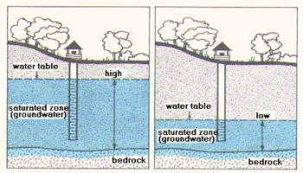
Current rate of long term decrease of groundwater storage averaged over aquifer area.
3.1 Groundwater depletion
1. Absent to very low: < 2 mm/yr
2. Low: 2 -20 mm/yr
3. Medium: 20-50 mm/yr
4. High: 50-100 mm/yr
5. Very high: > 100 mm/yr
Notes:
Groundwater depletion: Observed current rate of long-term progressive decrease of groundwater storage (accompanied by steadily declining ground-water levels), expressed as an equivalent depth of water averaged over the aquifer.
NOTE: depletion is NOT the same as water level decline or cone of depression!

Slide 27
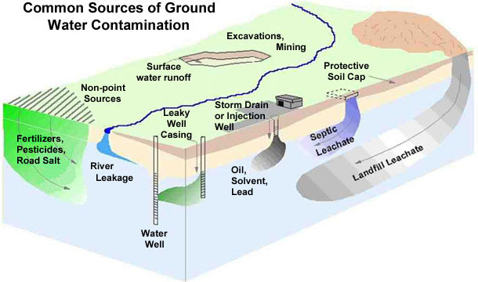
Observed polluted zones as percentage of total aquifer.
3.2 Groundwater Pollution
1. Very low: < 5%
2. Low: 5 – 10%
3. Medium: 10-25%
4. High: 25-50%
5. Very high: > 50%
Notes:
Groundwater pollution: Observed polluted zones as a percentage of total aquifer area (due to pollution caused water quality to exceed drinking water quality standards)

Slide 28
Indicator group 4:
Drivers of change and pressures
Notes:
Explain that in total 20 indicators have been developed, but that we will use only 10 of them as the core indicators
For budgetary reasons cut down from 20 to 10. Between Medium sized project and start of Full size project the methodology has been reviewed → in this process the 20 indicators have been divided into two groups

Slide 29
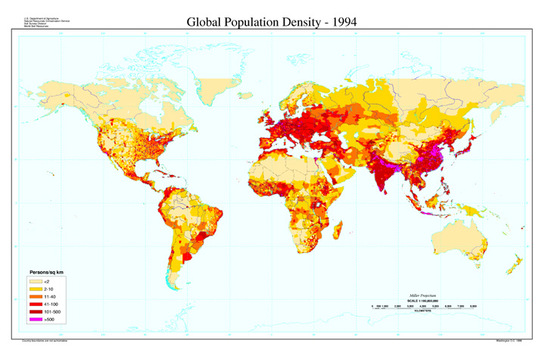
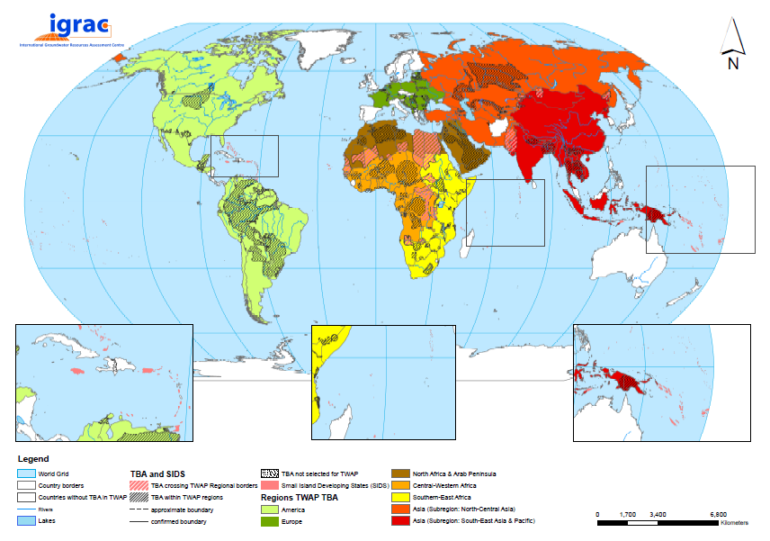
Number of people on top of aquifer per unit of area.
4.1 Population Density on Transboundary Aquifer
Very low: < 1 p/km²
2. Low: 1-10 p/km²
3. Medium: 10-100 p/km²
4. High: 100-1000 p/km²
5. Very high: > 1000 p/km²
Notes:
Population density: Number of people per unit of area on top of the aquifer
All components will be using the same data of “Gridded population of the world” a 10 x 10 km2 grid?! → consistency between the TWAP components

Slide 30

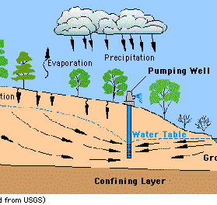
Total annual groundwater abstraction divided by long-term mean annual recharge.
4.2:
1. Very low: < 2%
2. Low: 2-20%
3. Medium: 20-50%
4. High: 50-100%
5. Very high: > 100%
Notes:
Groundwater development stress: Total annual groundwater abstraction divided by long-term mean annual groundwater recharge
Note: It’s not by definition “good enough” to stay below 100% It depends on the system what is a critical value. In some systems 20% might already cause problems.

Slide 31

Indicator group 5:
Enabling environment for TBA/SIDS resource management
Notes:
Explain that in total 20 indicators have been developed, but that we will use only 10 of them as the core indicators
For budgetary reasons cut down from 20 to 10. Between Medium sized project and start of Full size project the methodology has been reviewed → in this process the 20 indicators have been divided into two groups

Slide 32
Indicator group 5: Enabling environment for transboundary aquifer resources management/SIDS groundwater management (2 core out of 2)
5.1: Transboundary legal framework / SIDS groundwater management legal framework
None in existence, nor under preparation
under preparation or available as an unsigned draft
limited scope signed by all parties (e.g. agreement to co-operate or exchange information)
full scope for TBA management or SIDS groundwater management signed by all parties.
Notes:
Transboundary legal framework/SIDS groundwater management legal framework: Existence, status and comprehensiveness of a binding agreement on the transboundary aquifer or SIDS groundwater under consideration
GOVERNANCE ASPECTS

Slide 33
Indicator group 5: Enabling environment for transboundary aquifer resources management/SIDS groundwater management (2 core out of 2)
5.1: Transboundary institutional framework/SIDS groundwater management institutional framework
Mandate and capacity for TBA/SIDS groundwater management
None in existence
Exist, but with limitations in mandate and/or capability
Domestic agencies do exist with full mandate and adequate capabilities
A special bi- or multi-national transboundary institution has been established with full mandate and adequate capabilities
Notes:
GOVERNANCE ASPECTS continued
Transboundary institutional framework/SIDS groundwater management institutional framework: Existence, mandate and capabilities of institutions or institutional arrangements for managing the transboundary aquifer or SIDS groundwater under consideration (all types of interventions)

Slide 34
Aquifer Assessment - 3:
a consideration of all the facts about the aquifer and a judgement or opinion of the position and of what is likely to happen.
Notes:
Aquifer assessment: a consideration of all the facts about the aquifer and a judgement or opinion of the position and of what is likely to happen.
3 – what is likely to happen: projections through modelling + expert judgement

Slide 35
Indicative Projections for 2030 and 2050
Annual amount of renewable groundwater resources per capita (indicator 1.2)
Human dependency on groundwater (indicator 2.1)
Population density (indicator 4.1)
Groundwater development stress (indicator 4.2)
Groundwater
River water
Rain water
Notes:
In the TWAP project the university of Frankfurt is working with a

Slide 36

Thank you

