Slide 1
Groundater flow modelling Stampriet Transboundary Aquifer System
Marc Leblanc, professor in hydrogeology, University of Avignon, France

Slide 2
Groundater flow modelling...
What?
Numerical model (≠ analytical solutions)
2. Simulate flow (and transport) in aquifer systems
3. Physical basis: porous media = Darcy Law
4. Spatially distributed model
5. Discretized in time (transient)
6. Surface water and groundwater interactions

Slide 3
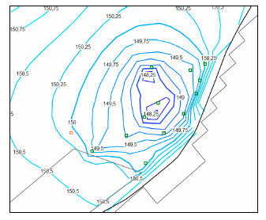
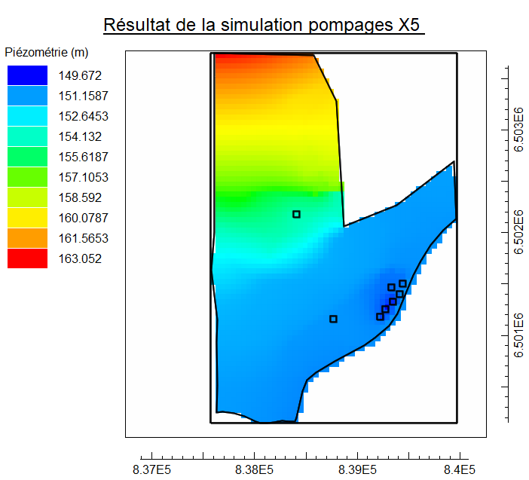
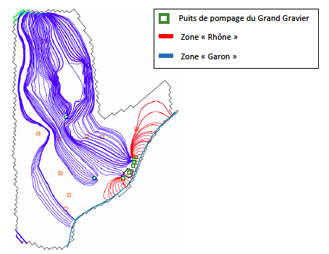
What?
An example: alluvial aquifer of the Rhône River
2. Quantify drawdown caused by new boreholes
1. Groundwater model simulating groundwater levels
3. Identify origin of water pumped

Slide 4
1. Darcy Law (porous media).
How?
2. Continuity principle.
3. Numerical solutions (finite difference method) => code.

Slide 5
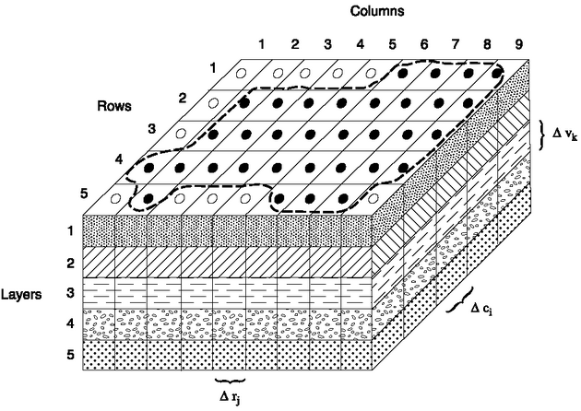
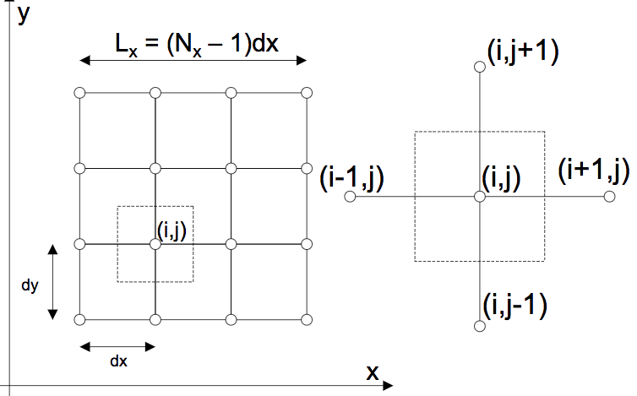
=> Computer program solves groundwater flow equation – here finite differences.
How?

Slide 6
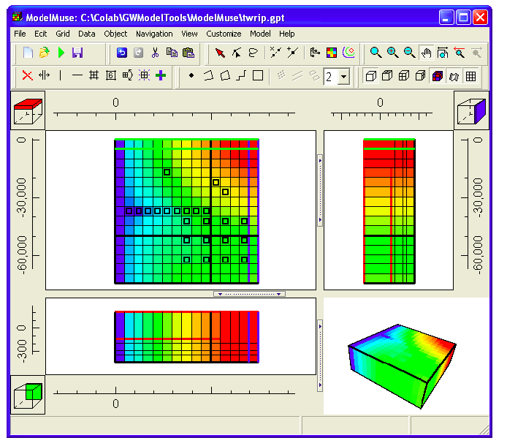
1. USGS MODFLOW = the code.
How?
2. USGS MUSE = the interface
Top view
Side view
Front view
3D view

Slide 7
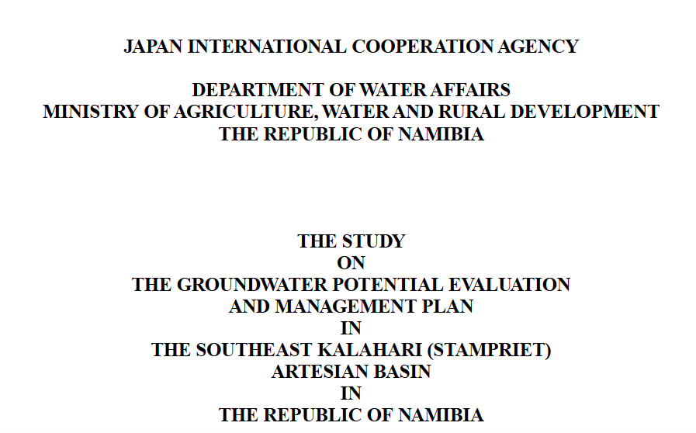
1. Compile all existing data
How?
2. Steady state calibration
3. Transient calibration
4. Uncertainty assessment
5. Simulations (scenarios)

Slide 8
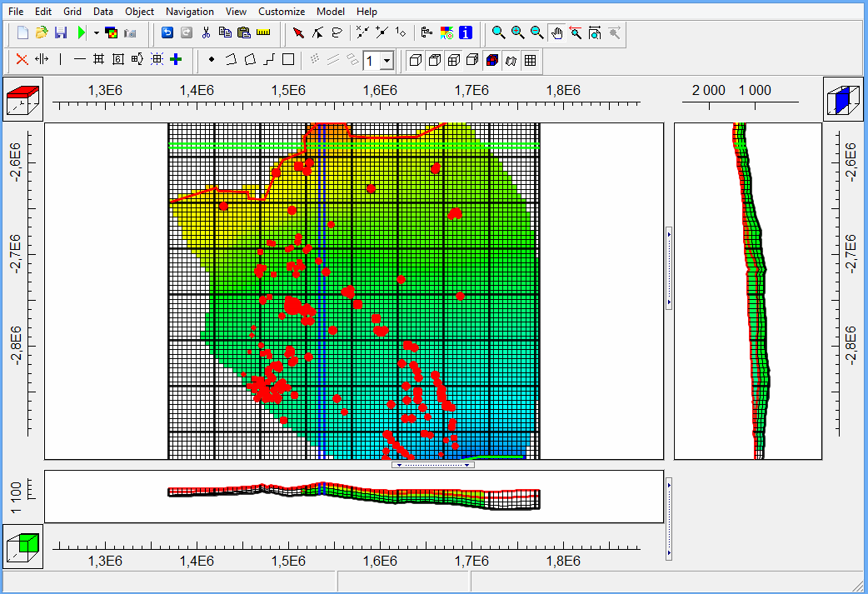
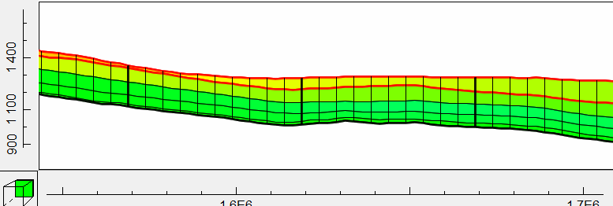
How?
Snapshots of Stampriet model – steady state calibration

Slide 9
1. Quantify distribution of water resources (in space and time)
Why?
2. Simulate scenarios :
=> increase in pumping = ?
=> climate change = ? decrease in recharge > impact on level and storage?
3. Test a hypothesis:
=> discharge area in south???
4. Quantify groundwater and surface water interactions

Slide 10
1. More observations / studies on:
recommendations?
=> recharge processes and fluxes
=> discharge processes and fluxes
=> exchanges between aquifers / aquitards (vertical and lateral)
=> any groundwater quality issues?
2. Importance of long term chronicles of groundwater levels (surface water levels, rainfall)
Thank you!
marc.leblanc@univ-avignon.fr

