Slide 1
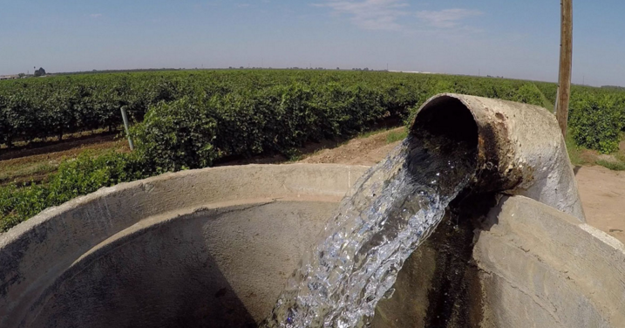


GROUNDWATER
FOR CLIMATE CHANGE ADAPTATION
Tales Carvalho Resende
International Hydrological Programme

Slide 2
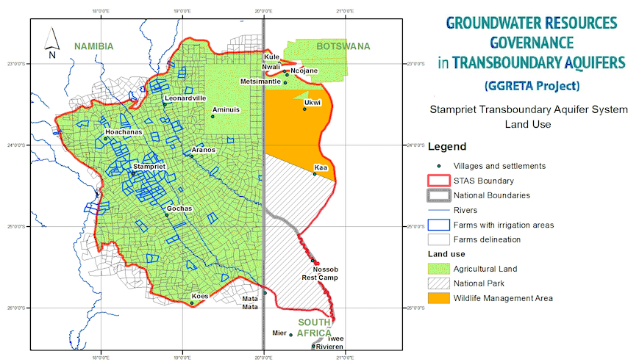
Stampriet Transboundary Aquifer System
(Botswana, Namibia, and South Africa)
Area: 86 000 km2
Rainfall: 150-300 mm/yr
Population: 50 000
Human dependency on groundwater: 100%
Increased interannual variability (more floods + more droughts)
Main economic activity: Agriculture and livestock (highly climate change dependent)
70% of abstraction occurs from shallow and highly vulnerable aquifers
Need to assess climate variability
impact on shallow aquifers recharge
Notes:
We all know about international rivers and treatees have long been in place to manage them.
The latest survey shows that there is at least 600 transboundary aquifers around the world.
Yet only a handful of international agreements on transboundary aquifers have been signed.
We need to put more emphasis groundwater governance, policies both at national and international level

Slide 3
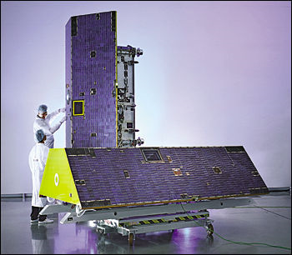
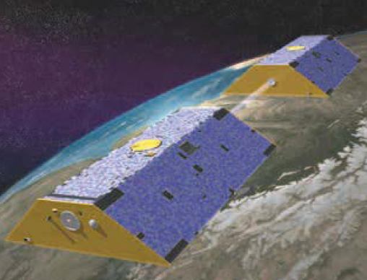

Climate Change adaptation in the STAS
Objective:
Assess the impact of climate variability in recharge despite the lack of data to support sound management strategies
Methods:
Gravity Recovery and Climate Experiment (GRACE):
  First satellite mission able to monitor total water storage changes (including groundwater) remotely
Global datasets for precipitation, runoff and evapotranspiration
Simplified water balance model
Limited water level / borehole data

Slide 4
Climate Change adaptation in the STAS
Objective:
Assess the impact of climate variability in recharge despite the lack of data to support sound management strategies
Methods:
Gravity Recovery and Climate Experiment (GRACE):
First satellite mission able to monitor total water storage changes (including groundwater) remotely
https://www.youtube.com/watch?v=fKVPFyu_tHQ
https://www.youtube.com/watch?v=ecBgUrGlKps
Global datasets for precipitation, runoff and evapotranspiration
Simplified water balance model
Limited water level / borehole data

Slide 5


Climate Change adaptation in the STAS
Climate variability cycles:
El Niño Southern Oscillation (ENSO): 2-7 years
North Atlantic Oscillation (NAO): 3-6 years
Pacific Decadal Oscillation (PDO): 20-30 years
Atlantic Multidecadal Oscillation (AMO): 50-70 years
Challenge:
GRACE’s limited time scale (15 years) < some natural climate variability cycles.
A better understanding on how natural climate variability (ENSO, etc…) affects precipitation and groundwater storage needs time scales > 10 years

Slide 6
Climate Change adaptation in the STAS
Solution:
”Extend” GRACE time frame to the past with adequate models to “reconstruct” groundwater level fluctuations

Slide 7
Climate Change adaptation in the STAS

Slide 8

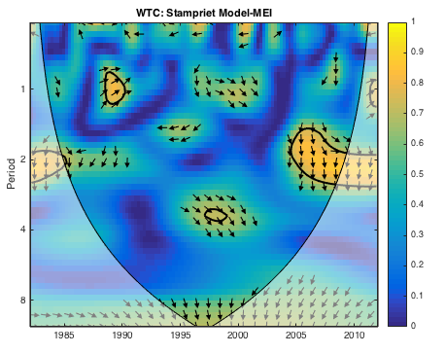
Climate Change adaptation in the STAS
Main findings:
Shallow aquifers are highly responsive to rainfall (1-4 months lag)
Strong correlation between ENSO and groundwater levels
El Nino years (ENSO+): falling water table
La Nina years (ENSO-): rising water table
Need to strengthen links with metereological agencies
Efficient CC adaptation strategies require stakeholder consultation from basin (ORASECOM) to local (farmers)
Work will provide further guidelines for agriculture and livestock planning (especially during drought periods)
La Niña-dominant years
Strong El Niño followed by strong La Niña

Slide 9
Impact of climate variability on water storage across Africa

Slide 10
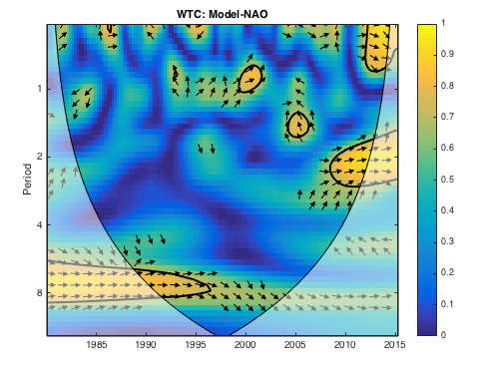
Impact of climate variability on the NWSAS
AMO -
AMO +
2
3
1

Slide 11
Impact of climate variability on water storage in the Sahel

Slide 12

Become involved with GRAPHIC
THANK YOU!
Please sign up for our newsletter & mailing list: http://www.graphicnetwork.net/newsletter/
t.carvalho-resende@unesco.org

