Slide 1
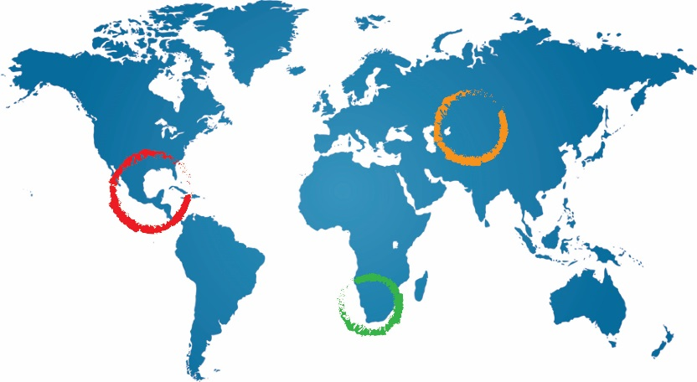
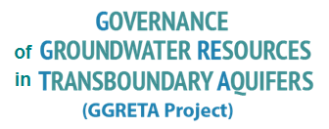
Why ‘science’ would help to make better decisions
Shammy Puri
Chair IAH Commission on Transboundary Aquifers & former Secretary General of IAH
Shammy Puri
3 November 2016
Paris, France

Slide 2
Key Points
Phase I has been successfully been completed
What are the take home messages from this phase?
For Phase II - planning & further developments
The aquifer system – further understanding its functioning
The aquifer system – clarifying the hydrogeological uncertainties
Quantification of the flows & discharges
Forecasting future alternative scenarios
Harnessing the science that will provide the answers and taking account of the data gaps – these provide the upper and the lower limits to the risk management
Provide input from scientific analysis to the governance for sound long term management & sustainability
The “science” that is required here is the practical / applied approach, rather than fundamental research

Slide 3
From Phase I to Phase II – keep the momentum up
There seems to be a good understanding of parts of the aquifer system – this needs to be extended in phase II
Phase I showed that there is relatively good data available – some additional data is needed – perhaps involving more data mining, some more field work, some additional searches
CONSOLIDATION OF INFORMATION - The information consolidation can take place through a mathematical simulation model – the existing models to be extended and refined
Some of the key tasks in phase II will be devoted to structuring the simulation model – several questions need to be answered …
In particular the vertical inter relations between aquifers
Water quality variations
Evolution of hydrogeochemistry

Slide 4
Input from Scientific Analysis to sound governance
The findings are stated in terms that are to be assimilated by ‘non specialists’ eg
How does the estimation of the ‘reserve’ affect the socio economics in the longer term?
What health / social impact is there of the water quality variations?
SUPPORT TO HYDRO DIPLOMACY – so that meaningful discussions take place, the findings of analysis are stated in terms of joint management of environmental risks ….
INSTITUTIONAL STRENGTHENING – what aspects of the aquifer system management require additional or new expertise within the Departments that have the responsibilities ….
Groundwater field technicians? Hydrogeologists? Remote sensing specialists?
Drilling rigs? Pump testing equipment? Lab analysis?

Slide 5
Practical Science for the sustainability of the STAS
From the WORK PLAN
MODLOW Model update
Tools for sustainable management
‘Consultative Frameworks / Working Groups’
Answers required from MODFLOW – Volumes of the resource, Degree of natural replenishment, Forecast of “Business as Usual”, Forecast of Business with Interventions
CONSULTATIVE FRAMEWORKS – technical working groups and their findings – feed into the legal and the institutional working groups ….
Outputs should be related to gaining economic benefits
Eventual establishment of a more formal consultative mechanism
The UN’s Draft Articles on the Use of Transboundary Aquifers can help to provide guidance

