Slide 1
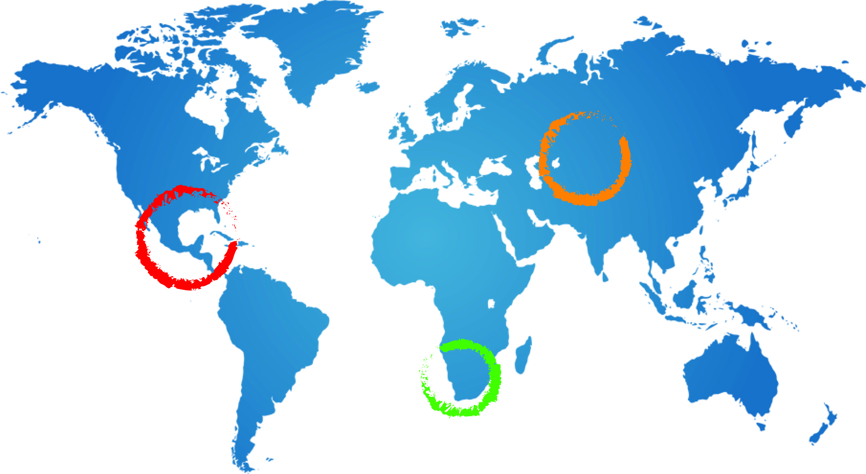
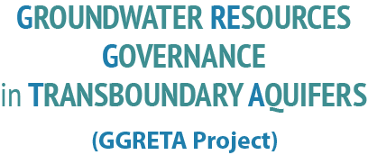
GGRETA: Stampriet case study: elements for a possible next phase of the project
A Ross
28 July 2015
Johannesburg

Slide 2
General orientation
The case study countries consider that while there has been substantial progress in understanding the aquifer there are still substantial knowledge gaps about the properties and dynamics of the STAS.
Recognising that a transboundary diagnosis can take several years to complete, the countries consider that the first priority for a further phase of the project is cooperative action to further build knowledge of the aquifer, tools to guide decision making and management capacity.

Slide 3
Priorities for a possible next phase 1
Establishment of a joint monitoring and data collection program for the STAS
Further scientific work to give more precise answers to key questions
estimates of the acceptable level annual take from the aquifer
descriptions of recharge mechanisms and estimates of recharge
more complete and accurate cross-sections of the aquifer
potential for increased use of treated water from the salt block region
Further boreholes to monitor and measure the deep transboundary aquifer
Valuation of the transboundary aquifer
Populating the IMS with data and putting it into full operation
Investments to improve water supply and water use efficiency in remote areas
Capacity building in research institutions –Botswana, Namibia, South Africa

Slide 4
Priorities for a possible next phase 2
Scenario development mining (exploration) and expanding irrigation Identification of further opportunities for development
Further work to validate the estimates of water use and water quality through the use of on ground surveys
More comprehensive stakeholder engagement
Standardised approach to assessing GW vulnerability to pollution
Need for further elaboration of these items so they can be discussed in countries (with experts) and further details on financing and finace shares

