Slide 1
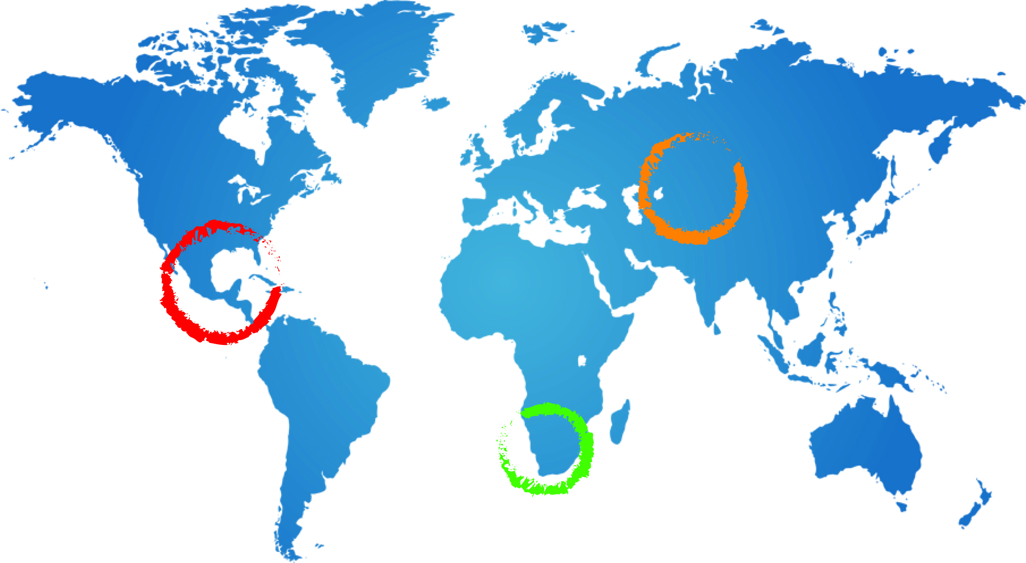
Presentation of the Stampriet Transboundary Aquifer System assessment indicators
+
Adoption of workplan for follow-up
Tales Carvalho Resende
31 July 2015
Johannesburg, South Africa

Slide 2
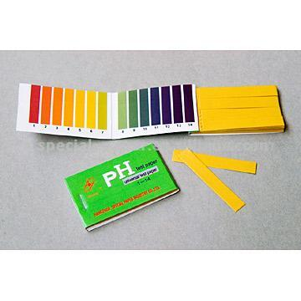
GGRETA - Methodology
To simplify complex systems
2

Slide 3
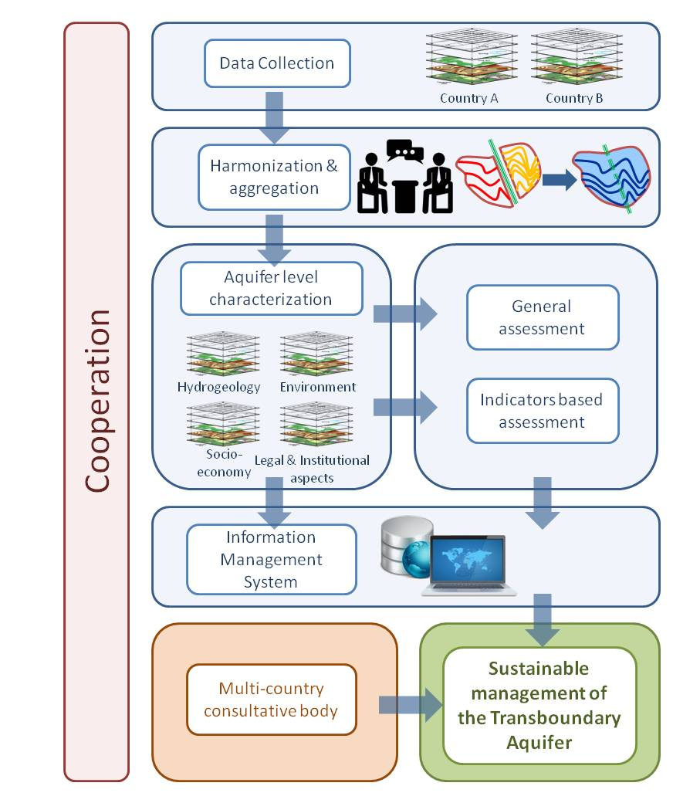
GGRETA - Methodology
Multi-disciplinary assessment:
Hydrogeology
Environmental & Socio-economic (incl. gender)
Legal & Institutional (incl. gender)
Indicators based assessment
Existing data
Target group for outputs is non-technical:
Managers, Decision makers, Stakeholders incl. general Public
3

Slide 4
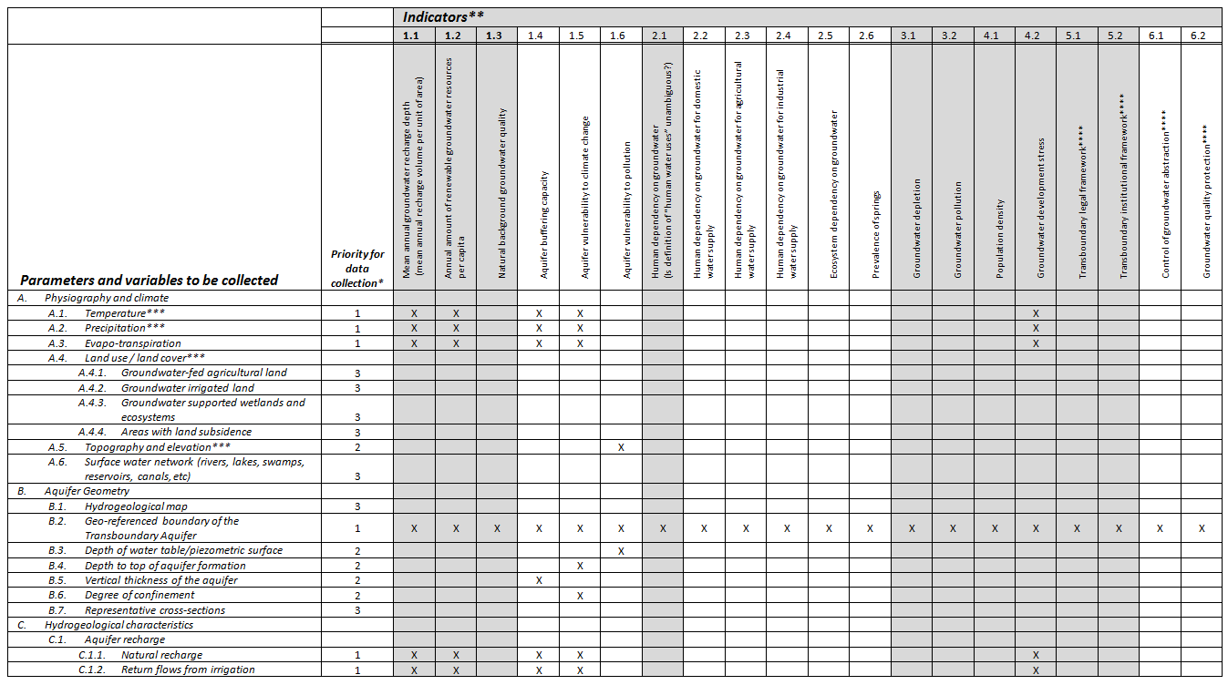
GGRETA – Data to be collected
2. Indicators calculated from data collected
1. Data to be collected
4

Slide 5
GGRETA – Data to be collected
Hydrogeology:
A. Physiography and Climate
Temperature, Precipitation, Evapo-trasnpiration, Land use, Topography and Surface water network
B. Aquifer geometry
Hydrogeological map, Geo-referenced boundary of the Transboundary Aquifer, Depth of water table/piezometric surface, Depth to top of aquifer formation, Vertical thickness of the aquifer, Degree of confinement, Aquifer's cross section
C. Hydrogeological Characteristics
Aquifer recharge, Aquifer lithology, Soil types, Porosity, Transmissivity and vertical connectivity, Total groundwater volume, Groundwater depletion, Natural discharge mechanism, Discharge by springs
5

Slide 6
GGRETA – Data to be collected
Hydrogeology:
A. Physiography and Climate
Temperature, Precipitation, Evapo-trasnpiration, Land use, Topography and Surface water network
B. Aquifer geometry
Hydrogeological map, Geo-referenced boundary of the Transboundary Aquifer, Depth of water table/piezometric surface, Depth to top of aquifer formation, Vertical thickness of the aquifer, Degree of confinement, Aquifer's cross section
C. Hydrogeological Characteristics
Aquifer recharge, Aquifer lithology, Soil types, Porosity, Transmissivity and vertical connectivity, Total groundwater volume, Groundwater depletion, Natural discharge mechanism, Discharge by springs
6

Slide 7
GGRETA – Data to be collected
Environmental & Socio-economic:
D. Environmental
Suitable for human consumption (natural groundwater quality), Groundwater pollution, Solid Waste and waste water control, Shallow groundwater table
E. Socio-economic
Population (total and density), Groundwater and Surface water use, Dependence of industry and agriculture on groundwater, Percentage of population covered by public water supply, Percentage of population covered by public sanitation
7

Slide 8
GGRETA – Data to be collected
Legal & Institutional:
F. Transboundary legal and institutional framework
Agreement, treaty, MoU
I. Domestic legal and institutional framework
Ownership of groundwater, Water resources planning, Groundwater resources abstraction and use, Abatement and control of groundwater pollution, Water resources protection measures, Government and non-government (including informal) water institutions, Implementation, administration and enforcement of the legislation on the statute books
8

Slide 9
GGRETA – Indicators
2. Indicators calculated from data collected
1. Data to be collected
9

Slide 10
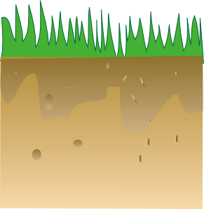
Indicators
Indicator group 1: Defining or constraining the value of aquifers and their potential functions
1.1 Recharge
Rate
Comments
1. Very low: < 2 mm/yr
2. Low: 2-20 mm/yr
3. Medium: 20-100 mm/yr
4. High: 100-300 mm/yr
5. Very high: > 300 mm/yr
No reliable recharge estimate is available for the confined aquifers, but it is very low (virtually non-renewable groundwater resources)
10

Slide 11
Indicators
Indicator group 1: Defining or constraining the value of aquifers and their potential functions
1.2 Renewable groundwater per capita
Comments
1. Low: < 1000 m³/yr/capita
2. Medium: 1000 – 5000 m³/yr/capita
3. High: > 5000 m³/yr/capita
Very low recharge in combination with low population density
11

Slide 12
Indicators
Indicator group 1: Defining or constraining the value of aquifers and their potential functions
1.3 Natural Background Quality
Comments
1. Very low: < 20%
2. Low: 20 - 40%
3. Medium: 40-60%
4. High: 60-80%
5. Very high: > 80%
Suitability for drinking water used as criterion.
It is accepted that local drinking water standards may vary.
fresh
Saline Arsenic
fresh
Percentage of aquifer area with natural groundwater quality satisfying local drinking water standards.
12

Slide 13
Indicators
Indicator group 1: Defining or constraining the value of aquifers and their potential functions
1.4 Aquifer buffering capacity
Comments
1. Low: < 10 years
2. Medium: 10 – 100 years
3. High: > 100 years
Proxy for the aquifer’s resilience to climatic variability
Ratio between volume stored and long-term mean ground­water recharge (equivalent to mean residence time)
13

Slide 14
Indicators
Indicator group 1: Defining or constraining the value of aquifers and their potential functions
1.5 Aquifer vulnerability to climate change
Comments
1. Low: confined aquifers containing only fossil water or receiving negligible recent recharge.
2. Medium: weakly recharged aquifers with limited interaction with other components of the hydrological cycle, due to location at considerable depth and/or hydraulic confinement.
3. High: aquifers actively interacting with streams, atmosphere
Auob/Nossob
Class 1 corresponds to ‘non-renewable groundwater’
Extent of expected groundwater budget regime change in response to change in climatic conditions
14

Slide 15
Indicators
Indicator group 1: Defining or constraining the value of aquifers and their potential functions
1.5 Aquifer vulnerability to pollution
Comments
1. Very low: < 20%
2. Low: 20 -40%
3. Medium: 40-60%
4. High: 60-80%
5. Very high: > 80%
- Approximate criteria for “Moderately to highly vulnerable: “
> 0.3 in GOD method
> 100 in DRASTIC method
Percentage of its horizontal area where the aquifer is considered moderately to highly vulnerable to pollution
15

Slide 16
Indicators
Indicator group 2: Role and importance of groundwater for humans & environment
2.1 Human dependancy on groundwater
Comments
Abstraction of water includes the quantity used and all losses.
No data available, but there is no permanent surface water in the area.
1. Very low: < 20%
2. Low: 20-40%
3. Medium: 40-60%
4. High: 60-80%
5. Very high: > 80%
Groundwater
Groundwater
River water
Lake water
Percentage of groundwater in total water abstraction for all human water uses
16

Slide 17
Indicators
Indicator group 2: Role and importance of groundwater for humans & environment
2.2 Human dependency on groundwater for domestic water supply
Comments
1. Very low: < 20%
2. Low: 20-40%
3. Medium: 40-60%
4. High: 60-80%
5. Very high: > 80%
Groundwater
Groundwater
Abstraction of water includes the quantity used and all losses.
River water
Lake water
Percentage of groundwater in total water abstraction for domestic use
17

Slide 18
Indicators
Indicator group 2: Role and importance of groundwater for humans & environment
2.3 Human dependency on groundwater for agricultural water supply
Comments
1. Very low: < 20%
2. Low: 20-40%
3. Medium: 40-60%
4. High: 60-80%
5. Very high: > 80%
Groundwater
Groundwater
Surface water contributes to livestock watering, in the form of water ponds
River water
Lake water
Percentage of groundwater in total water abstraction for agricultural water supply
18

Slide 19
Indicators
Indicator group 2: Role and importance of groundwater for humans & environment
2.4 Human dependency on groundwater for industrial water supply
Comments
1. Very low: < 20%
2. Low: 20-40%
3. Medium: 40-60%
4. High: 60-80%
5. Very high: > 80%
Groundwater
Groundwater
(Not applicable – apparently no industries in the area)
River water
Lake water
Percentage of groundwater in total water abstraction for industrial use
19

Slide 20
Indicators
Indicator group 2: Role and importance of groundwater for humans & environment
2.5 Ecosystem dependency on groundwater
Comments
1. Very low: < 5%
2. Low: 5-10%
3. Medium: 10-25%
4. High: 25-50%
5. Very high: > 50%
Groundwater
Groundwater
Auob/Nossob only
Phreatic water level taken as a proxy
River water
Lake water
Percentage of the aquifer’s area where the aquifer has a phreatic water level shallower than 5 m below surface
20

Slide 21
Indicators
Indicator group 2: Role and importance of groundwater for humans & environment
2.6 Prevalence of springs
Comments
1. Very low: < 5%
2. Low: 5-10%
3. Medium: 10-25%
4. High: 25-50%
5. Very high: > 50%
Springs are very sensitive for changes in groundwater budget. Therefore a meaningful indicator of change.
Groundwater
Groundwater
River water
Lake water
Total annual groundwater discharge by springs, divided by mean annual groundwater recharge
21

Slide 22
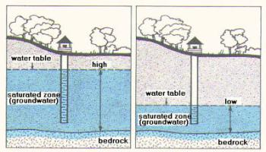
Indicators
Indicator group 3: Changes in groundwater state
3.1 Groundwater depletion
Comments
1. Absent to very low: < 2 mm/yr
2. Low: 2 -20 mm/yr
3. Medium: 20-50 mm/yr
4. High: 50-100 mm/yr
5. Very high: > 100 mm/yr
Depletion should target a long-year trend; short-term variations due to climatic variability should be discarded.
Observed polluted zones as percentage of total aquifer
22

Slide 23
Indicators
Indicator group 3: Changes in groundwater state
3.2 Groundwater pollution
Comments
1. Very low: < 5%
2. Low: 5-10%
3. Medium: 10-25%
4. High: 25-50%
5. Very high: > 50%
Local drinking water quality standards as a criterion.
Observed polluted zones as percentage of total aquifer
23

Slide 24
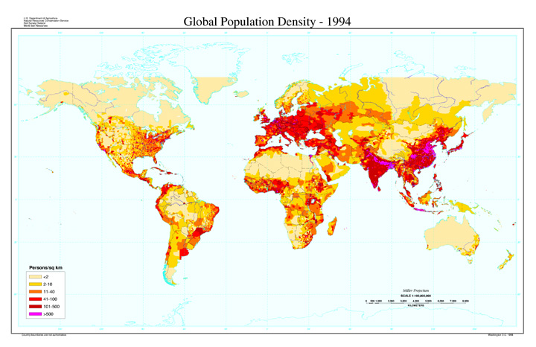
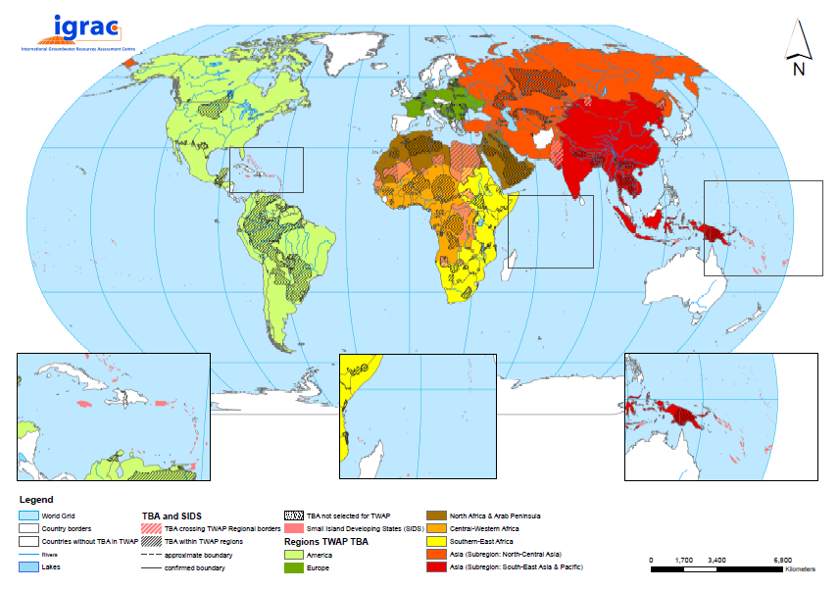
Indicators
Indicator group 4: Drivers of change and pressures
4.1 Population Density on Transboundary Aquifer
1. Very low: < 1 p/km²
2. Low: 1-10 p/km²
3. Medium: 10-100 p/km²
4. High: 100-1000 p/km²
5. Very high: > 1000 p/km²
Number of people on top of aquifer per unit of area.
24

Slide 25
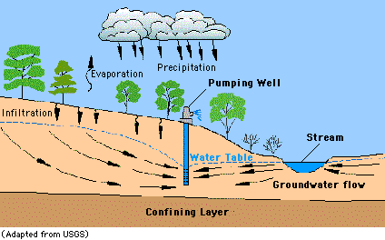
Indicators
Indicator group 4: Drivers of change and pressures
4.2 Grondwater Development Stress (=Abstraction/Recharge)
Comments
1. Very low: < 2%
2. Low: 2-20%
3. Medium: 20-50%
4. High: 50-100%
5. Very high: > 100%
Measure for the degree of modification of the groundwater budget (repercussions for outflow and storage)
Total annual groundwater abstraction divided by long-term mean annual recharge.
25

Slide 26
Indicators
Indicator group 4: Drivers of change and pressures
4.2 Grondwater Development Stress (=Abstraction/Recharge)
Comments
1. Very low: < 2%
2. Low: 2-20%
3. Medium: 20-50%
4. High: 50-100%
5. Very high: > 100%
Measure for the degree of modification of the groundwater budget (repercussions for outflow and storage)
Total annual groundwater abstraction divided by long-term mean annual recharge.
26

Slide 27
Adoption of workplan for follow-up
Activities | Time
Finalization of the final draft assessment report | End September 2015
Feedback from Governments | End of October 2015
2nd stakeholder consultation meeting (Stampriet) | Early November 2015
Finalization of final assessment report | November 2015
Final meeting (Paris?) | First half of December 2015
27

Slide 28
THANK YOU
t.carvalho-resende@unesco.org

