Slide 1
Political Economy Analysis and Private Sector Engagement
Nick Tandi
Tools for Sustainable Management of Transboundary Aquifers
29 July 2015
Birchwood, Pretoria

Slide 2
Presentation outline
Political Economy Analysis (PEA)
Private Sector Engagement
  What is the interest ?
  Types and examples of engagement: when and how the private sector gets involved
  Reflections for the Stampriet

Slide 3
Political Economy Analysis (PEA)
Increasing recognition that understanding power and politics is critical for effectiveness of development interventions
For development initiatives to succeed they must not only be viable economically, technically, socially and environmentally – they must also be viable politically
This has led to the development of Political Economy Analysis

Slide 4
SIWI PEA Project
SIWI Project: Framework for Political
Economy Analysis of Transboundary Basins in Africa
Client: Cooperation in International Waters in Africa (CIWA), financed through a Multi-Donor Trust Fund; World Bank

Slide 5
SIWI PEA Project Objectives
Formulate a method of analysis for understanding the political economy drivers and constraints that influence cooperation and develop scenarios that can inform the overall strategic thinking and decisions related to CIWA engagement in different international waters contexts in Africa
To develop comprehensive Political Economy Analyses of selected cases of Transboundary Basins in Africa.

Slide 6
SIWI PEA Project Results
Draft framework has been developed
Framework integrates economic and human behaviour factors
Framework provides practical tool for:
Analysing:
  Structural and technical elements
  The players – institutions and agents
  Power and influence
Using the above analysis to provide PEA advice on cooperation over shared waters
Case studies

Slide 7
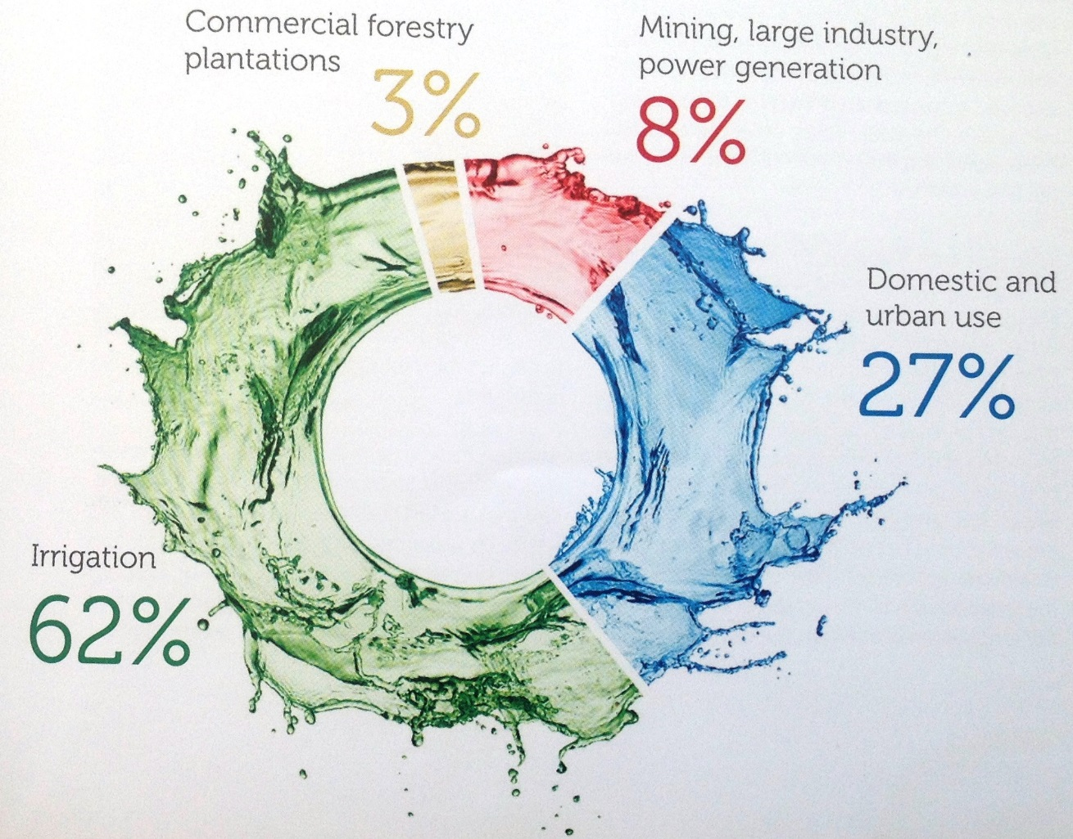
Is the private sector the largest water user ?
WRC,2011

Slide 8
The global water risk:
”Charting our Water Future” 2009

Slide 9
What are the most important global risks of concern for society and business ?
WEF, 2014
Notes:
Cost of water in textiles also related to other costs such as chemicals etc. Effecient water use improved effiiany in production cycles
This is now a real issue of concern at board room level but also a realisation that production effeciencies are fast reaching diminishing marginal retruns .
Investment has to be outside in many different forms. Food and beverage sector helping farmes to save water, industry assisting municplaities to save water , or co-treatment of industrial and domestic wastewater.
This opening opportunity for patnership at diference scales but raising questions about where the opportunities lie for partnershp, the capacities required for partnership, the partnership risk , integrrity and otherwise

Slide 10
Examples of water risk.
CDP Water Report, South Africa 2013
86% of respondents reported exposure to substantive water-related risks
72% already experienced water-related impacts past five years
Water stress most anticipated risk, followed by water quality, flooding and price
Flooding most commonly reported actual impact (48% of companies)
Illovo Sugar reported R3 million worth of damage due to floods Dec 2012
Water stress reported by 34% of companies
Mediclinic no water for over a week at three different sites
Half of companies have almost all of their operations in water-stressed areas
Notes:
86% of respondents reported exposure to substantive water-related risks with 72% of respondents having already experienced water-related impacts in the last five years
In general water stress or scarcity continues to be the most reported anticipated risk, followed by declining water quality, flooding and higher water prices. In 2013 flooding was the most commonly-reported impact, reported by 48% of companies. Illovo Sugar, for example, reported R3 million worth of damage due to floods in December 2012. Water stress was reported by 34% companies, with Mediclinic, for example, experiencing no water for over a week at three different sites. Poor water quality accounted for just 5% of reported impacts.
Almost half of respondents (48%) reported that almost all (over 90%) of their operations are situated in water-stressed areas.
Two-thirds of all the anticipated risks are seen to have the potential to impact the business’s direct operations or their supply chains within the next five years.

Slide 11
Types of water risks faced by the private sector
Physical risk: Scarcity, flooding and quality impacts on operations, supply chains and investments
Reputational risk : How brand is affected by water management.
Regulatory risk. Compliance to changing regulations (quantity, quality, price)

Slide 12
Reputational risks
Water related protests in relation to protest events in SA. Tapela, 2013
“Water scarcity, could adversely affect the ratings of global mining companies if they fail to proactively manage the accompanying operational and political risks to their businesses”. Moody's, Feb 2013

Slide 13
The range of private stakeholders ( and interests)
Water financing
Water using
Water management
Financial services providers with clients exposed to water risk
Industry with agricultural supply chains

Slide 14
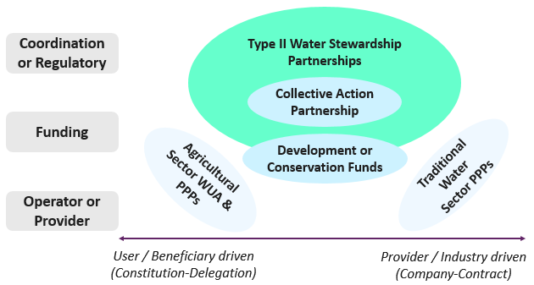
Examples of partnership types
Source: SWPN and Pegasys. On going work

Slide 15
PPPs
Burger, 2008

Slide 16
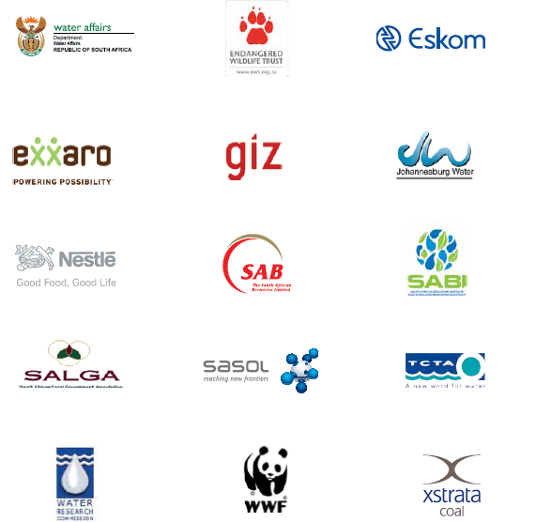

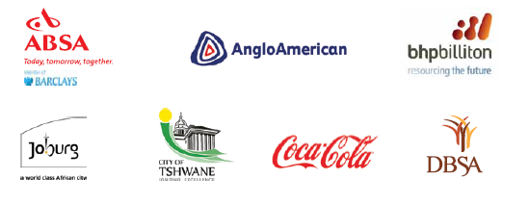

Water Stewardship Partnership example: SWPN
Notes:
Formed after request from Minister Molewa to WEF
Following formation of global business leadership group adressing water risk

Slide 17
Example of project development process diagram
Concept development & buy in
Forum establishment
Business case
Identification sponsor
Full feasibility led by sponsor
Project implementation
Source. SWPN. Vaalharts project
Broad
Detailed
Notes:
Is this it ?
The real question is do we want to get involved in the big picture as opposed to the details ?
Define our results (or at least role and objectives) along this chain carefully aligning them to the objectives of the working group and SWPN ?
Risk is that there may not be water savings but WUE yes.
The partnership required and sell them the idea

Slide 18
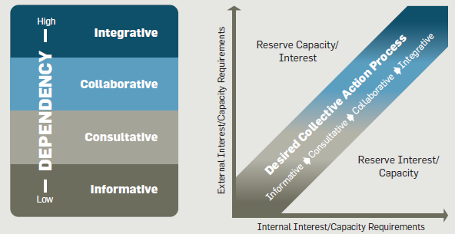
Mapping Dependency, Interest and Capacity
Source: CEO Water Mandate, 2013

Slide 19
Levels of collaboration
Level | Description
Informative | Coordinated information sharing. Interest is expanding knowledge, increasing transparency, familiarity and trust
Consultative | Convening for the exchange ideas and expertise Shared understanding of interests and challenges enables informed independent decision making
Collaborative | Seeks to move interested parties closer together Establishing a case for joint action
Integrative | Emerges when there is alignment of interests and resources Joint actions are pursued to address challenges or opportunities Formalisation of joint structure
Source: CEO Water Mandate,

Slide 20
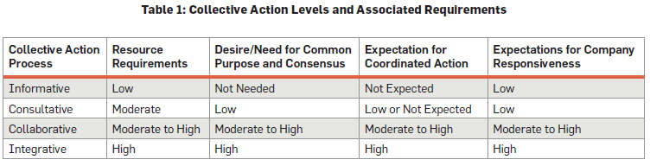
Mapping partnership requirements

Slide 21
Partnership challenges and risks
Building trust and developing collective action momentum
Balancing partnership development and results on the ground
Managing the potential for policy or process capture
Demonstration projects “never fail and never scale”
Moral hazard

Slide 22
Key success factors of the SWPN
Political leadership at ministerial level
Strong support from the national water authorities
Business leadership
A shared and detailed analysis of the water situation, risks and trends
A focus must on action and implementation but maintaining policy coherence
A secretariat and project management system
An inclusive approach towards stakeholders
An operating model and funding framework must be evolved over time but in line with the maturity of the institution and the projects

Slide 23
Ke a leboga
Thank you

Slide 24
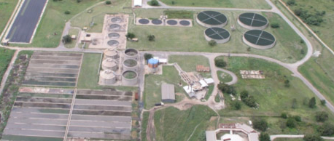
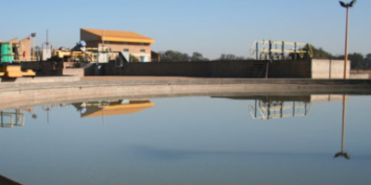
Wastewater treatment. Rustenburg example
In the early 2000s, Rustenburg Local Municipality (RLM) faced the following problems:
  A 50 yr old Bospoort Water Purification plant that could no longer purify the polluted water from the Bospoort Dam.
  Dam received effluent from Rustenburg and Boitekong Sewerage Treatment Works; the former being an overloaded works with poor effluent quality
The technical solution implemented from 2004 -6 consisted of:
  Refurbishment and extension of the existing Rustenburg Sewerage Treatment Works to increase the treatment capacity from 22 Ml/d to 42 Ml/d
  Refurbishment of the Bospoort Water Purification Works to enable it to cope with the highly eutrophic water from the Bospoort Dam and still produce 12 Ml/d of potable water.

Slide 25
Wastewater treatment. Rustenburg example
But RLM did not have the estimated R 150 Million required at the time
The Rustenburg Water Services Trust was created with the legal status of a municipal entity under the Municipal Services Act
The refurbishment project is ring-fenced under the Trust and financed by Absa
The Trust services the debt in the following ways:
  Selling treated effluent to the mines for use as process water
  Selling portable water to RLM from Bospoort Water Purification at Randwater rates
  Charging RLM a tariff for sewerage treatment

Slide 26
Wastewater treatment. Rustenburg example
The above income streams service the debt and cover the Trust´s operation and maintenance costs
Any surplus generated by the trust will be allocated to RLM to expand their water services
The tariff charged to RLM was forecasted to be substantially lower than what the municipality had planned for operation and maintenance of its sewerage treatment works
Project partners. RLM, Bigen Africa, Absa, Magalies Water

