Slide 1
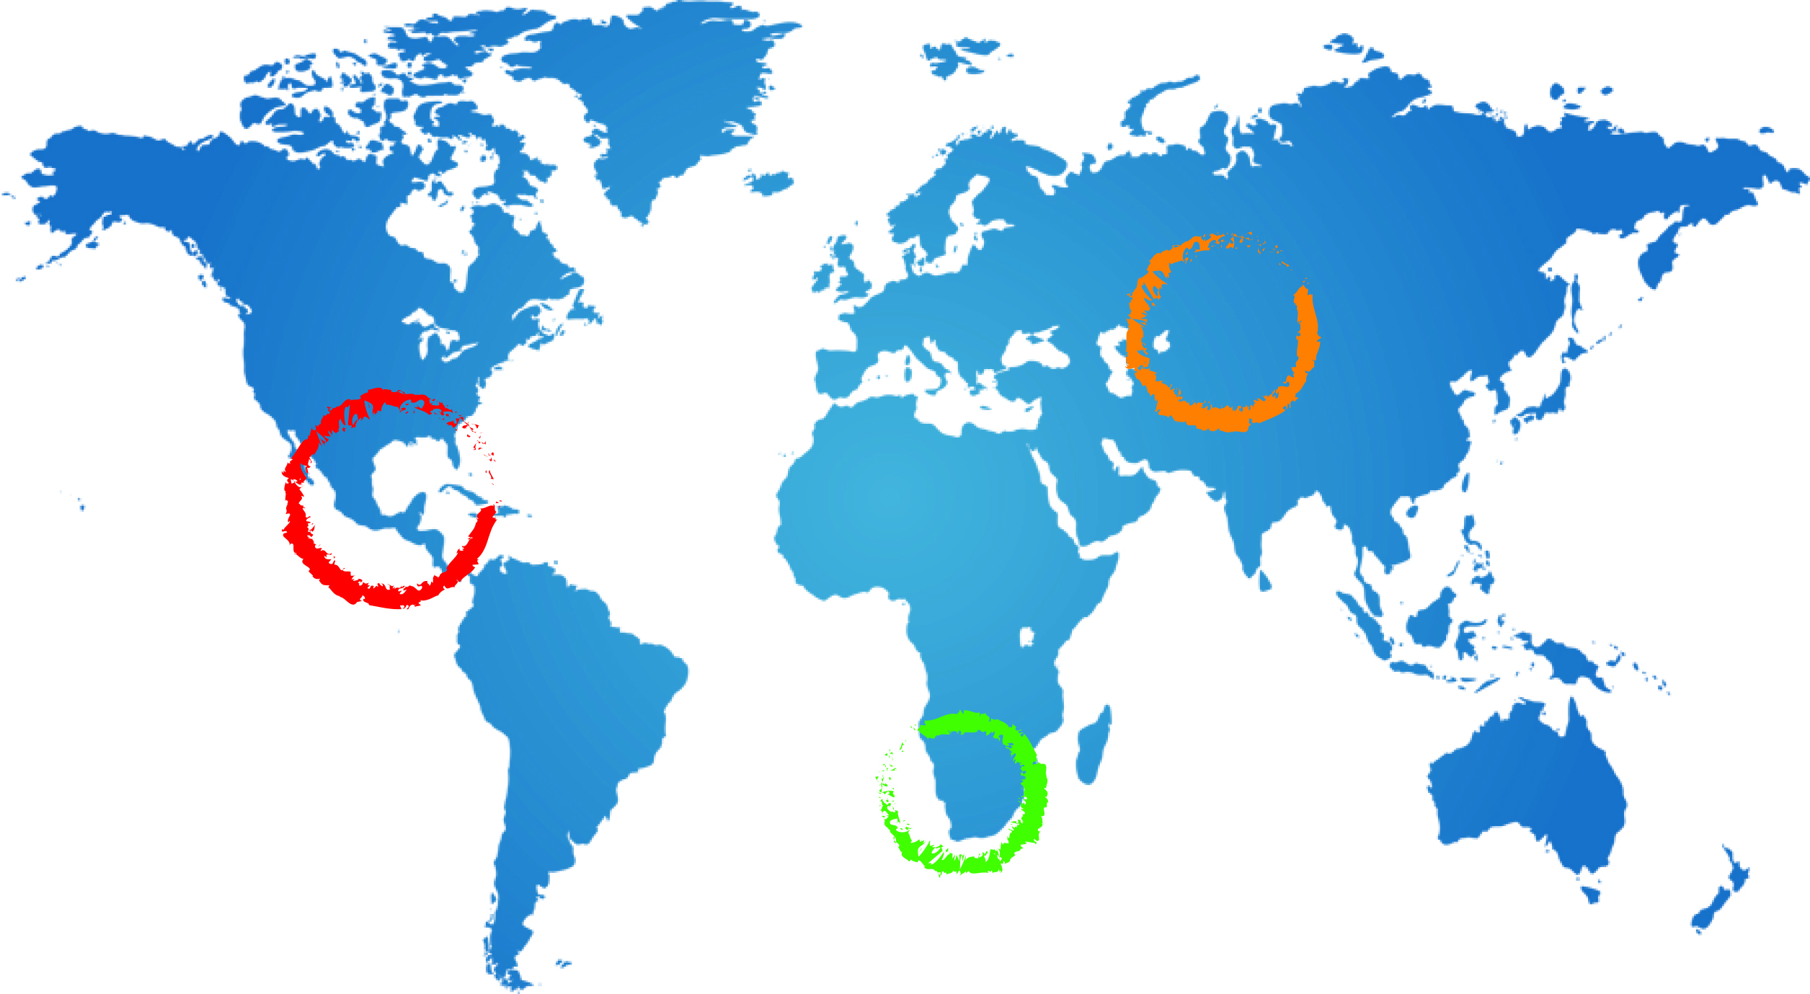
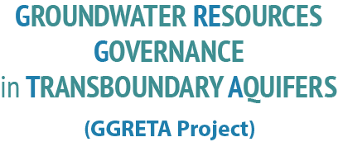
Draft diagnostic: Stampriet Transboundary Aquifer System
Andrew Ross PhD
Consultant UNESCO
A Ross
29 July 2015
Johannesburg

Slide 2
Contents of presentation
Introduction to diagnostic analysis
Overview of diagnostic results
STAS management issues
Legal, policy and institutional responses
Questions for discussion

Slide 3
What is a diagnostic analysis?

Slide 4
Scope and contents of transboundary diagnostic analysis
Issues related to sustainable development of the STAS
risks, impacts and their causes
Causal chain (a) immediate (waste) (b) underlying (bore management), (c) root (population growth, education, poverty)
Opportunities for improving STAS use and management
Identification and analysis of legal, policy and institutional measures for addressing these issues

Slide 5
Management issues
Value of Groundwater in the STAS area
Groundwater depletion
Groundwater pollution
Data deficits
Law and policy implementation

Slide 6
Value of Groundwater in the STAS area
In all three countries groundwater is the major source of water in the STAS area, for human consumption, livestock and irrigation.
Over most of the area GW is the only source of water
Therefore GW is essential for the survival of human and animal populations and the environment in the area
According to currently available data, 95% of current abstraction from the STAS comes from Namibia of which half is for irrigation.
But also some communities in Botswana and the Kgalagadi Frontier Park rely on the STAS

Slide 7
Groundwater depletion
Little evidence of GW depletion in the STAS at current levels of development
BUT it is not possible to come to a firm conclusion because of lack of reliable data especially time series on groundwater levels or groundwater abstraction
Main risks of future depletion (or pollution) of the STAS are large-scale irrigation, mining, future settlement development and GW transfer,
Magnitude of risk depends on scale and timing of transfer or development

Slide 8
Groundwater pollution
Substantial local pollution of the Kalahari aquifer(s) around settlements
Limited evidence of pollution of the deeper transboundary aquifers
Main sources of pollution are pit latrines, oxidation ponds, waste dumps and poorly constructed and managed bores

Slide 9
Data deficits are a critical management issue
Major deficits in key hydrogeological, socioeconomic and environmental data undermine good management of the TBA
Lack of aquifer specific data on GW abstraction and pollution
Serious deficiency of time series data on GW abstraction, groundwater levels and groundwater quality
Where data exist they are incomplete, not well organized/edited, and can be difficult to retrieve

Slide 10
Implementation of law and policy
The framework for implementation of and groundwater management is generally in place in the three countries
but implementation and enforcement poses some challenges.
The STAS includes large areas where water abstraction and pollution is not subject to regular inspections or controls.
In Namibia regulations to support enforcement of the water law have being drafted but are not in place yet.
In Botswana, the Water Policy has been approved by Cabinet (since 2012), but has not yet been debated in Parliament.

Slide 11
Legal, institutional and policy responses
Structured response
Levels of responses
National legislative responses
National institutional responses
Policy and management responses; transboundary, national, mixed

Slide 12
Structured response
Identify priority areas for intervention
National and multicountry
Identify interventions that are feasible, effective, cost-effective
Develop ideas in a consultative process with stakeholders
Carry out structured analysis to choose between options

Slide 13
Level of responses
Legal, policy and institutional responses to current and future challenges in the STAS are at two complementary levels
Transboundary responses by two or more countries
Domestic responses
Both depend on domestic GW relevant law and policy, and implementation of that law and policy

Slide 14
National legislative responses
Existing GW relevant legislation of each STAS country regulates well drilling, GW abstraction and use, point source pollution
A long-term legislative response strategy could include
Updating older legislation
Bringing mining legislation in line with IWRM
Improvement of legislation covering pollution from non-point sources and man-made interferences in natural recharge areas
Improvement of the quality and performance of implementation of regulations

Slide 15
National institutional responses
Improving the quality and performance of GW administration
Better coordination of multiple government actors engaging with GW ( eg water, agriculture, mining, energy, environment)
Facilitating consultation between governments and other stakeholders (industry, communities) before making decisions that impact GW
Maintaining skilled GW personnel and finances for GW administration
Increasing the capacity of groundwater users to supplement government in the exercise of certain functions (eg data collection, enforcement)

Slide 16
Possible policy and management responses - transboundary
Joint monitoring program with data management and data sharing mechanism (making use of IMS)
Separate monitoring of the Kalahari and the Auob and Nossob aquifers
Comprehensive assessment of the value of STAS
Development of joint guidelines eg for borehole management, and risk management for major developments
Investment in additional monitoring boreholes
Joint proposals for funding of priority projects

Slide 17
Possible national policy and management responses
Large number of possibilities. Could include:
Improved borehole regulation, licensing and inspection
Promotion of increased water use efficiency
Further public investment in wastewater and waste management
Protection of recharge zones in Namibia
Program to further evaluate the risks and opportunities related to prosopis

Slide 18
Transboundary and national policy and management responses
Public education about benefits of GW and requirements for groundwater conservation and pollution avoidance
Training groundwater management professionals
Proposals for funding of priority projects by external agencies
Stakeholder engagement and consultation

Slide 19
Questions for discussion
What are the opportunities for developing the STAS? What sectors, regions? How will the demand for GW from the STAS develop in the next 10-15 years?
What are the main risks relating to development of the STAS?
What would be the consequences if the STAS was depleted or degraded?
Are current GW management measures sufficient to manage the STAS under possible future development scenarios?
What additional GW legislative, policy and institutional measures could be considered? What are the barriers to such measures?

Slide 20
Thank you for your attention
a.ross@unesco.org
Telephone 33 (0)1 45 68 39 43

Slide 22
Key findings: Integrated assessment: Stampriet Transboundary Aquifer System (STAS)
STAS is not heavily used at current levels of development – but level of sustainable use remains unclear
Important to distinguish between shallow aquifers (Kalahari) and deeper aquifers – different characteristics, different management
Quality of GW worse in southern part of aquifer (salt block area)
Local pollution of shallow aquifers
STAS may be at risk if large scale GW transfer, irrigation or mining development occurs
Legal and institutional framework is adequate, but problems implementing national legislation

