Slide 1
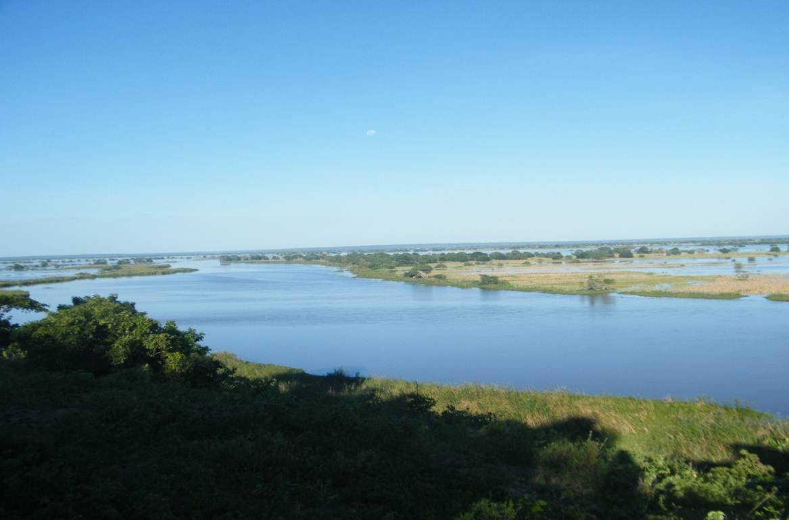


Resilience Building in the Limpopo River Basin (RESILIM)
Nkobi M. Moleele
RESILIM
Regional Meeting on Tools for the Sustainable Management of Transboundary Aquifers
28-31 July 2015

Slide 2
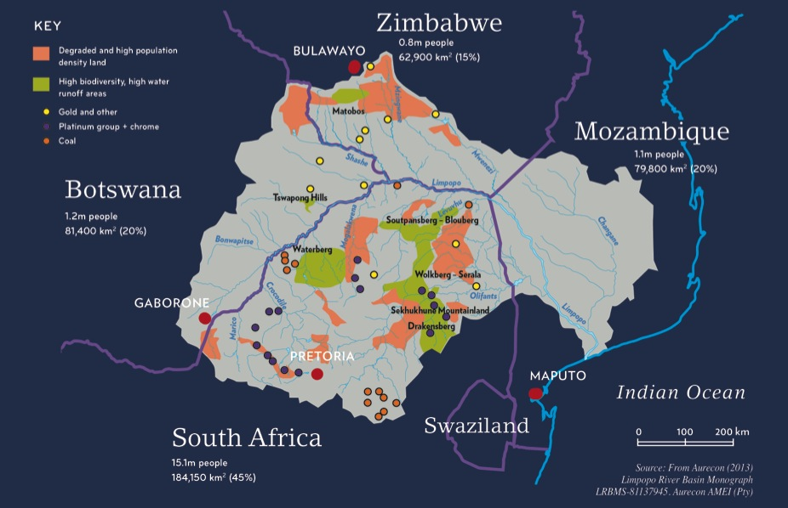
Resilience in the Limpopo Basin Program
WHY RESILIM ?
Climate change, Demographic change and Globalization of economic systems
Presents enormous challenge to society world wide
Conceptualized and operationalised to complement the existing capacity development needs and initiatives in the Basin.
Ability of a socio-ecological system to anticipate and reduce risk or adapt to shocks or disturbances (e.g. climate variability and change).
This includes the ability to “bounce back” from negative impacts or to “bounce forward”, transforming a challenge into an opportunity

Slide 3
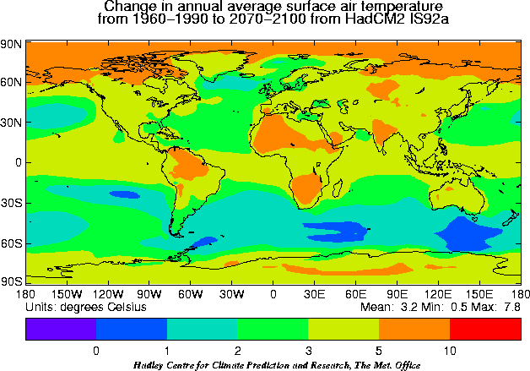
Motivation

Slide 4
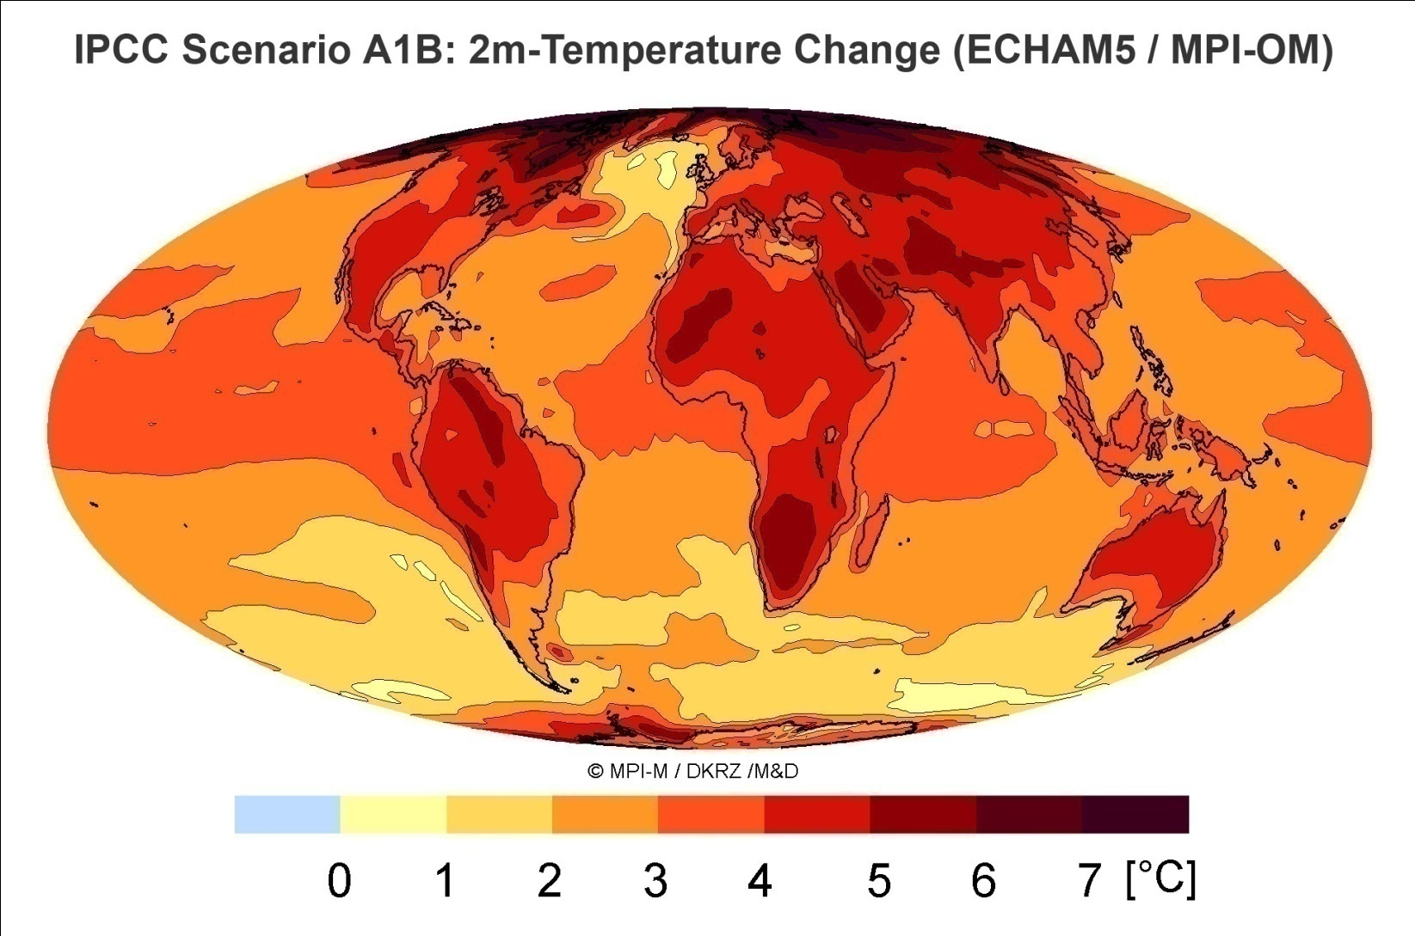
Global Warming prediction for this century: Strong and negative changes for most of Africa

Slide 5
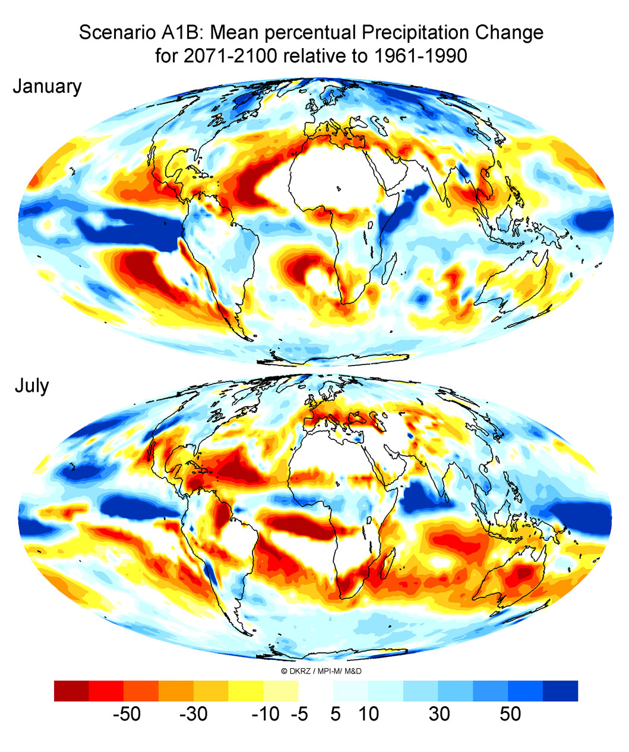
Less rainfall for most of southern Africa

Slide 6
RESILIM Program Objectives
The RESILIM program overall goal is to improve trans-boundary management of the Limpopo River Basin resulting in enhanced resiliency of people and ecosystems.
Reduce climate vulnerability by promoting the adoption of science-based adaptation strategies for integrated, trans-boundary water resource management.
Conserve biodiversity and sustainably manage high-priority ecosystems.
Build the capacity of stakeholders to sustainably manage water and ecosystem resources.

Slide 7
The LRB is shared by 4 countries and is characterized by water scarcity
Natural resource
Rainfed agriculture
Poverty
Less diversified eco.
Evolving governace
Mostly semi-arid with highly a variable climate - Drought and Flooding
Land-use patterns, ecosystems, and social, economic and governance systems
Large rural populations
Notes:
Transboundary – 4 riparians
Existing water scarcity – generally low and highly variable rainfall – but extremes exist
Agriculturally important
Immense mineral resources
High ecotourism potential
A current intense focus of industrial and mining development
Headwaters include important industrial and urban centres of southern Africa

Slide 8
General Water Scarcity in the LRB is viewed in terms of “closure” and deficit

Slide 9
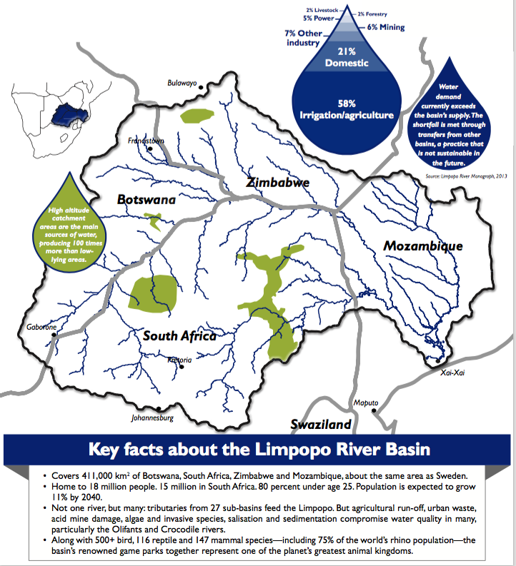
…Key factors of the Limpopo Basin…

Slide 10
Water, biodiversity and CC – a nexus in the LRB
The LRB is already water scarce – closed status
Dimensions of water, ecosystems and livelihoods are tightly linked and interrelated, a change in one has significant impacts on the others, and vice versa
Few/ no buffers or excesses in this system of linkages in the LRB - small changes in an input pathway usually lead to clearly observable impacts on output pathways or products
External influences: population dynamics and growth (including the economic effects), livelihood needs and the effects of governance.

Slide 11
A systems based approach requires a combination of methodological and synthesized analysis
Risk and Vulnerability Mapping
1st to 4th Order Impact Assessments – how does CC cascade through a system?
Political and Livelihoods Economy Analysis
Institutional Mapping
Analysis of the nuances of vulnerability and development of an adaptive capacity framework
Particiatory analysis
Multicriteria analysis: assessing the dimensions of return on investment

Slide 12
Spatial mapping brings focus on specific areas revealing
8 representative case studies of vulnerability
Notes:
Putting it all together – we can draw a picture of general vulnerability, which is combination of three sub-maps – Exposure, Sensitivity and Adaptive Capacity (as outlines in the R&V mapping report.
Each one of these can be described in broad terms, based on our summaries. But the contributors of vulnerability may be different in each case. We need to understand that

Slide 13
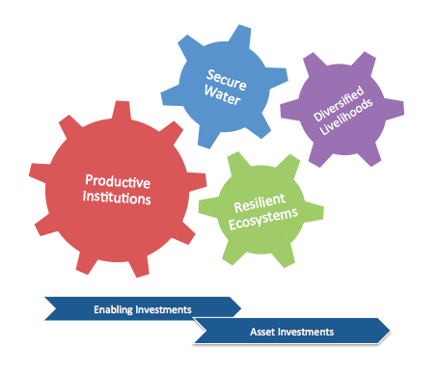
Four Integrated Investment Programs

Slide 14
Investment Domain By Category
Class
Enabling
Governance, management, and compliance
Institutional and capacity development
Data and knowledge management
Asset
Development of Ecological Services
Built infrastructure
Domain

Slide 15
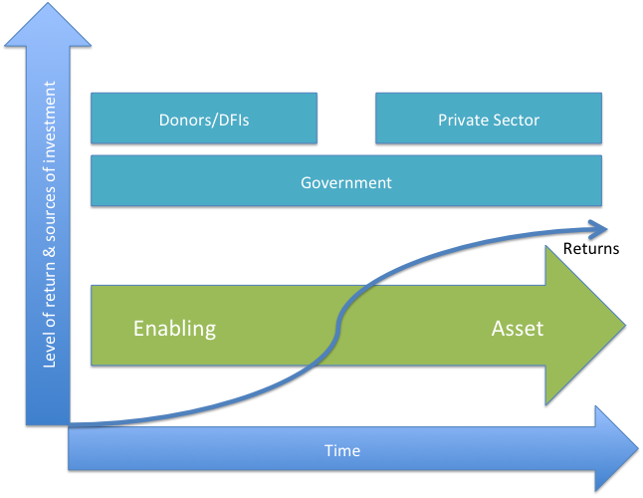
Sequencing of Investors and Investments

Slide 16



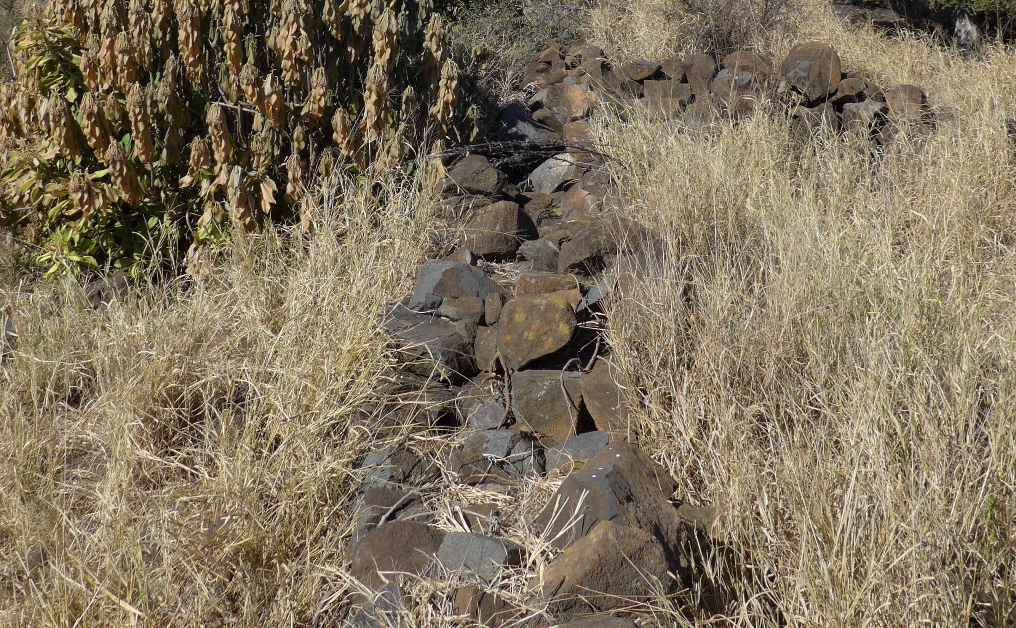



Resilience in the Limpopo Basin:
the Potential Role of the Transboundary Ramotswa Aquifer
(RESILIM-TBA)

Slide 17
Overall objectives
To support a long-term joined vision and cooperation on the shared groundwater resources of the upper Limpopo region
To understand how to enhance overall water storage, including using the aquifer
To facilitate joint management and better groundwater governance, focused on coordination, scientific knowledge, social redress and environmental sustainability
To reduce poverty and inequities and to increase prosperity, livelihoods and food security in face of climate chance and variability
To contribute to the building of trust and transparency related to the use and development of the shared aquifer resource
To encourage the states to enter into agreements on their shared aquifer(s)

Slide 18
Specific objectives
To increase the recognition of the importance and vulnerability of the transboundary Ramotswa aquifer
To improve the understanding of the socio-economic importance of the aquifer area and the inequalities in water security across the population
To improve the understanding of the extent and hydrogeology of the transboundary aquifer resources under present and future climate and population projections
To assess the feasibility and best options for managed aquifer recharge (MAR) for securing the buffer and controlling the water quality, using wastewater, flood and storm water
To assess the feasibility and best options for small-scale irrigation (ag-water solutions)
To establish national and cross-border dialogue and cooperation on the Ramotswa and further encourage international cooperation on transboundary aquifers in the SADC region
To develop tools for shared and harmonised management and monitoring of the groundwater resources
To develop human and institutional capacity for shared and harmonised management and monitoring of the groundwater resources
To publish and disseminate results and findings

Slide 19
Activities and outputs
Objectives | Activities | Output
A, F | Multi-stakeholder engagement | Report on Joint strategic action plan (SAP), International conference
B | Socio-economic and institutional baseline assessment | Report on Transboundary diagnostic analysis (TDA)
C | Hydrogeological characterisation (air-borne geophysics) | Hydrogeological maps Report on hydrogeology
D | Buffer assessment and MAR solutions | Report on MAR
E | Ag-water solutions | Report on ag-water solutions
G | Hydrogeological model | Calibrated model, Scenario assessments, Report on modelling
G | Joint database | Joint database
H | Training | Training material, Trained staff in relevant organisations
I | Coordination and scientific documentation | Progress reports, Scientific papers

Slide 21
Defining Vulnerability
The assessment of vulnerability includes measures of:
exposure to harm (climate-related risk factors) and;
sensitivity of both people and the environment to this harm
together these show potential impact to harms, and;
the capacity of human and environmental systems to adjust and respond to these harms, and their consequences.
Source: The Intergovernmental Panel on Climate Change (IPCC)
Exposure
Vulnerability
Adaptive Capacity
Sensitivity
Potential Impact

Slide 22
Three Stages of Analysis
Adaptive capacity
Ability for the population to adapt to climate change
Exposure
The risk of climate events both now and in the future
Sensitivity
How sensitive the population and environment are to the current and future climate events
Notes:
Exposure; The risk of climate events both now and in the future
Sensitivity; How sensitive the population and environment are to the current and future climate events
Adaptive capacity; Ability for the population to adapt to climate change
Each of these is a summary layer comprised of multiple input layers

Slide 23
Impacts cascade through the system; assessing impacts on other components highlights where vulnerability is most concentrated, what the drivers are and identifies the elements of resilience
Notes:
The 1-4th framework makes linkages between basic climate parameters(1st order), the resulting physical and chemical processes in the physical and biotic environment (2nd order), the resulting ecosystem services and production potential (3rd order) and finally the resultant social and economic conditions (4th order) that arise as a result.

Slide 24
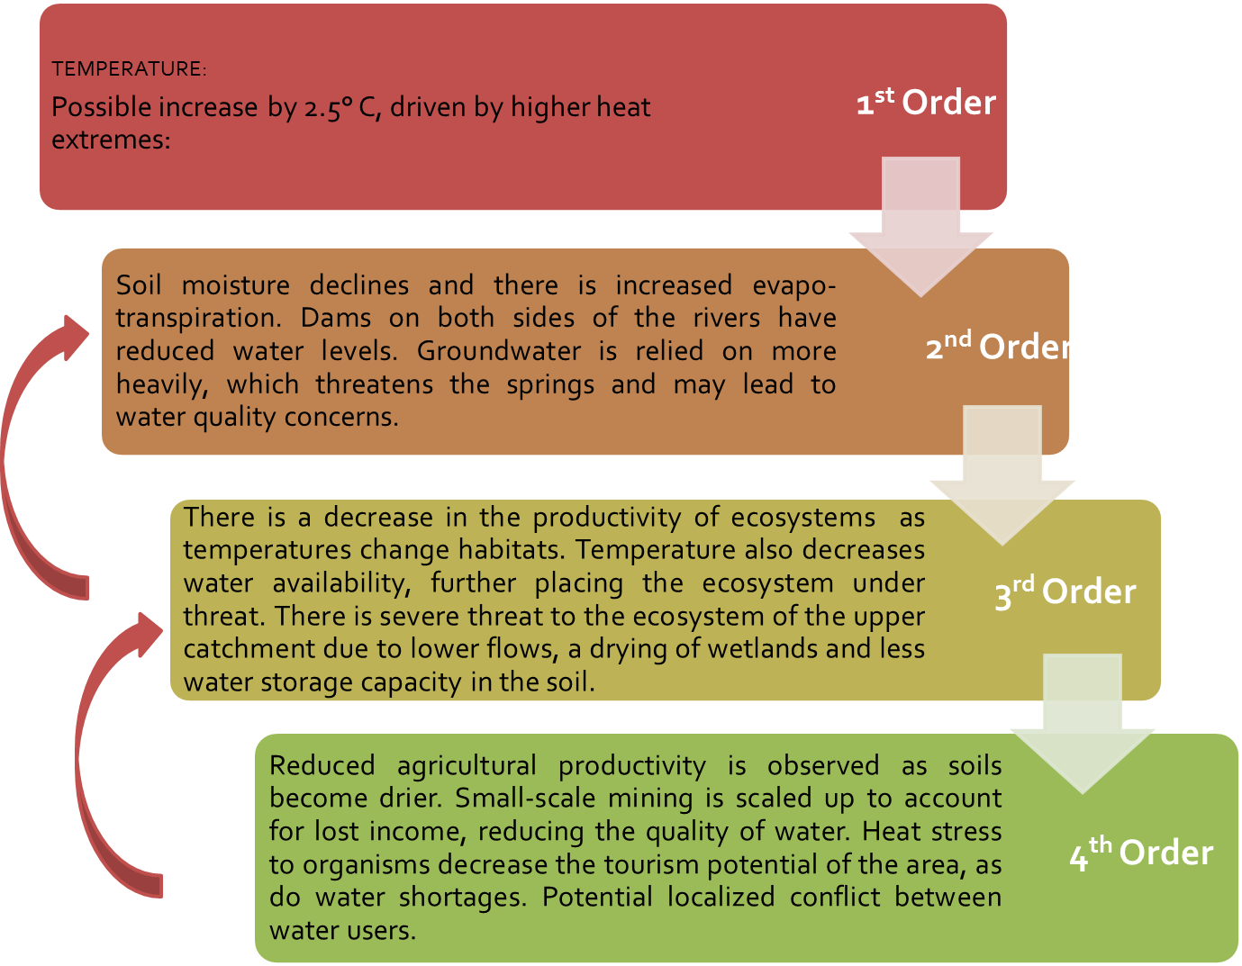
02 March 2015
Upper Limpopo – First to Fourth Order Impact Assessment

Slide 25
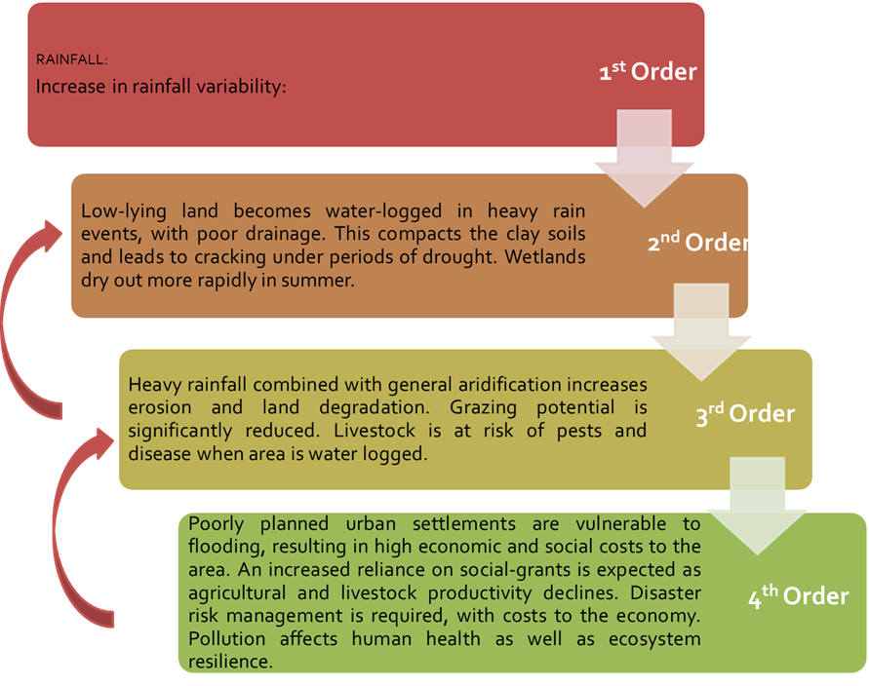
02 March 2015
Pretoria North - First to Fourth Order Impact Assessment

Slide 26
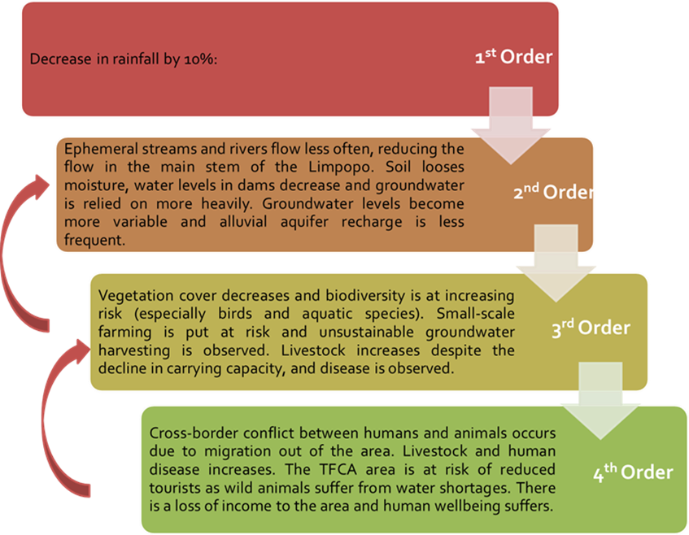
02 March 2015
Shashe - Limpopo River Confluence - First to Fourth Order Impact Assessment

Slide 27
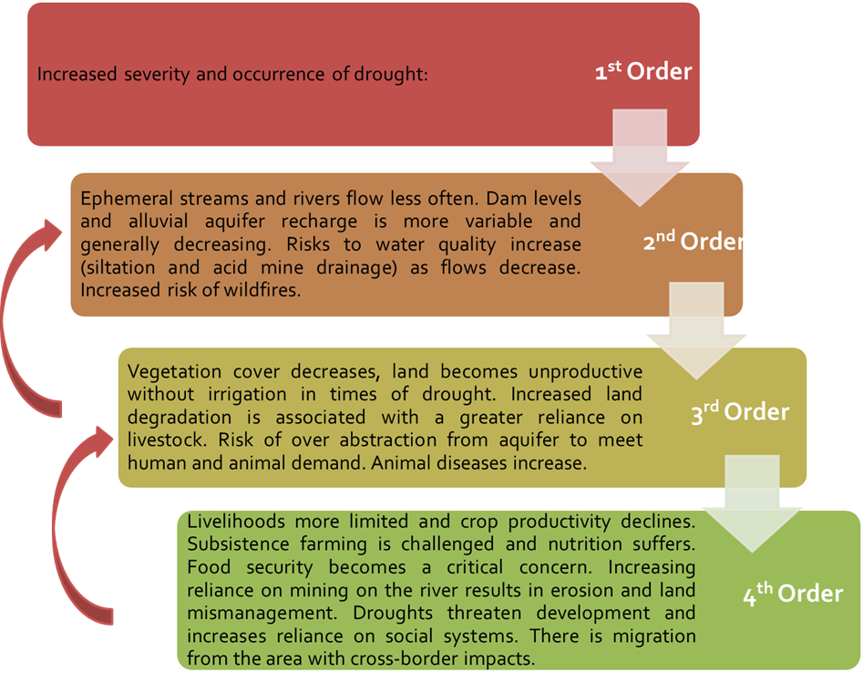
02 March 2015
Upper Umzingwane - First to Fourth Order Impact Assessment

Slide 28
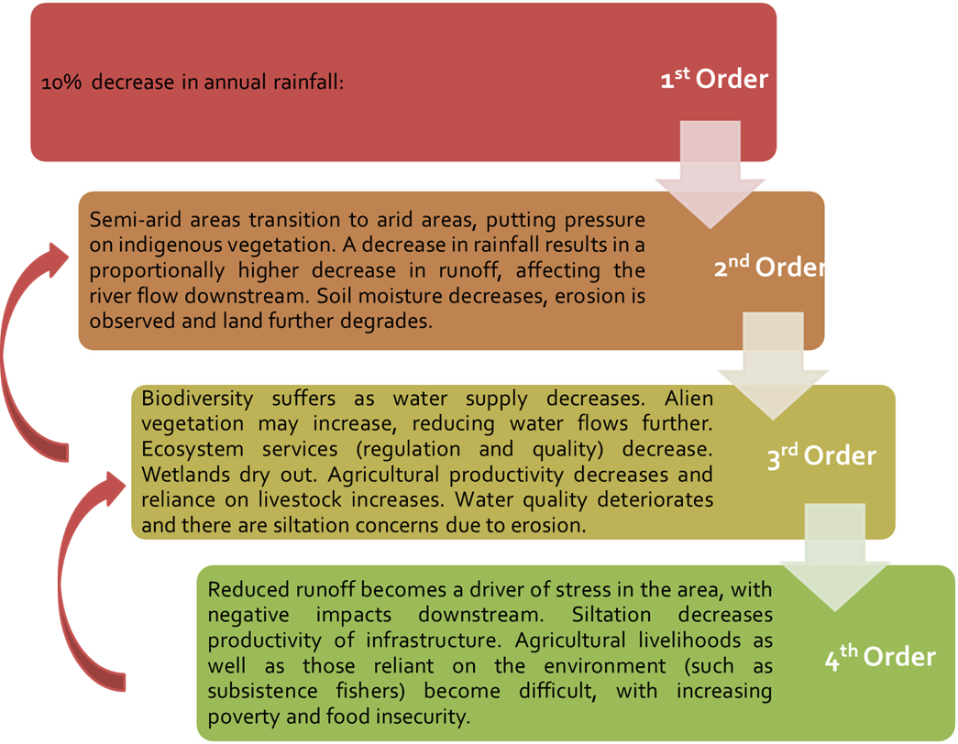
02 March 2015
Soutpansberg - First to Fourth Order Impact Assessment

Slide 29
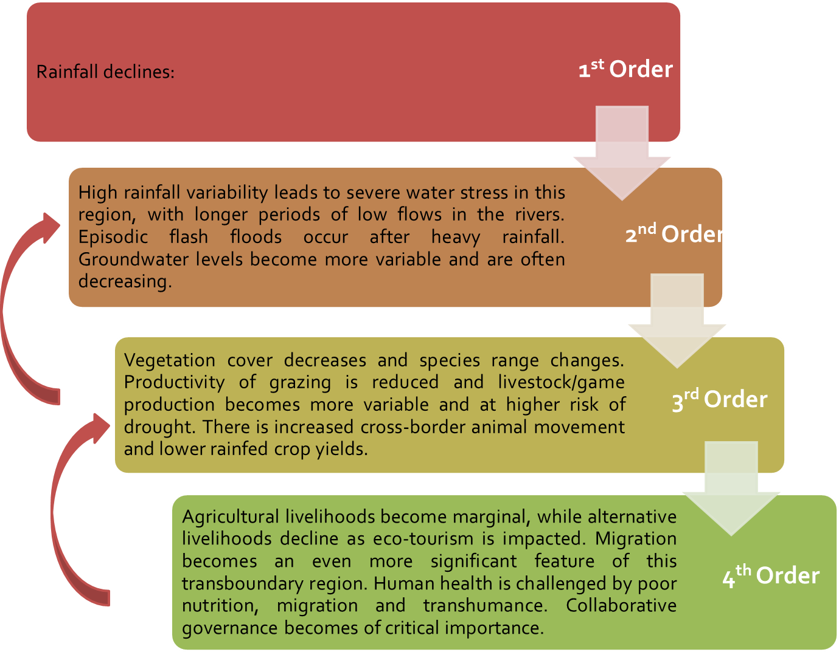
02 March 2015
Pafuri Triangle - First to Fourth Order Impact Assessment

Slide 30
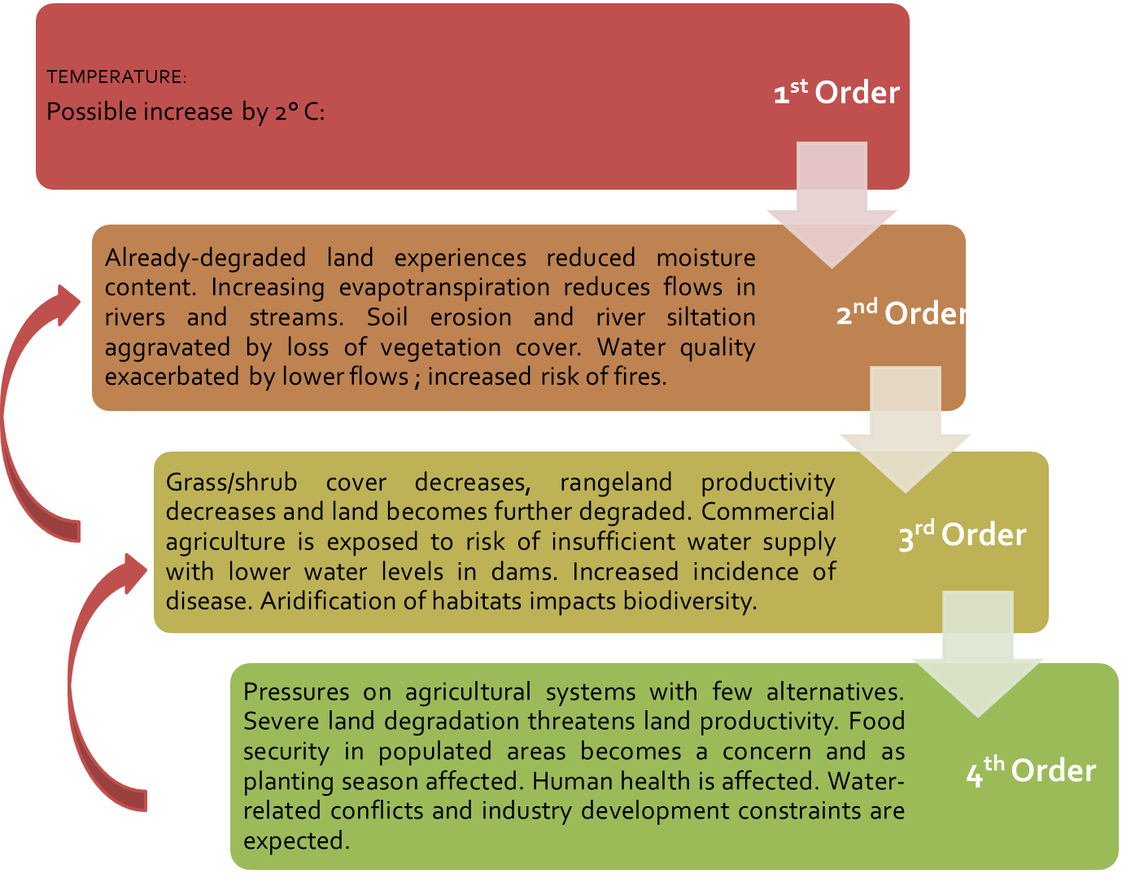
02 March 2015
Middle Olifants – Former homeland area of Lebowa First to Fourth Order Impact Assessment

Slide 31
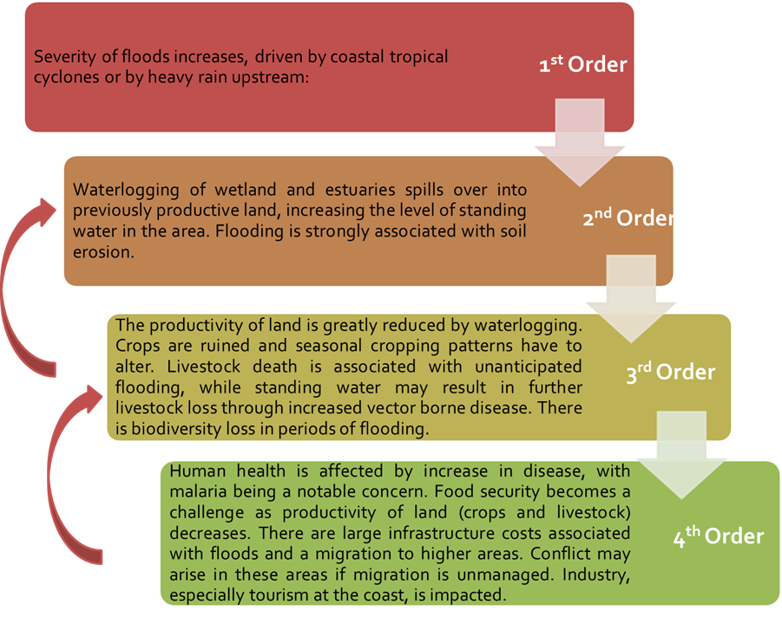
02 March 2015
Lower Limpopo - First to Fourth Order Impact Assessment

Slide 32
Degraded land (orange) juxtaposed against high biodiversity, high runoff catchment areas (green) emphasizes the relationship between the high water
and land demand on these once-fertile areas.
Notes:
Identification, in the Think Piece, of potential strategies for focusing on resilience using water, ecosystems and climate change as the dominant factors

