Slide 1
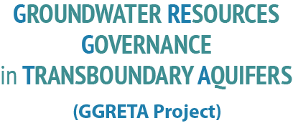
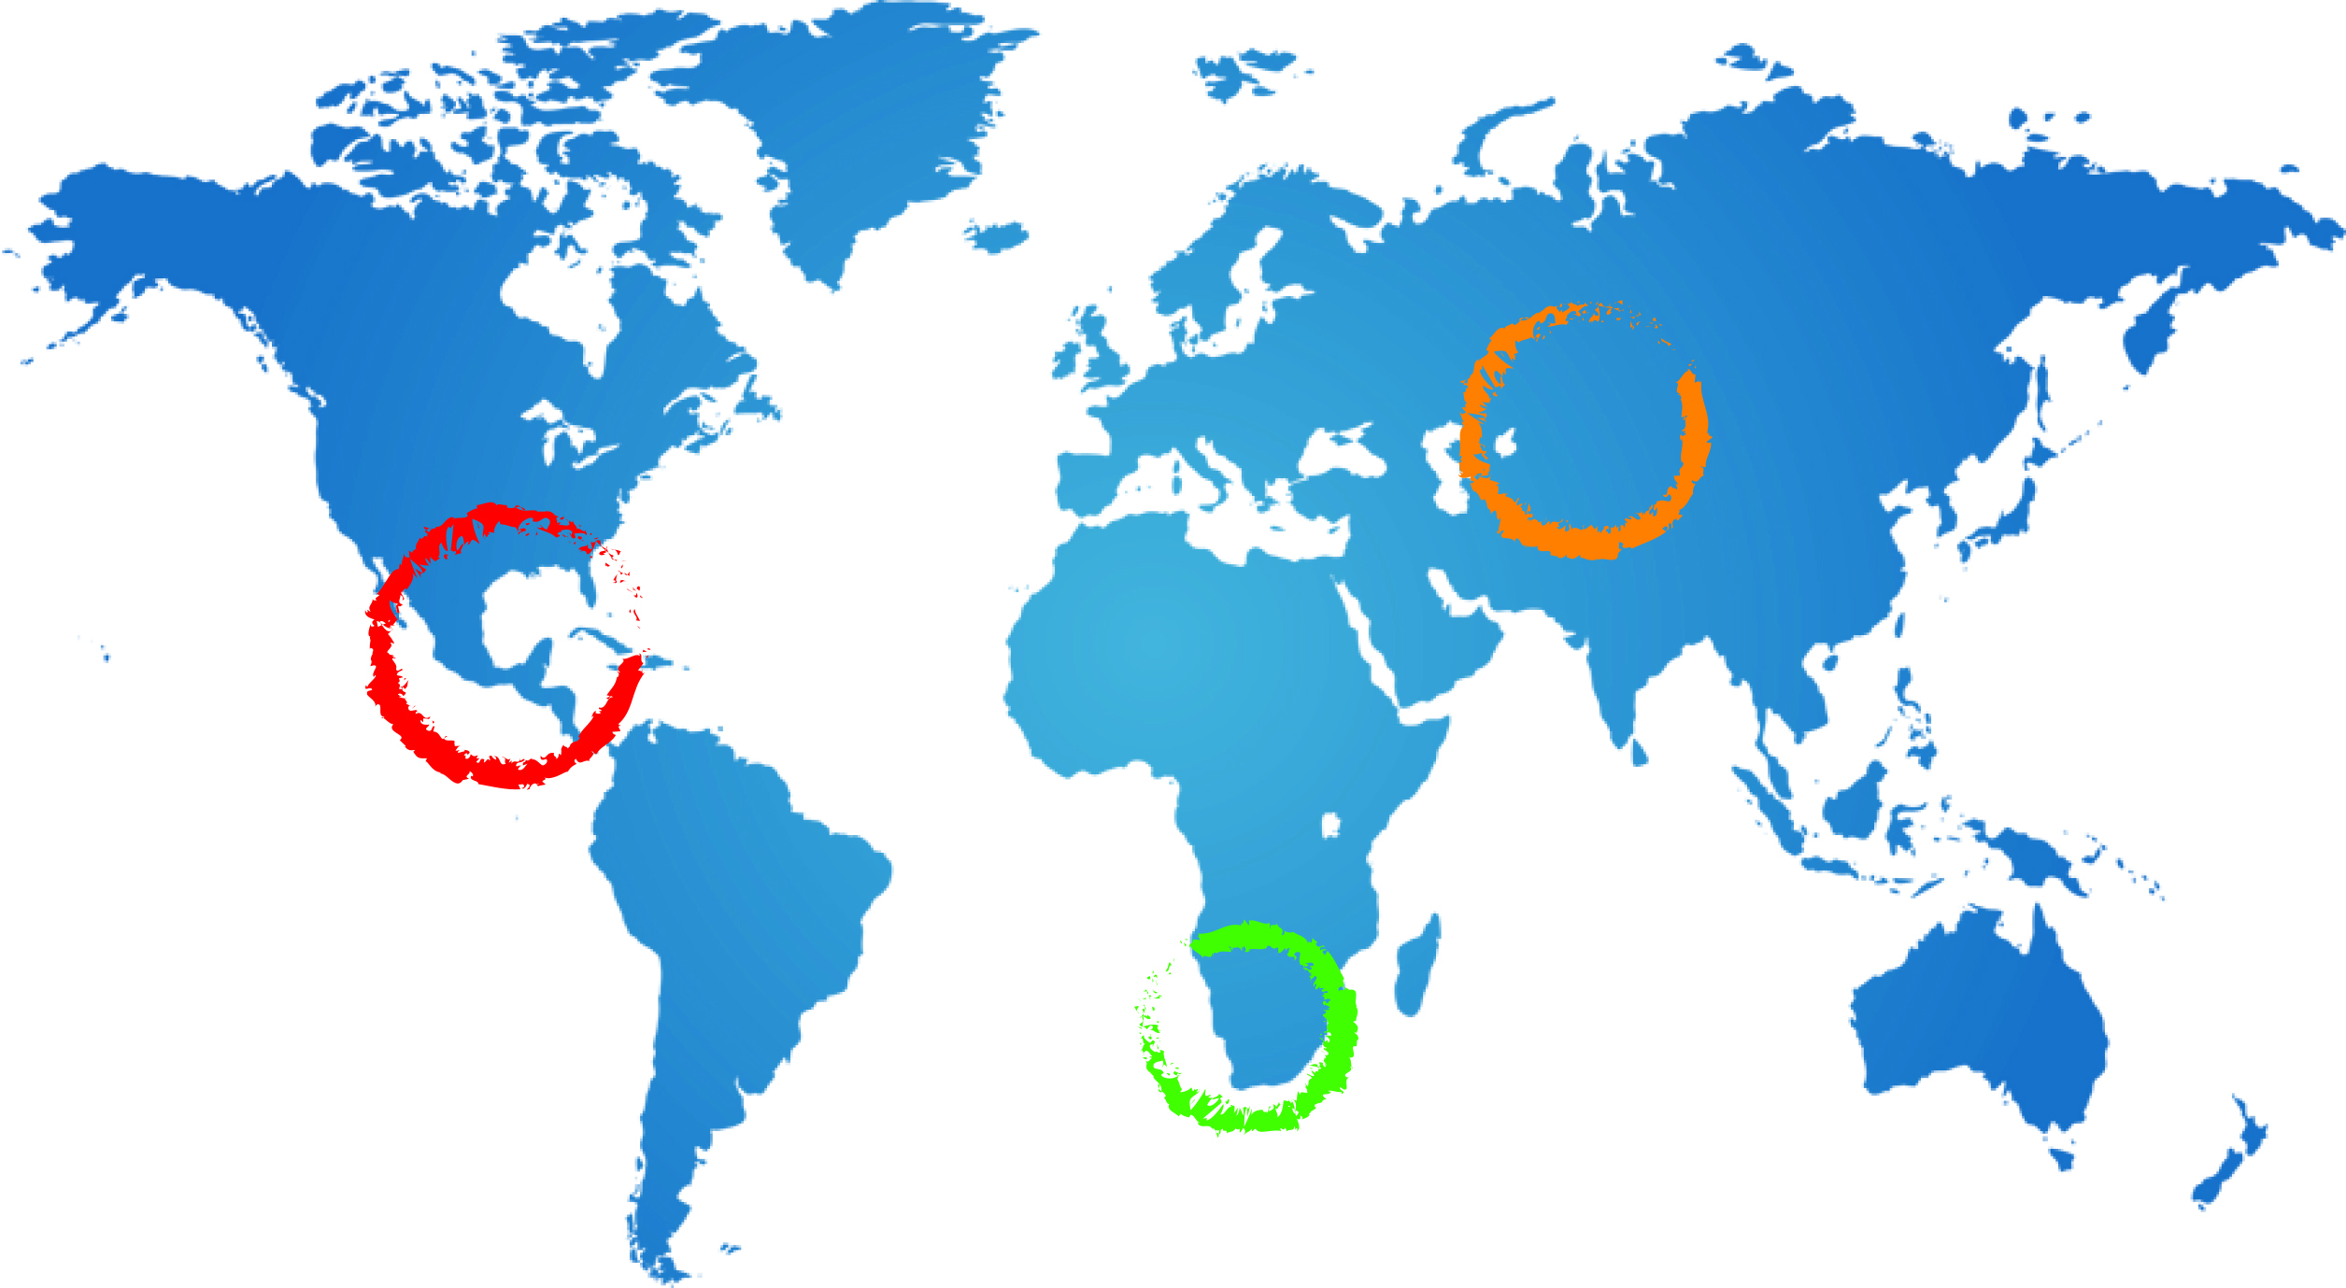
Chapter Six:
Contemporary Policy and Management issues and possible responses
Piet Kenabatho
Senior Lecturer (Hydrology)-Dept of Environmental Science, University of Botswana
A Ross
23 February 2015
Johannesburg

Slide 2
General Observations regarding the STAS
While the risk of future increased development of settlements, irrigation and mining may pose the biggest threat to the STAS, there are a number of more immediate management challenges with related policy implications
These include gaps in data about the aquifer, possibility of groundwater pollution in the Kalahari aquifer system and challenges in implementing groundwater policy and regulation.

Slide 3
Current policy and management issues
Data deficits
A major deficit in key hydrogeological, socioeconomic and environmental data in all three countries which threatens to undermine good management of the TBA system.
For example, a serious deficiency of time-series data on groundwater abstraction, groundwater levels and groundwater quality.
Where data exist, they are incomplete, not well organised/edited, and can be difficult to retrieve.

Slide 4
Groundwater pollution
Although there is a relatively low risk of pollution of the STAS as a whole there is a high risk of local pollution around settlements (but for the Kalahari aquifer) and the TBA (mainly at recharge areas, in Namibia)
Pit latrines, oxidation ponds and waste dumps pose particular risks.
Further threats arise from deficiencies in the protection of boreholes, i.e. poorly constructed and managed bores [casing] owing to lack of correct supervision when the casing and seal were placed,
i.e. leaking casing that were not repaired.

Slide 5
Implementation of Law and Policy
The implementation of groundwater quantity and quality regulations poses some challenges.
The STAS includes large areas where water abstraction and pollution is not subject to regular inspections or controls.
For example, In Namibia regulations to support enforcement of the water law have being drafted but are not in place yet.
In Botswana, the Water Policy has been approved by Cabinet (since 2012), but has not yet been debated in Parliament.
Provisions such as Water Resources Board, Water and Energy Regulator are likely to address some key water challenges

Slide 6
Possible policy and management responses
There are a wide variety of possible policy and management responses to the above issues
These include law and regulation, economic instruments, information and education, public private partnerships and community action.
Some actions can be taken by national governments or other national organizations, other actions would benefit from multicountry cooperation.

Slide 7
Policy and Management responses
1. National
Countries could invest in additional boreholes [e.g. to address data gaps and improve knowledge & management of the STAS]
Infrastructure investments to address groundwater pollution [for the Kalahari, and the TBAs]
Could review/develop borehole drilling supervision/regulation/licensing mechanisms to improve borehole equipping procedures (i.e. casing issues)
Obligations to monitor [measure] water levels & abstraction levels
Investment in capacity building esp. groundwater expertise in the STAS
Identify and engage stakeholders, & undertake community education & awareness programs to address monitoring and management issues

Slide 8
2. Multi-country cooperation
Could undertake joint monitoring/maintenance programmes for the STAS
Establish data management/sharing mechanisms (consolidation, analysis, reporting)
Reviewing experiences and developing guidelines on borehole mgt/abstraction control/pollution reduction
Develop risk management guidelines related to major new developments
Could undertake joint funding of agreed mgt structure(s) of the STAS
Develop proposal for external funding of priority issues
Develop mechanisms for Protection of recharge zones

Slide 9
Possible Practical Examples of responses
Effective monitoring of water levels and quality with monthly or three monthly reports are needed to provide input to the managers of the STAS,
Will assist in the management of on-going variations in water availability/use
This is especially important in the major recharge zones of the aquifer in Namibia.
There is a need for further investment in groundwater management and monitoring capacity, including further recruitment and training [e.g. Botswana, WUC]

Slide 10
Possible Practical Examples of responses
Further public investment in borehole conservation and protection, and wastewater and waste management facilities is required
Establishment of programs to educate the public about the benefits of groundwater and requirements for groundwater conservation and pollution avoidance
International experience indicates that community self-management can be an effective tool for controlling groundwater abstraction and minimizing pollution
Such initiatives improve the local management of GW and implementation of GW regulations, and also reduce the costs
Strategies are needed to improve the implementation of the main elements of groundwater laws and regulations

Slide 11
Acknowledgement
The Project Team members
Countries in the STAS

