Slide 1
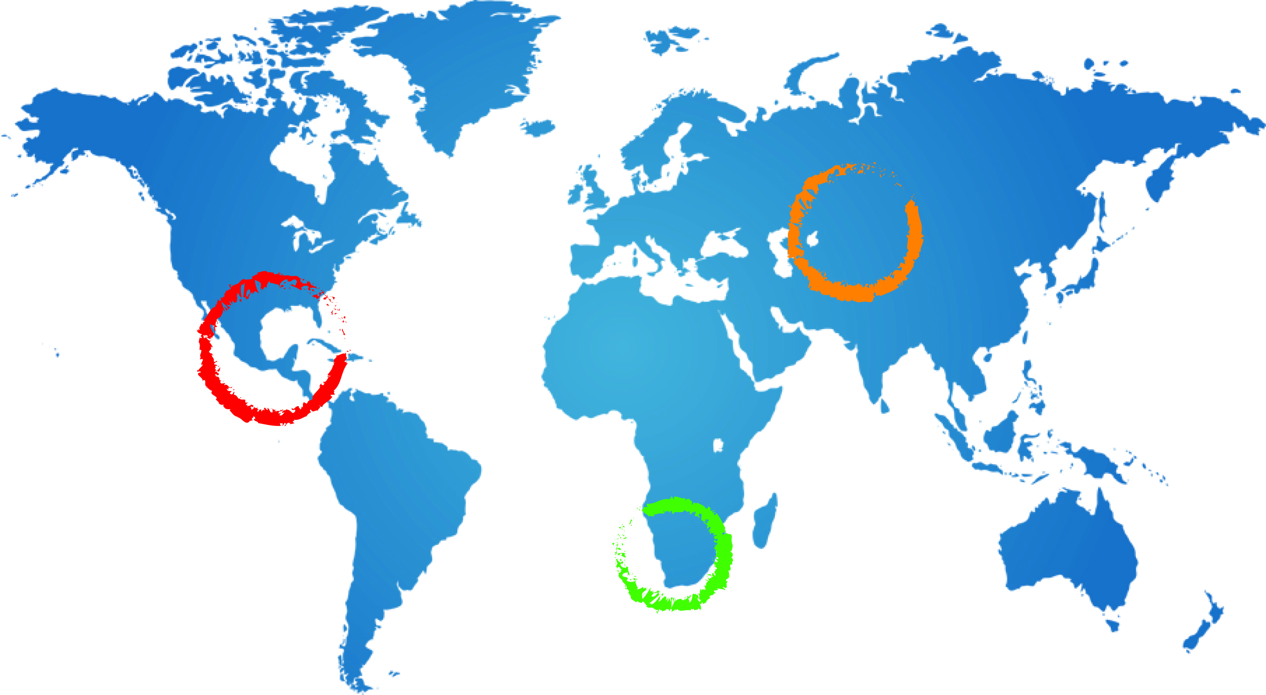
Introduction to GGRETA Technical Workshop:Johannesburg: 23-26 February 2015
Andrew Ross
Senior groundwater specialist UNESCO
A Ross
23 February 2015
Johannesburg

Slide 2
Meeting Objectives
Finalize the harmonized data - as much as possible
Discuss content and process for integrated aquifer assessment
Agree on workplan for finalizing harmonized data and integrated aquifer assessment report – with clearly defined tasks, responsibilities and deadlines
Technical sessions: IMS, indicators, mapping

Slide 3
Day 1: Review and finalize content and presentation of harmonized data
Parallel sessions to finalize the harmonized data (variables) working in cross country hydrogeological, socioeconomic/environmental, legal/institutional groups
Objectives of each parallel session
Finalize as many harmonized data products as possible – tables, charts, series, maps
Identify difficulties in getting harmonized products
Identify where help is needed in getting harmonized products e.g. maps
Plenary session to present results from parallel sessions
identify variables and indicators where cross disciplinary collaboration is needed eg groundwater pollution
identify priorities for preparation of maps (afternoon of day 3 and morning of day 4)
identify means for sharing data across countries and specialisms
Plan For Finalizing Harmonized Data with clearly defined tasks, people responsible and deadlines for each variable

Slide 4
Day 2: Discuss content and process for integrated aquifer assessment
Introduction to assessment methodology, indicators, and assessment roles and responsibilities (Outline circulated on 30 January)
Report
an overview report (around 20 pages)
data on which the report is based - variables and indicators
additional analysis where required
Objectives of parallel sessions on chapters 2-5 and plenary sessions on chapters 6 and 7
draft “contents page” for chapters 2-7
workplan for drafting these chapters: including tasks, people responsible and deadlines
process for preparing chapters 8 and 9

Slide 5
Day 3: Agree on a workplan for finalizing harmonized data and the integrated aquifer assessment report – with clearly defined tasks, responsibilities and deadlines
The workplan with defined tasks, people responsible and deadlines will include:
plan for finalizing harmonized data agreed on day 1
plan for drafting and preparing assessment report chapters agreed on day 2
further activities including sharing data and uploading information into the IMS
Time has been allocated in the session to discuss any resourcing and logistical issues related to the workplan

Slide 6
Day 3-4: Technical sessions
Introduction and briefing on IMS
Presentation of harmonized data and maps in format ready to input into IMS
Preparation of maps
based on priorities identified on day 1
parallel sessions on hydrogeological and socioeconomic/environmental variables
Conclusions and follow up actions from sessions on representation of spatially distributed data
Conclusions - outcomes from meeting

