Slide 1
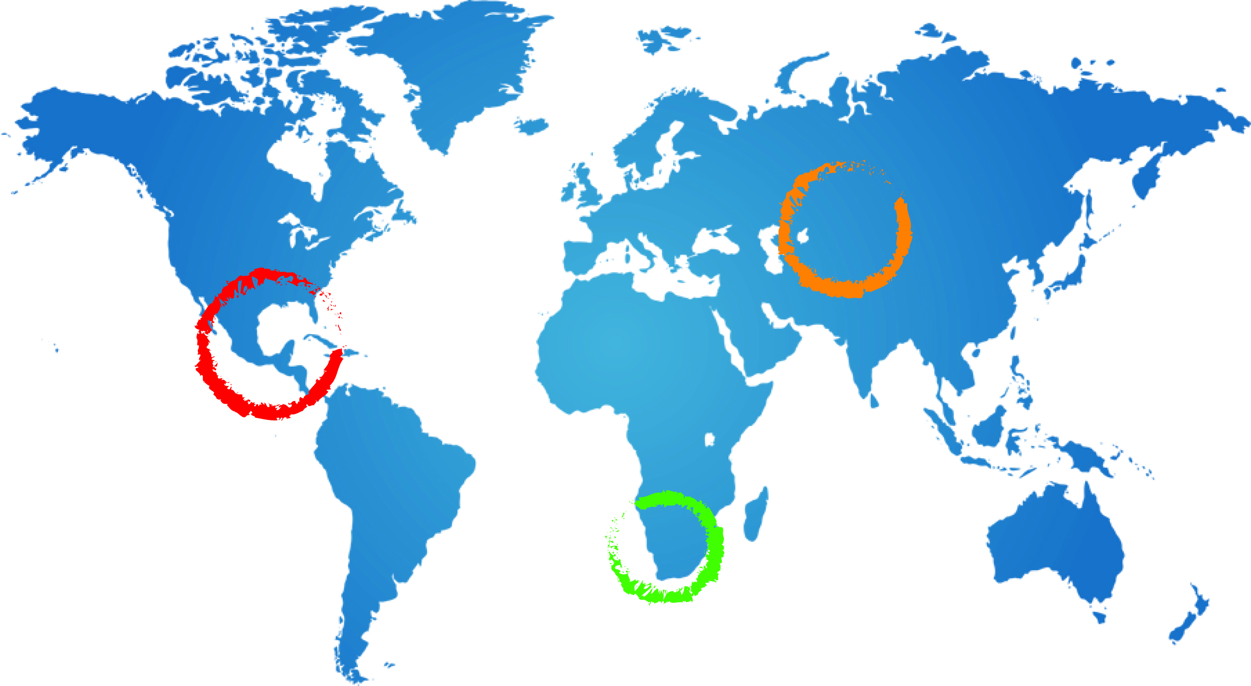
The GGRETA Project Proposed workplan
Andrew Ross / Geert-Jan Nijsten
A Ross
20 October 2014
Pretoria

Slide 2
Proposed Workplan

Slide 3
What | Who | Deadline
Last data collection, including gender | National specialists | 30 November
Overview of available data and define focus Hydrogeological Socio-economic Environmental Legal & Institutional Gender | -Regional coordinator -Stefano Burchi -Francesca Greco | 15 November
Data harmonisation TBA LEVEL Clear overviews of data Output MAPS in GIS Output TABLES Output NARRATIVES Calculation of indicators | National specialists in transboundary teams | Complete draft: 15 December
Reviewing draft harmonisation | Regional coordinator, UNESCO, IGRAC | 15 January
Finalizing harmonisation products | National specialists in transboundary teams | 15 February
Uploading into IMS | National specialists & IGRAC | 15 March

Slide 4
What | Who | Deadline
Assessment outline | UNESCO | 30 November 2014
Draft assessment report and materials | National specialists, Regional coordinator | Early March 2015
Review of draft assessment | UNESCO, WWAP, IGRAC | Mid March 2015
Final assesment report and materials | National specialists, Regional coordinator, UNESCO, WWAP, IGRAC | Mid April 2015

Slide 5
Outstanding issues
Meeting report
Assessment outline
Combined progress report of data collection Oct 2014
Table of data harmonisation steps
Data collection
Gender methodology + workplan
Data harmonisation
Legal indicators methodology: feedback national specialist (5 november) and response S. Burchi (19 november)
How to organise process of working in transboundary teams?
GIS work for map outputs→ who?
Assessment
How to organise process of working in transboundary teams?

