Slide 1
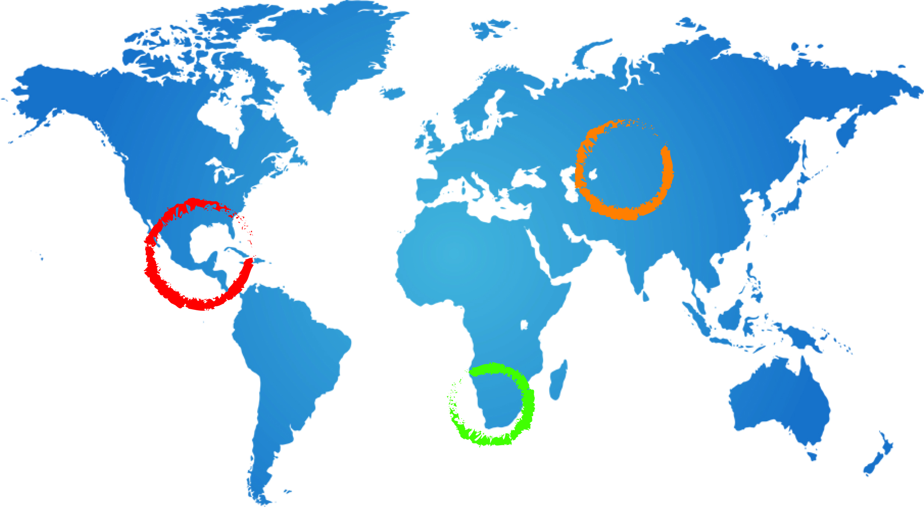
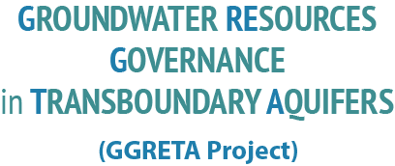

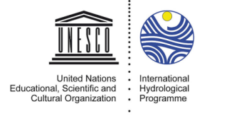
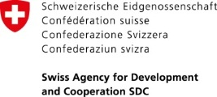




The GGRETA Project: Context, introduction and progress
Andrew Ross
Senior groundwater specialist UNESCO
A Ross
20 October 2014
Pretoria

Slide 2
Contents of this presentation
Context for the project: UNESCO IHP activities related to groundwater, our partners
GGRETA project on transboundary groundwater governance
Progress, recent developments and next steps

Slide 3
Context - importance of groundwater resources and management challenges
GW supplies most of the worlds unfrozen freshwater
2.5 billion people depend solely on GW for their daily needs
Groundwater has a number of special features
  Invisibility, Information gaps, difficulties and costs of monitoring, weakness of institutions, inadequacy of infrastructure and tools, finance, lack of transboundary governance models
Issues and challenges include
  Overexploitation, risks of pollution, weak or absent regulation, decision-making under uncertainty and risk, achieving groundwater security under hydrological scarcity, impacts of climate change and globalization

Slide 4
International Hydrological Programme
The only global intergovernmental scientific programme on water resources in the UN system
Created in 1975 after the International Hydrological Decade
6 year phases, one unifying theme
Member States define needs and plans of phases
Growing emphasis on management and social aspects
Focus on gender equality and Africa

Slide 5
UNESCO‘s water family
UNESCO-IHP
UNESCO-IHE
UN WWAP
UNESCO regional offices
UNESCO national commissions
IHP national committees
Category 2 centres, IGRAC
Academia: UNESCO chairs,
research institutes, universities
UNESCO has a unique network to support transboundary water diplomacy

Slide 6
IHP VII and VIII
IHP VII (2008-2013): Water dependencies: Systems under Stress and Societal Responses
Groundwater resources activities
  Transboundary Aquifers Management (ISARM); Global Hydrogeological Map (WHYMAP); Groundwater and Climate Change (GRAPHIC); Groundwater for Emergency Situations (GWES); GEF projects executed by UNESCO – regional and global
IHP VIII (2014- 2021): “Water Security: Responses to Local, Regional, and Global Challenges”
Includes a separate GW component:
  Sustainable groundwater management, managed aquifer recharge, impacts of climate change on aquifers, groundwater quality protection, transboundary aquifer management

Slide 7
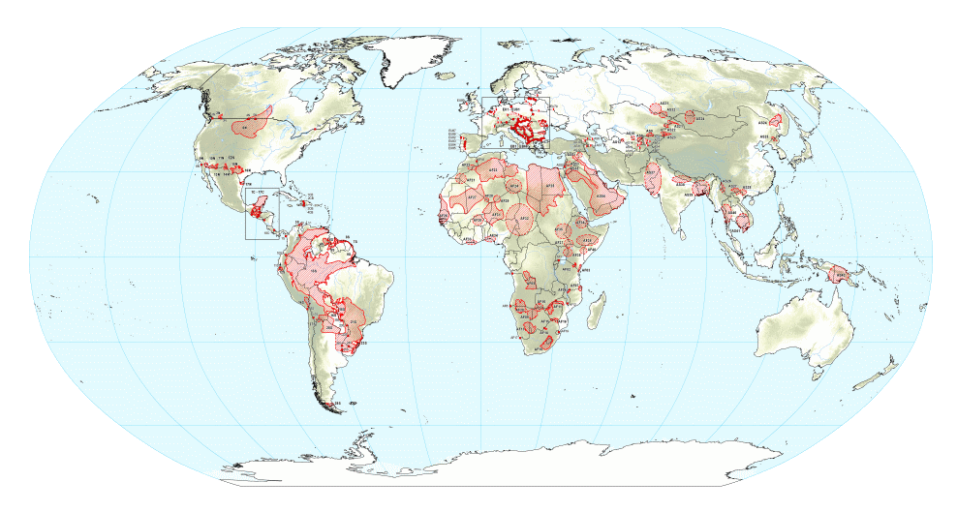
ISARM, TWAP and GGRETA
Where does GGRETA come from?
  ISARM TWAP GGRETA
ISARM:
  International Shared Aquifers Resources Management
  Inventory of Transboundary Aquifers (TBAs)
TWAP:
  Transboundary waters assessment program
  Follow up of ISARM
  Global assessment of TBAs
GGRETA:
  Groundwater Governance of
  Resources in Transboundary Aquifers
  In-depth assessment of TBA case studies
7

Slide 8
The assessment of Transboundary Aquifers is being carried out at 2 levels:
Level 1 (TWAP)
global baseline
assessment
Level 2 (GGRETA):
in-depth assessment in
pilot TBAs (case studies)
Data at level of national segments
Reduced set of indicators
Covering 166 TBAs and 43 SIDS
Funded by the GEF and partner co-financing contributions
Spatially and temporally differentiated data (maps, time series)
Full set of indicators
Applied in three selected TBAs:
Funded by SADC

Slide 9
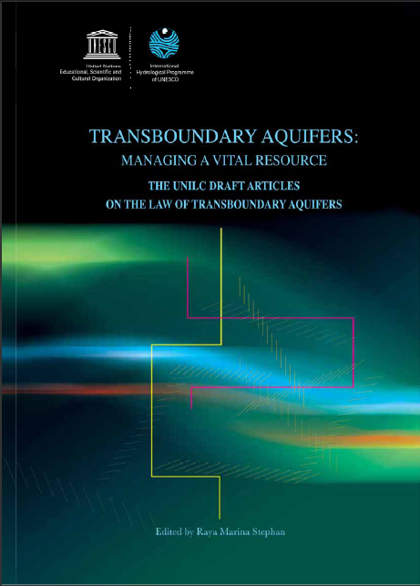
UN GA Resolution on the Law of Transboundary Aquifers
In December 2008, the UN General Assembly adopted the Resolution (A/RES/63/124) on the
‘Law of Transboundary Aquifers'.
Legal Framework for the sustainable management of shared groundwater resources
A tool of international law that provides recommendations to Member States
UNESCO-IHP provided technical expertise to the UN General Assembly
The UNGA called upon UNESCO to support Member states in the implementation of the resolution. A key building block for future transboundary cooperation

Slide 10
SADC project on groundwater governance of resources in transboundary aquifers (GGRETA)
Water Diplomacy Cluster of SDC
3 aquifers: Central America (Trifinio), Central Asia (Pretashkent), Southern Africa (Stampriet)
8 countries:
Project targets:
  Improve knowledge and recognition of importance and vulnerability of TBAs
  Enhance cooperation and water security

Slide 11
GGRETA Two-step approach
Building recognition of the shared nature of the resource, and mutual trust through joint fact finding and science based diagnostics (Component 1); and
Reaching consensus on transboundary consultation and governance mechanisms (Component 2).
Multi Country
Consultative Body
Data collection
(mainly existing)
Data harmonisation
TBA
assessment
Sustainable management of TBA
Proposal for harmonised monitoring

Slide 12
Component 1
Component 2
Initiating the consultation process among countries
Facilitating the process of agreeing on priority issues
Laying the foundations to establish cooperation mechanisms among countries
  Training in international law and cooperation.
PHASE 2 ?
Builds on TWAP methodology for the assessment of TBAs
Includes hydrogeological, socio-economic, environmental, legal and institutional aspects of aquifer systems
Aquifer sharing states in each TBA should agree on a joint monitoring programme, with harmonized classifications, reference systems, language, format, and software

Slide 14
Progress and recent developments
Data collection and processing nearing completion
  Reporting framework and templates established
  Gender methodology, variables and indicators prepared
  Introduction of Potential Conflict-Cooperation Potential (PCCP) methodology
Recent meetings
  Technical meeting 21-23 May in Windhoek
  Follow up mission to Botswana, Namibia and South Africa
  5-15 August

Slide 16
Regional technical seminar: 21-23 May 2014
Made the national teams fully operational
Explained and updated the project methodology and planning
Commenced the data collection activities relating to the aquifer assessment.
Agreed on the priorities and schedule of data collection and processing
Agreed on reporting template for national teams
Prepared a first draft of data availability in Namibia, Botswana and South Africa.
Agreed on a revised version of the project management structure.

Slide 17
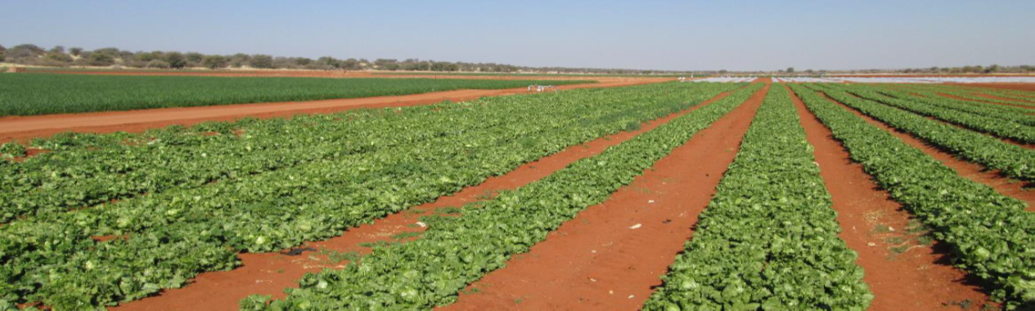
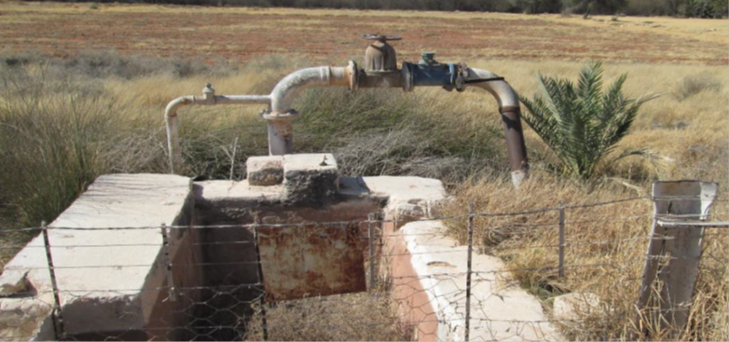

Slide 18
Follow up mission to Botswana, Namibia and South Africa: 5-15 August 2014
Reviewed progress on data collection – provided additional guidance.
Agreed with the NTTGs priorities and timing for collection of remaining data.
Elaborated reporting templates for deliverables.
Updated government representatives about the project progress.
Undertook field visit in Namibia
Obtained guidance from government representatives about next activities and project meetings.
  Regional Technical meeting in South Africa, October 2014
  Following meeting (tentatively scheduled in Botswana in April 2015).

Slide 19

WWAP Project on Gender Sensitive Water Monitoring
The UN WWAP UNESCO project :
will develop through 4 phases with the help of international experts in the Working Group on Gender Sensitive Water Monitoring Assessment and Reporting
WWAP is currently in PHASE I – Production of
the Toolkit for gender sensitive water
monitoring
Integration with GGRETA
analysis
The preparatory work consists essentially in the:
identification of a very limited number of generic indicators ( ongoing)
preparation of the detailed work program related to gender ( ongoing)

Slide 20

Paving the way for hydro-diplomacy in the Stampriet
Potental Conflict Cooperation Potential (PCCP) Program
How does PCCP integrate in GGRETA now?
  Development of a Capacity and Skills Enhancement Toolkit for Hydro-diplomacy applied to transboundary aquifer management
  Enhancement of hydrodiplomacy capacities and skills:
    Pilot training for the Stampriet Aquifer
  Coordination of trust-building measures for other cases, as needed, other types of trust building achievements will be organized to nurture dialogue among stakeholders
  Collection of related conflict/cooperation indicators from the 3 cases in the aim of nurturing dialogue a joint aquifer management

Slide 21
Next steps
Completion of data collection, including gender component
Data harmonization and preparation of indicators including gender
Commencement of aquifer assessment
Preparation for development of multi-country consultation mechanism

Slide 22
Thank you for your attention
a.ross@unesco.org
Telephone 33 (0)1 45 68 39 43

Slide 24
History of cooperation
Regional cooperation in the water sector was established in 2000 through the Revised Protocol on Shared Watercourses in the Southern Africa Development Community.
Of the 15 major river basins which are shared by two or more nations, 11 have a Commission or Technical Committee.
ISARM-SADC became operative in 2007 in a network covering all SADC countries. By 2011 twenty-nine transboundary aquifer systems had been identified and broadly described in the region.
Resolution in 2007 by the African Ministers Council on Water (AMCOW) to ‘promote the institutionalisation of groundwater management by river basin organisations.
In 2007, the ORASECOM became the first river basin commission in SADC to establish a Groundwater Technical Committee.
In 2008 the ISARM-SADC decided on the Kalahari-Karoo aquifer system as the first pilot area in which to test transboundary aquifer management principles.

