Slide 1
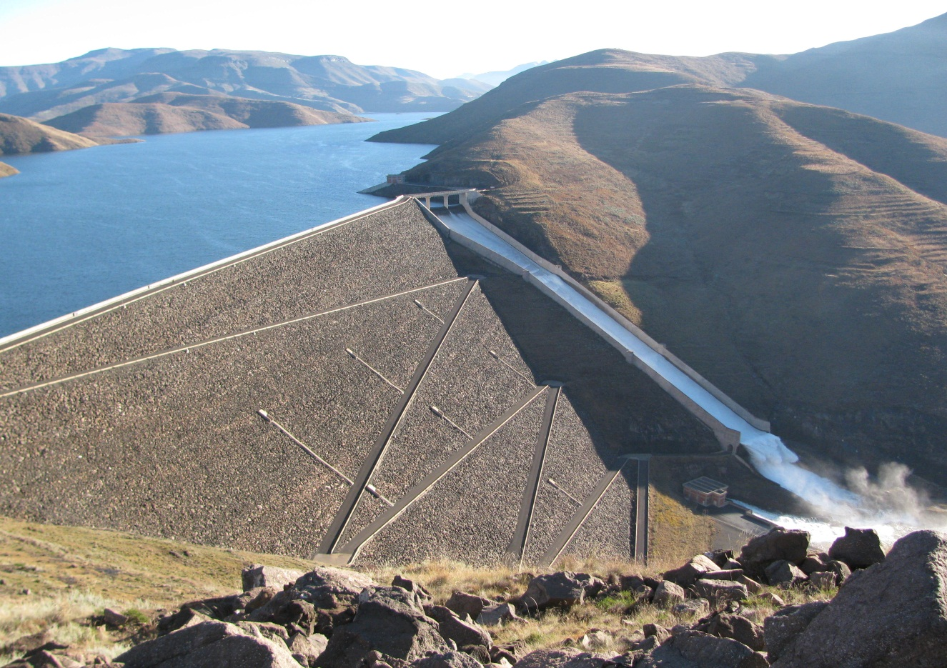
ALLOCATING WATER ACROSS BORDERS

Slide 2
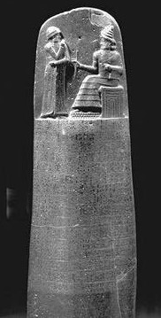
A 5000 YEAR HISTORY OF WATER ALLOCATION

Slide 3
SOME THINGS THAT FASCINATED ME…
Water allocations ‘freed up’ people to pursue other livelihoods – kick starting major civilisations.
The approach and scale of allocations grew with our ability to alter the natural flow in systems.
Early colonial allocations were imposed on people, leading to problems that still dog transboundary allocations to this day.
The ability to store water to cope with variability proved very beguiling and drove water allocation processes throughout the 20th century.
21st century approaches toward water allocation recognise the need for environmental economic growth in the face of both climate and demographic changes.

Slide 4
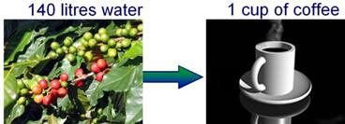
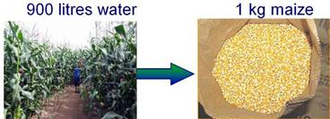
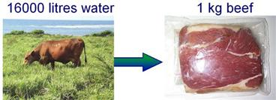
BUT WHAT REALLY GRABBED MY ATTENTION…
What is a ‘Water footprint’?
WWW.WATERFOOTPRINT.ORG

Slide 5
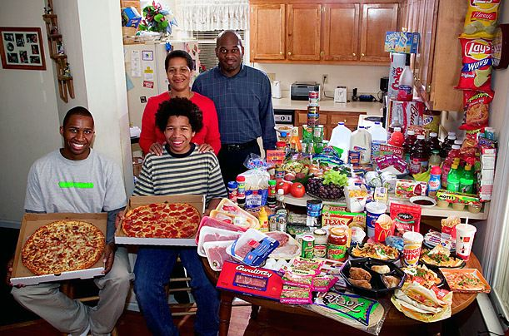
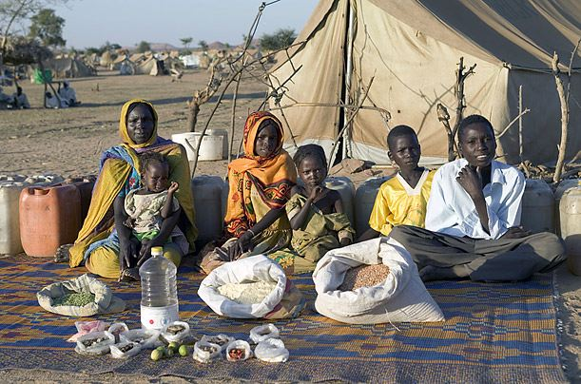
ADDRESSING POVERTY MEANS MUCH HIGHER WATER AND ENERGY FOOTPRINTS
PHOTOS FROM NATIONAL GEOGRAPHIC

Slide 6
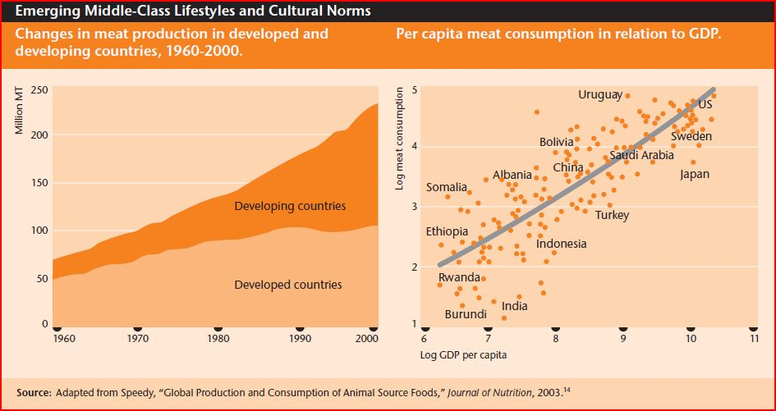
ECONOMIC GROWTH REQUIRES A SEA CHANGE IN THE WAY WE USE AND ALLOCATE WATER

Slide 7
MODERN APPROACHES TO WATER ALLOCATION
Modern approaches to water allocation planning is founded on the following;
Deciding on how much water you have to allocate and how you will deal with variability.
Deciding on who gets what (reasonable and equitable use).
Deciding on what environmental flows are required.
Including economic modelling and other economic / energy considerations

Slide 8
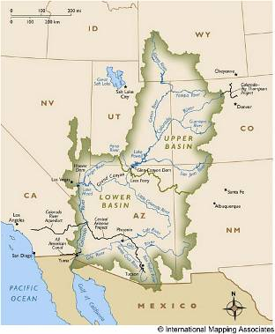
SOME EXAMPLES…
The Colorado River Compact (1922);

Slide 9
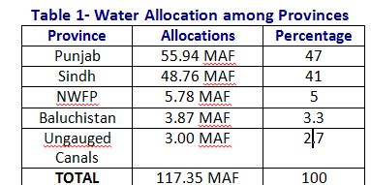
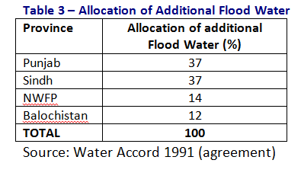
The Indus

Slide 10
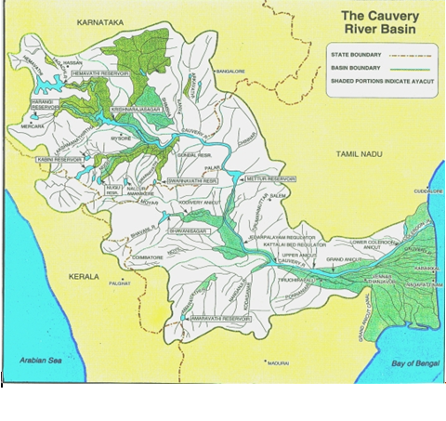
The Cauvery
- Harmon, History (Helsinki) and Hobbs

Slide 11
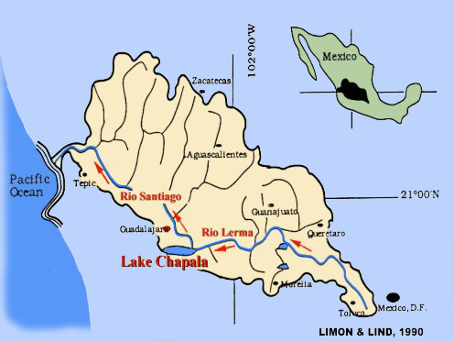
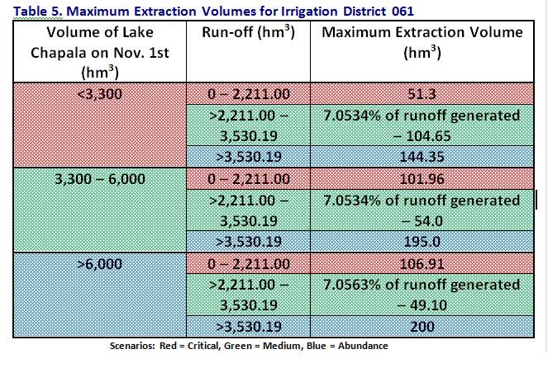
The Lerma-Chapala

Slide 12
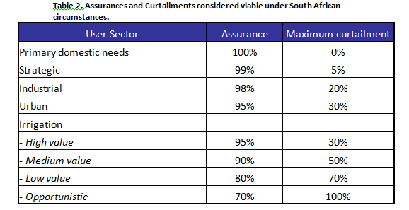
The Inkomati
Stochastic approaches based on assurance of supply and penalty structures – very Hobbsian…
In the InKomati Catchment;
- 100% assurance = 342 million m³/a
- 95% assurance = 427 million m³/a
- 85% assurance = 499 million m³/a
3. Environmental allocations are complex.

Slide 13
TRANSBOUNDARY WATER ALLOCATION.
The water allocation process is very political, and may take years of negotiation.
Final agreement is often catalysed from outside.
In many cases volumes are decided on a median availability with ‘rules’ for allocating deficits and surpluses.
Surpluses may mean over the median volume, as well as that from new storage.
Sometimes percentages (or scenarios) are allocated, and volumes decided later.
Stochastic models represent some of the most sophisticated methods, but transboundary application may be challenging.

Slide 14
APPROACHES TO REASONABLE AND EQUITABLE
The natural characteristics of the basin,
- length of the river;
- area of the basin; and
- contributions made to the runoff.
Socio-economic needs and dependency,
- Water demands of economy, and
- Population dependent,
Defining priority use,
- Vital human, environmental and strategic needs
Existing and potential uses, and
Availability of alternatives and water use efficiency.

Slide 15
KEY LESSONS….
A common vision for social and economic development.
Strong oversight is necessary to facilitate agreement.
Allocation plans must be nested.
Transboundary allocations are increasingly based on the extent of the social and economic dependency on water
Increasingly complex water supply systems require increasingly complex methods for assessing the allocable volumes.
Once water has been allocated it is very difficult to curtail.
Annual allocation plans are needed.
There is no one size fits all.

Slide 16
THANK YOU

