Slide 1
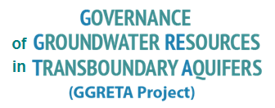
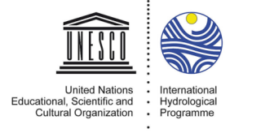
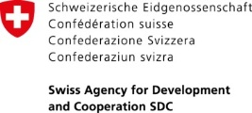
Overview of project activities
May 2017 to October 2017 –
4th ORASECOM Ground Water Hydrology Committee Meeting
1 November 2017
Piet Kenabatho
University of Botswana

Slide 2
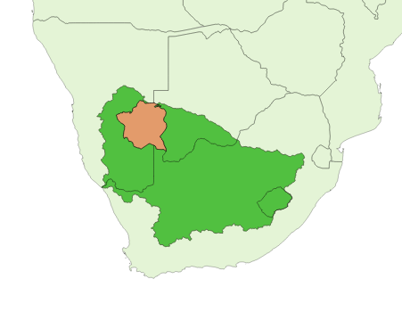
The Stampriet Transboundary Aquifer System (STAS)
The STAS lies entirely within the Orange-Senqu River Basin.
The STAS covers a total area of 86 647km² (73% of the area in Namibia, 19% in Botswana, and 8% in South Africa).
The STAS is a large farming area with approximately 1200 farms (mostly in Namibia), out of which 80 are irrigation farms
Groundwater use: 52% irrigation, 32% stock watering, 16% domestic use
No mining and industrial activities
Area lightly populated (approximately 50 000 inhabitants)
Annual groundwater abstraction: 20Mm³ (around 70% in the Stampriet area)

Slide 3
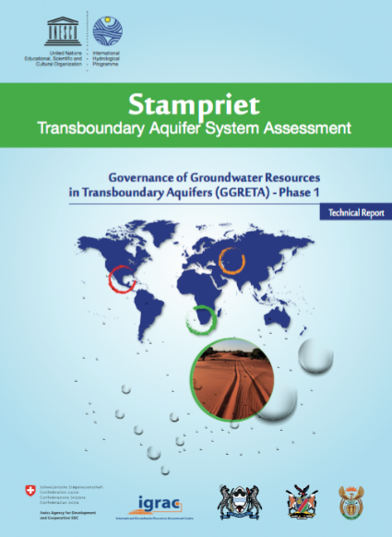
The GGRETA project
Governance of Groundwater Resources in Transboundary Aquifers (GGRETA) project:
Funded by the Swiss Agency for Development and Cooperation (SDC)
Implemented by UNESCO International Hydrological Programme (IHP)
Phase 1 (2013-2015): In-depth assessment of the STAS
Phase 2 (2016-2018):
Capacity-building modules on groundwater modeling, legal and institutional, and gender issues
Development of the STAS numerical model
Set the baseline for institutionalizing cooperation over the STAS

Slide 4
Capacity-building modules

Slide 5
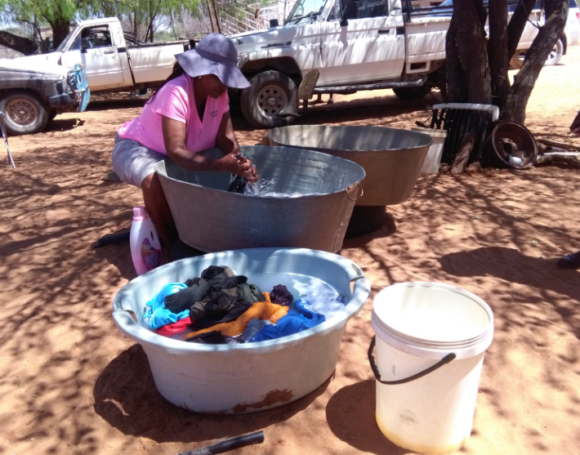
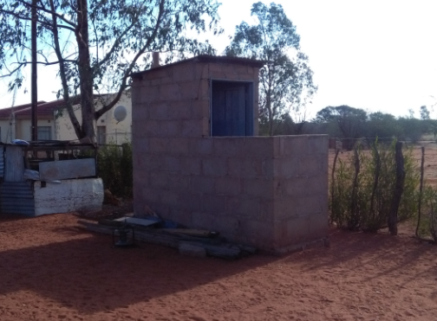
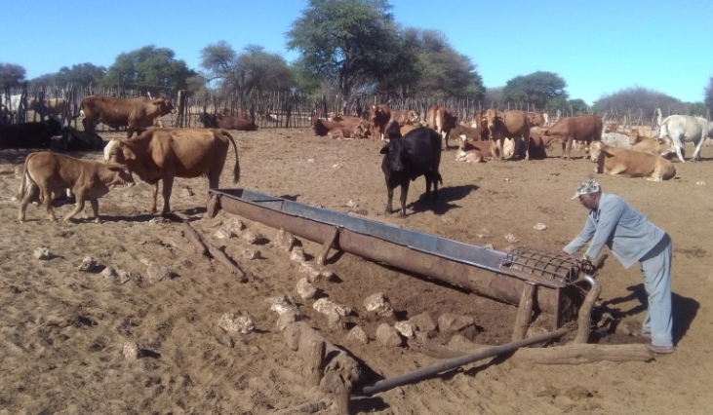
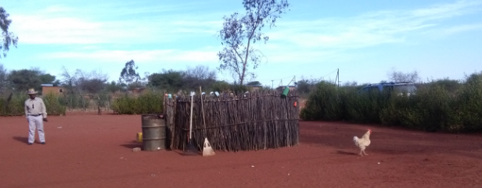
Gender surveys
Gender surveys were undertaken in coordination with the Department of Water Affaires in Namibia and Botswana in October 2017
Results will be presented by end 2017
Some pictures from Ncojane, Botswana:

Slide 6
Development of the STAS Numerical Model

Slide 7
STAS Numerical Model - Overview
Currently undertaking calibration process (which has taken longer than expected and led to some delays)
Preliminary results/simulations are now expected to be validated with Countries early 2018

Slide 8
Baseline for institutionalizing cooperation over the STAS

Slide 9
Key dates
May 2017 (3rd ORASECOM Ground Water Hydrology Committee Meeting):
Namibia presents a proposal to nest the STAS Multi-Country Cooperation Mechanism (MCCM) structure into the ORASECOM Ground Water Hydrology Committee.
August 2017 (ORASECOM Council Meeting):
Commissioners support the nesting of the STAS MCCM at the ORASECOM Council Meeting.
September 2017:
Study visit to the Observatory of the Sahara and Sahel (OSS) in Tunisia to share experiences on institutionalizing cooperation over transboundary aquifers.

Slide 10
Study visit to the Observatory of the Sahara and Sahel (OSS)
Main objective of the study visit:
Learning from the experience of Tunisia, Algeria and Libya in institutionalizing cooperation over the North-Western Sahara Aquifer System (NWSAS).
Attended by:
Department of Water Affairs (Botswana)
University of Botswana
Department of Water Affairs and Forestry (Namibia)
NamWater
Council for Geoscience (South Africa)
Observatory of the Sahara and the Sahel
UNESCO-IHP
Swiss Agency for Development and Cooperation

Slide 11
Study visit to the Observatory of the Sahara and Sahel (OSS)
Rationale of the study visit:
The NWSAS and STAS settings are quite similar in several aspects
 | NWSAS | STAS
Hydrogeology (low recharge rates) | Yes | Yes
Joint tools (Joint borehole database) | Yes | Yes
Joint tools (Numerical model) | Yes | Under preparation
Institutional framework | OSS | ORASECOM

Slide 12
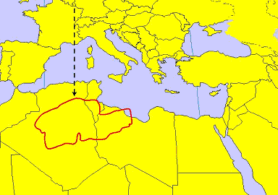
North-Western Sahara Aquifer System (NWSAS)
The NWSAS is one of the largest aquifers in the world (1 million km2)
Shared by Algeria (60%), Libya (25%) and Tunisia (15%)
Contains considerable water reserves which are nevertheless lowly renewable and not fully exploitable
Main source of water supply for domestic, agricultural and industrial activities of more than 4 million people.
Water use in the NWSAS increased x7 over the past 50 years and has led countries to work together

Slide 13
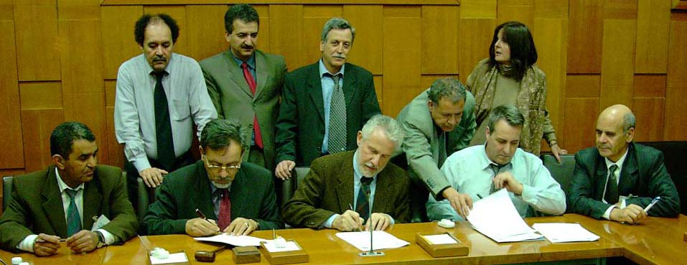
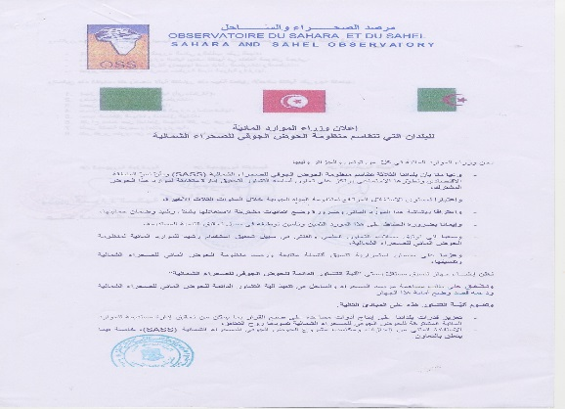
The NWSAS project
Actions on the ground!
Phase 3 (2007 – 2013):
Elaboration of operational recommendations for the utilization, management, and measurement of water extracted for agricultural purposes
Phase 2 (2003 – 2006): Operationalization of the consultation mechanism
2002:
Algeria, Libya and Tunisia decide to establish a consultation mechanism for the governance of the NWSAS
Phase 1 (1999 – 2002):
In-depth assessment of the NWSAS
- Development of a joint borehole database

Slide 14
The NWSAS Consultation Mechanism
The main objectives of the NWSAS CM are:
Production of indicators on the resource and water demand,
Elaboration of management scenarios,
Enhancement and updating the database,
Development and management of joint monitoring networks.
Other missions include:
Undertake joint studies and research,
Define exchange of data protocols,
Update the model and develop their utilization,
Ensure the application of monitoring indicators,
Identify risk and vulnerable zones,
Organize trainings, information and raising awareness actions,
Publish an annual report of the state of the NWSAS.

Slide 15
Structure of the NWSAS Consultation Mechanism
MINISTER’S COUNCIL
IN CHARGE OF NWSAS WATER
(Algeria, Libya, Tunisia)
PERMANENT TECHNICAL COMMITTEE (PTC)
- ANRH (Algeria)
- DGRE (Tunisia)
-GWA (Libya)
NATIONAL COMMITTEES
Algeria
Libya
AD HOC WORKING GROUPS
(AWG)
Tunisia
COORDINATION UNIT (CU) OF THE CONSULTATION MECHANISM
Hierarchical relation Functional relation

Slide 16
Nesting a Multi-Country Cooperation Mechanism (MCCM) for the Stampriet Transboundary Aquifer System (STAS) in ORASECOM
Regional Meeting on Transboundary Aquifers Cooperation in Africa
Observatory of the Sahara and the Sahel (OSS), Tunis, Tunisia
Maria Amakali
Namibia
6 September 2017

Slide 17
www.orasecom.org
Roles and functions of ORASECOM are changing
Towards integrated basin wide management, equitable allocation, benefit sharing and regional integration
Basin Wide IWRM Plan is “to provide a framework for sustainable development and management of the water resources, taking into account the need for improved distribution and equitable allocation of benefits, in order to contribute towards socio-economic upliftment of communities within the basin, and ensure future water security for the basin States.”
Plan is an expression of optimal use of water resources through joint actions of all 4 Member States
Plan projects will be coordinated, facilitated and managed at basin level – Secretariat

Slide 18
Forum of the Parties
Council of Commissioners
TASK TEAMS
ORASECOM Structure
ORASECOM
SECRETARIAT
CTT
FTT
LTT
TTT
Water Resources Quality Working Group
SADC-GMI
(Invited Member)
Ground Water Hydrology Committee
STAS Multi-Country Cooperation Mechanism
FP - LS
FP - BW
FP - NA
FP - ZA
Focal Points
(current GGRETA project)
(Hydrogeology + Model)
(Legal and institutional)
(Hydrogeology + Model)
(Gender)
(Legal and institutional)
(Hydrogeology + Model)
(Gender)
(Legal and institutional)
(Gender)

Slide 19
Advantages
Support IWRM “a process which promotes the coordinated development and management of water, land and related resources in order to maximise economic and social welfare in an equitable manner without compromising the sustainability of vital ecosystems”
Institutional, technical and policy support
Legal foundation
Revised Agreement – (The object of the Commission shall be to initiate, enhance, and maintain greater collaboration between the Parties on matters relating: Groundwater management and use)
IWRM Plan (1.1: Surface and groundwater assessments
1.1.1: Update hydrology for catchments as required 1.1.2: Improve assessments of aquifers (storage capacities, recharge rates, sustainable yields and other characteristics)
Funding arrangements
Country support to TTT/FP members
Opportunities for project support

Slide 20
Rationale for a STAS MCCM
Over-arching objective: Transitioning from GGRETA project-driven cooperation to institutionalized cooperation
Short-term objective:
Continue joint study & characterization of STAS, and generate flow of data feeding the STAS numerical model
Reporting of activities at each meeting of the Ground Water Hydrology Committee (GWHC) – Technical TT – Council – Forum of Parties
Long-term objective: Move from data collection & exchange to joint strategizing/advising STAS countries on management of STAS resources
Value-added:
STAS vision/perspective
consistency of direction & purpose of domestic actions
joint control of data & information feeding the STAS numerical model

Slide 21
Future Functions
Aquifer and aquifer-related data collection & exchange,
Developing and maintaining the STAS joint borehole database and numerical model,
Managing the data flow feeding the STAS model,
Set-up the framework and workplan for joint monitoring activities
Promoting and incorporating the STAS on the agenda of ORASECOM,
Attracting donor interest and eventually funding for STAS-related activities,
Liaising and coordinating joint activities with the SADC Groundwater Management Institute,
Any other matters that may arise or decided upon by the Country Representatives.

Slide 22
ORASECOM response
Council supports the proposal
Key considerations:
Provide feedback to ORASECOM
Share information gathered - housing
Proper handover of project

Slide 23
Some similarities between the STAS MCCM and the NWSAS CM
Functions | NWSAS CM | STAS MCCM
Political decisions | Council of Water Ministers (Ministers level) | Forum of the Parties (Ministers level)
Approval of budget for CM | Permanent Technical Committee (Director General level) | Council (Director General level)
Preparation of work program planning and activities in accordance to budget allocated to CM | Coordination Unit | Ground Water Hydrology Committee (GWHC)
Approval of work program planning and activities | Permanent Technical Committee (Director General level) | Technical Task Team (Experts level) followed by Council (Director General level)

Slide 24
Some similarities between the STAS MCCM and the NWSAS CM
Functions | NWSAS CM | STAS MCCM
Database and model update | Coordination Unit with the assistance of OSS Water Program | Ground Water Hydrology Committee (GWHC) with the assistance of National committees
Data collection and execution of activities | National committees | National committees (currently GGRETA project focal points)
Ad hoc working groups | - Experts nominated by the PTC. - Formed when necessary for the evaluation of studies, or to support the PTC. | - Experts nominated by the Council. - Formed when necessary for the evaluation of studies, or to support the GWHC.
Role of host institution | - Hosting the CM Coordination Unit. - Support for the implementation of the NWSAS CM activities. | - Support for the implementation of the STAS MCCM activities.
Annual budget | 90 000 EUR | Not defined

Slide 25
Suggestions for potential cooperation
Twinning programme between the NWSAS CM and the STAS MCCM.
Could be taken ahead through a Memorandum of Understading (MoU) between OSS and ORASECOM regarding cooperation, technical assistance, capacity building and information sharing on transboundary aquifers management.

Slide 26
Next meeting
Regional meeting in early 2018 in collaboration with SADC-GMI to present the process that led to the nesting of the STAS MCCM in ORASECOM to other River Basin Organizations (RBOs), e.g. OKACOM, ZAMCOM, LIMCOM, etc…

Slide 27
THANK YOU FOR YOUR ATTENTION!

